Slide 1

Topological Data Analysis Using Discrete Homology
Nathan Kershaw
Joint with Sterling Ebel and Chris Kapulkin

Slide 2
References
Main references:
S. Ebel, C. Kapulkin and N. Kershaw, Discrete homology computations by reduction to zero differentials, 2026. https://arxiv.org/abs/2608.04262.
C. Kapulkin and N. Kershaw, Topological data analysis using persistent discrete homology, 2025. https://arxiv.org/abs/2506.15020
Other references:
H. Barcelo, V. Capraro and J. A. White, Discrete homology theory for metric spaces, Bull. Lond. Math. Soc 46 (2014), no. 5, 889-905.
H. Barcelo, C. Greene, A. S. Jarrah, V. Welker, Discrete cubical and path homologies of graphs, Algebr. Comb. 2 (2019), no. 3, 417-437.
C. Kapulkin and N. Kershaw, Efficient computations of discrete cubical homology, 2024. arxiv.org/abs/2410.09939

Slide 3

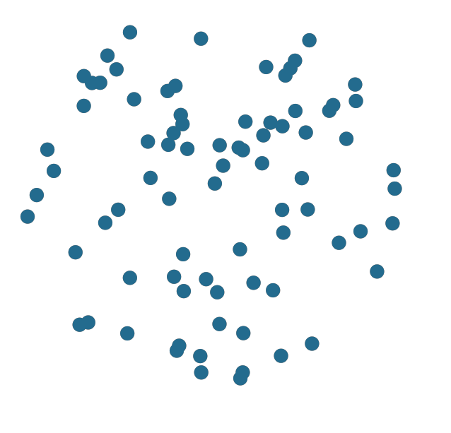


Motivation: Vietoris—Rips persistence
Idea: shape of data carries relevant information
$$H_{1}\left(X\right)=0$$
$$H_{1}\left(X\right)=0$$
Try to use homology to differentiate these datasets

Slide 4
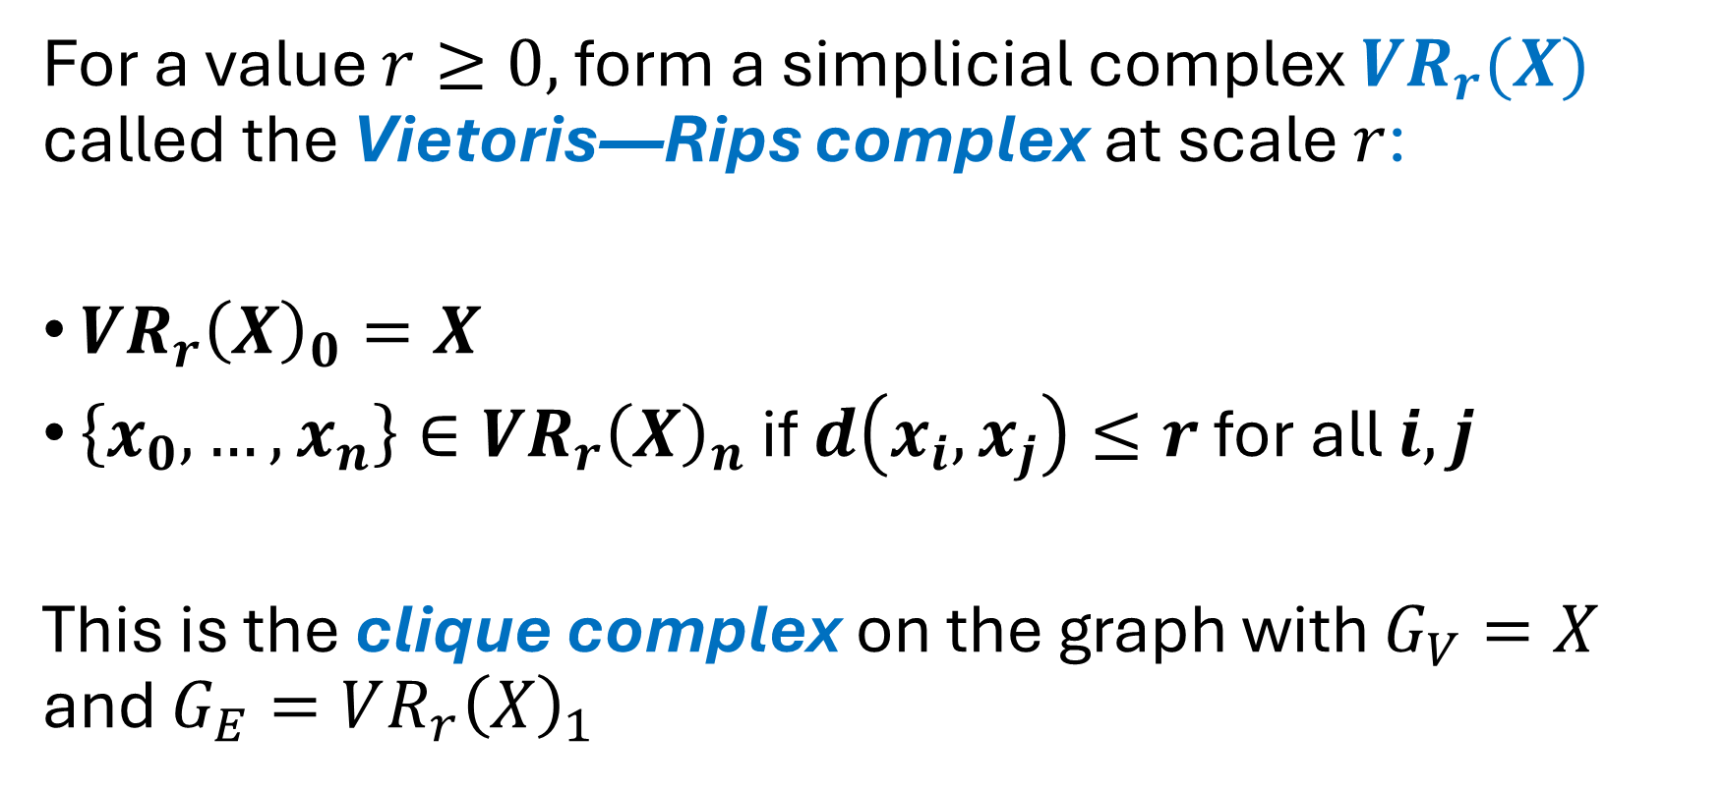
Vietoris—Rips persistence
For a value $r≥0,$ form a simplicial complex $VR_{r}(X)$ called the Vietoris—Rips complex at scale $r$:
$VR_{r}{\left(X\right)}_{0}=X$
$\left\{x_{0},…, x_{n}\right\}∈VR_{r}{\left(X\right)}_{n}$ if $d\left(x_{i},x_{j}\right)≤r$ for all $i,j$
This is the clique complex on the graph with $G_{V}=X$ and $G_{E}=VR_{r}{\left(X\right)}_{1}$

Slide 5
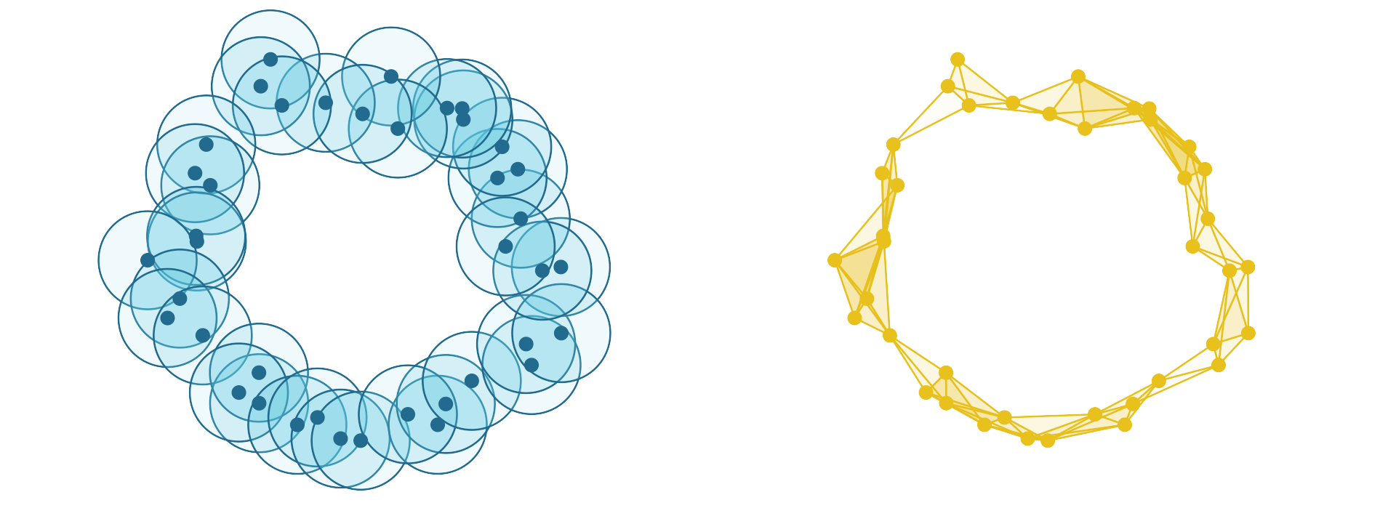

Vietoris—Rips persistence
At scale $r=0.5$:

Slide 6
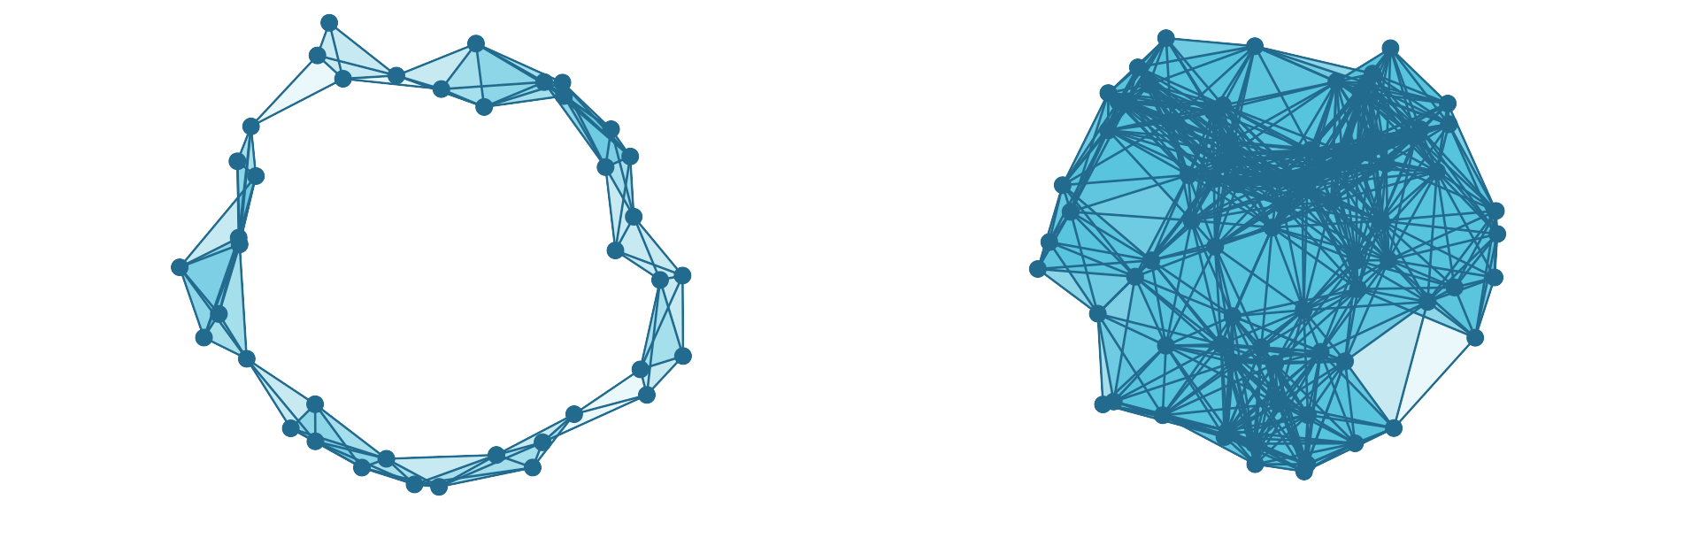


Vietoris—Rips persistence
At scale $r=0.5$:
$$dim⁡(H_{1}\left(X\right))=1$$
$$dim⁡(H_{1}\left(X\right))=0$$

Slide 7
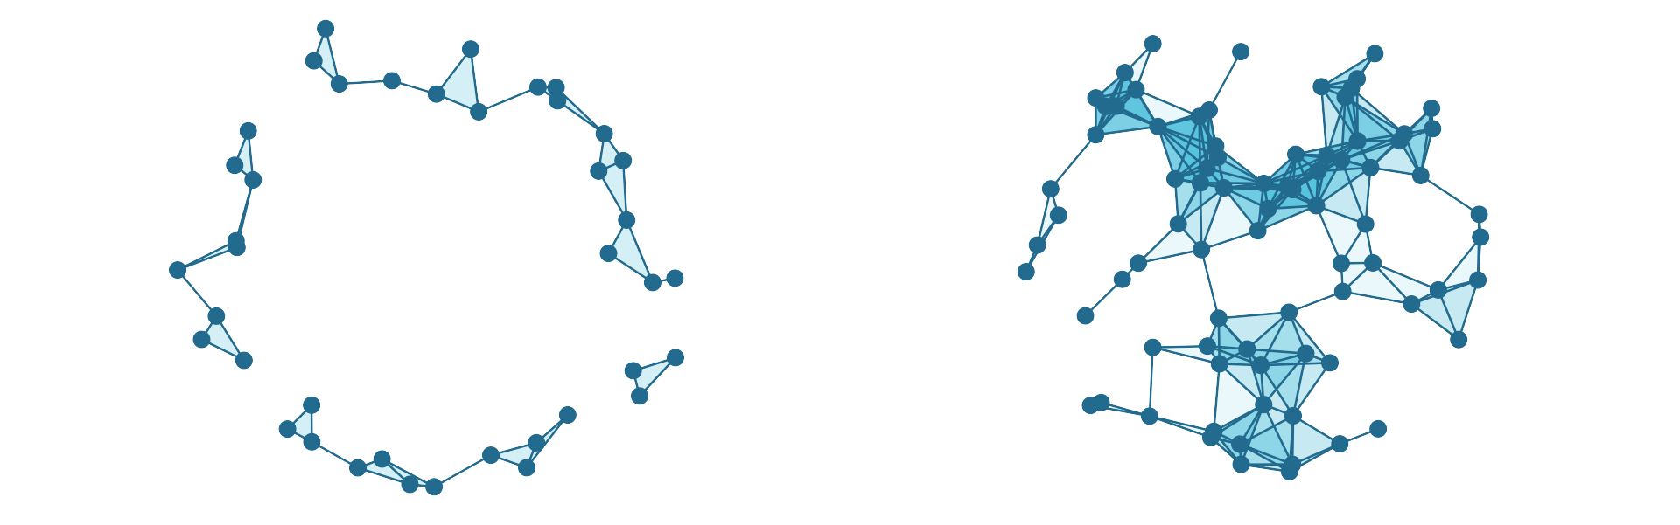



Vietoris—Rips persistence
At scale $r=0.3$:
$$dim⁡(H_{1}\left(X\right))=0$$
$$dim⁡(H_{1}\left(X\right))=3$$

Slide 8
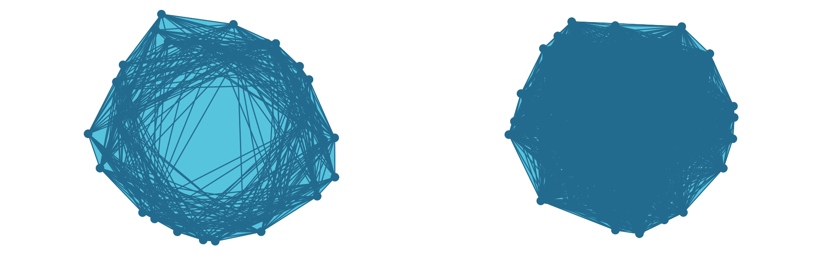

Vietoris—Rips persistence
At scale $r=1.5$:
$$dim⁡(H_{1}\left(X\right))=0$$
$$dim⁡(H_{1}\left(X\right))=0$$

Slide 9
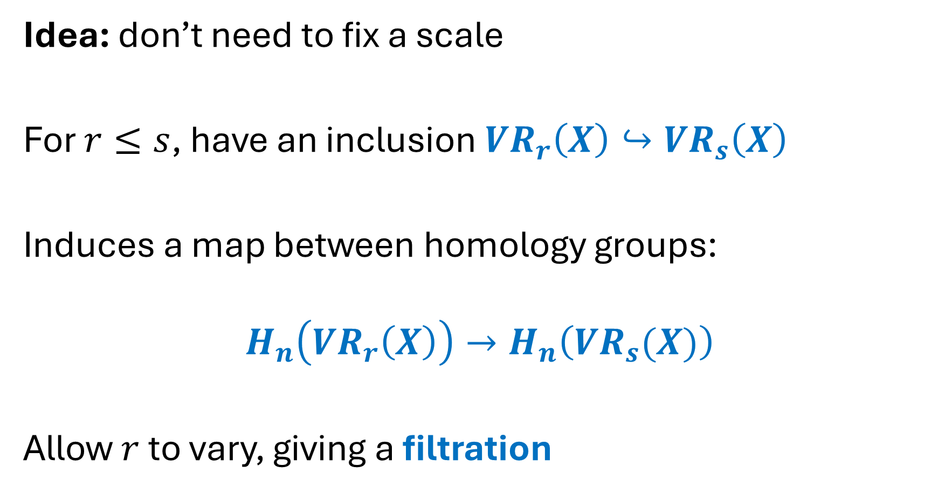
Vietoris—Rips persistence
Idea: don’t need to fix a scale
For $r≤s$, have an inclusion $VR_{r}\left(X\right)↪VR_{s}\left(X\right)$
Induces a map between homology groups:
$$H_{n}\left(VR_{r}\left(X\right)\right)→H_{n}\left(VR_{s}(X)\right)$$
Allow $r$ to vary, giving a filtration

Slide 10

Vietoris—Rips persistence

Slide 11
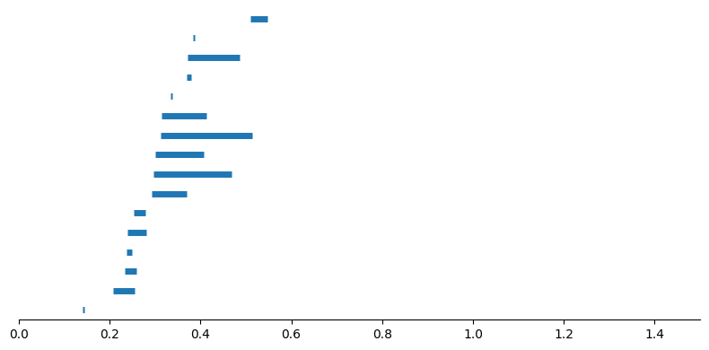
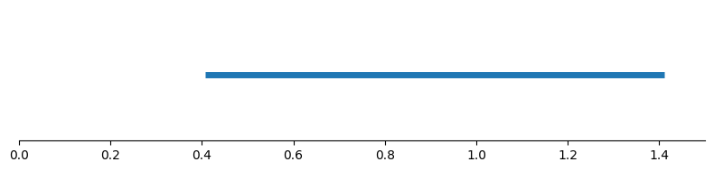
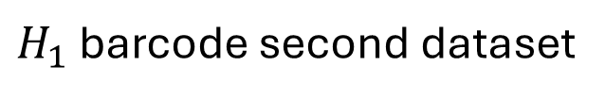
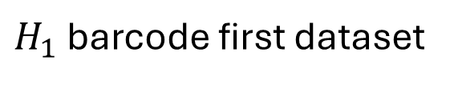
Vietoris—Rips persistence
Track when homology generators appear/disappear (are born/die) using a barcode
$H_{1}$ barcode first dataset
$H_{1}$ barcode second dataset

Slide 12
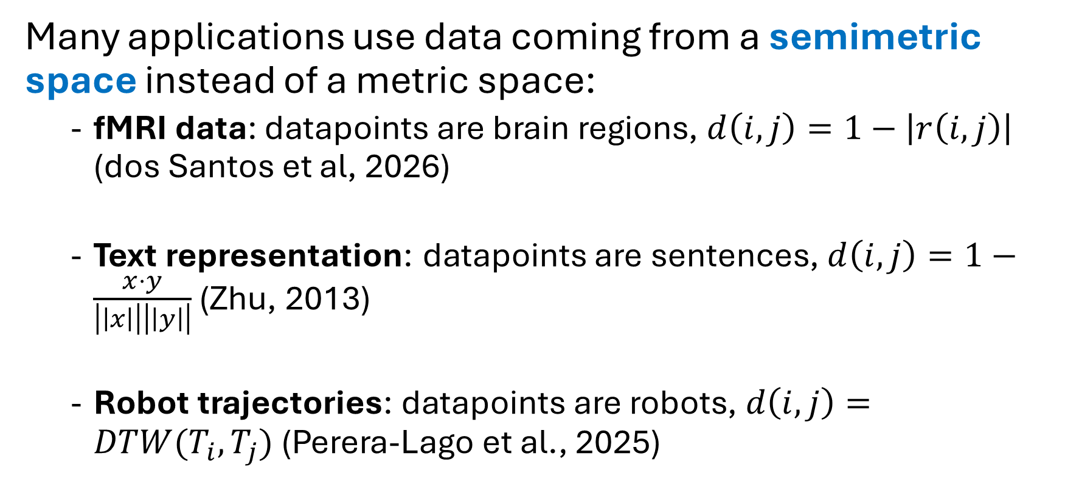
Non-metric setting
Many applications use data coming from a semimetric space instead of a metric space:
  fMRI data: datapoints are brain regions, $d\left(i,j\right)=1−\left|r\left(i,j\right)\right|$ (dos Santos et al, 2026)
  Text representation: datapoints are sentences, $d\left(i,j\right)=1−\frac{x⋅y}{\left|\left|x\right|\right|\left|\left|y\right|\right|}$ (Zhu, 2013)
  Robot trajectories: datapoints are robots, $d\left(i,j\right)=DTW(T_{i},T_{j})$ (Perera-Lago et al., 2025)
Notes:
https://www.sciencedirect.com/science/article/pii/S0960077926006958
https://www.researchgate.net/publication/262311097_Persistent_homology_An_introduction_and_a_new_text_representation_for_natural_language_processing
https://arxiv.org/abs/2502.02112

Slide 13

Non-metric setting
Example: data comes from metric, noise added to distance matrix

Slide 14
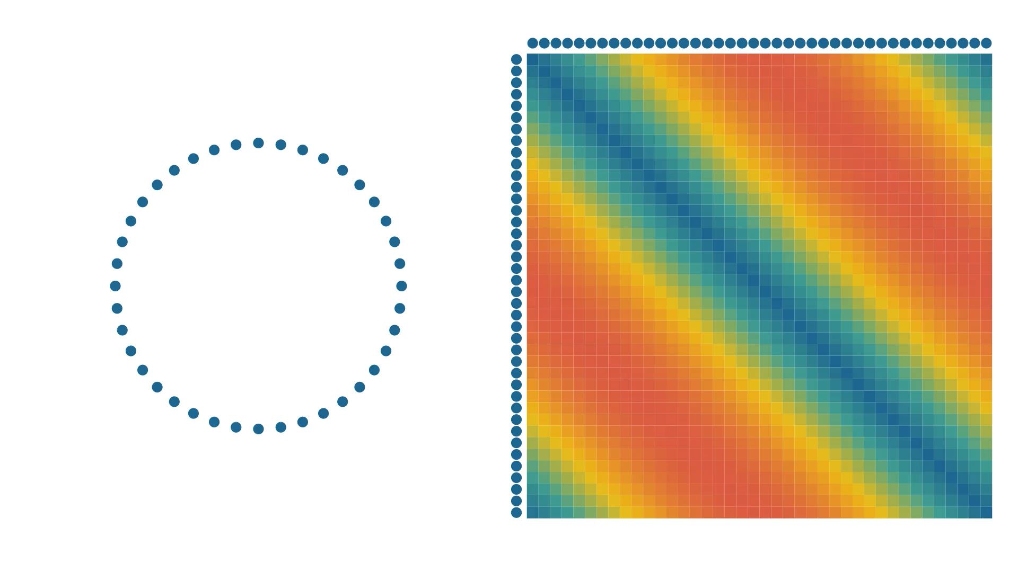
Non-metric setting
Example: data comes from metric, noise added to distance matrix

Slide 15
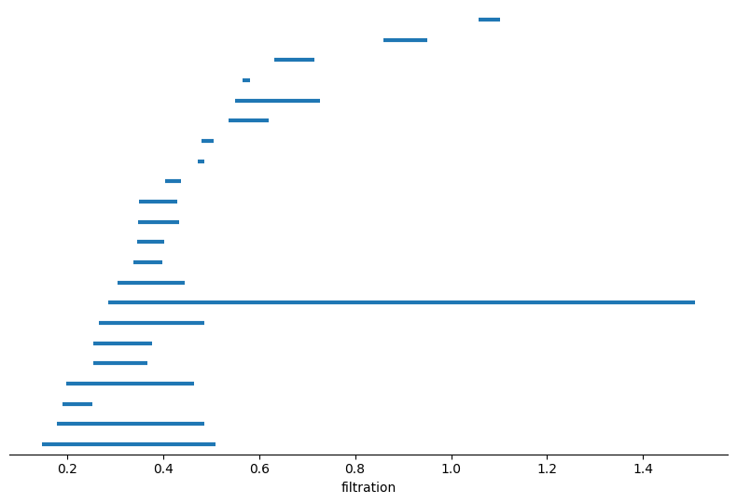
Non-metric setting
Metric noise
Non-metric noise
We thus need to develop more noise resistant methods

Slide 16
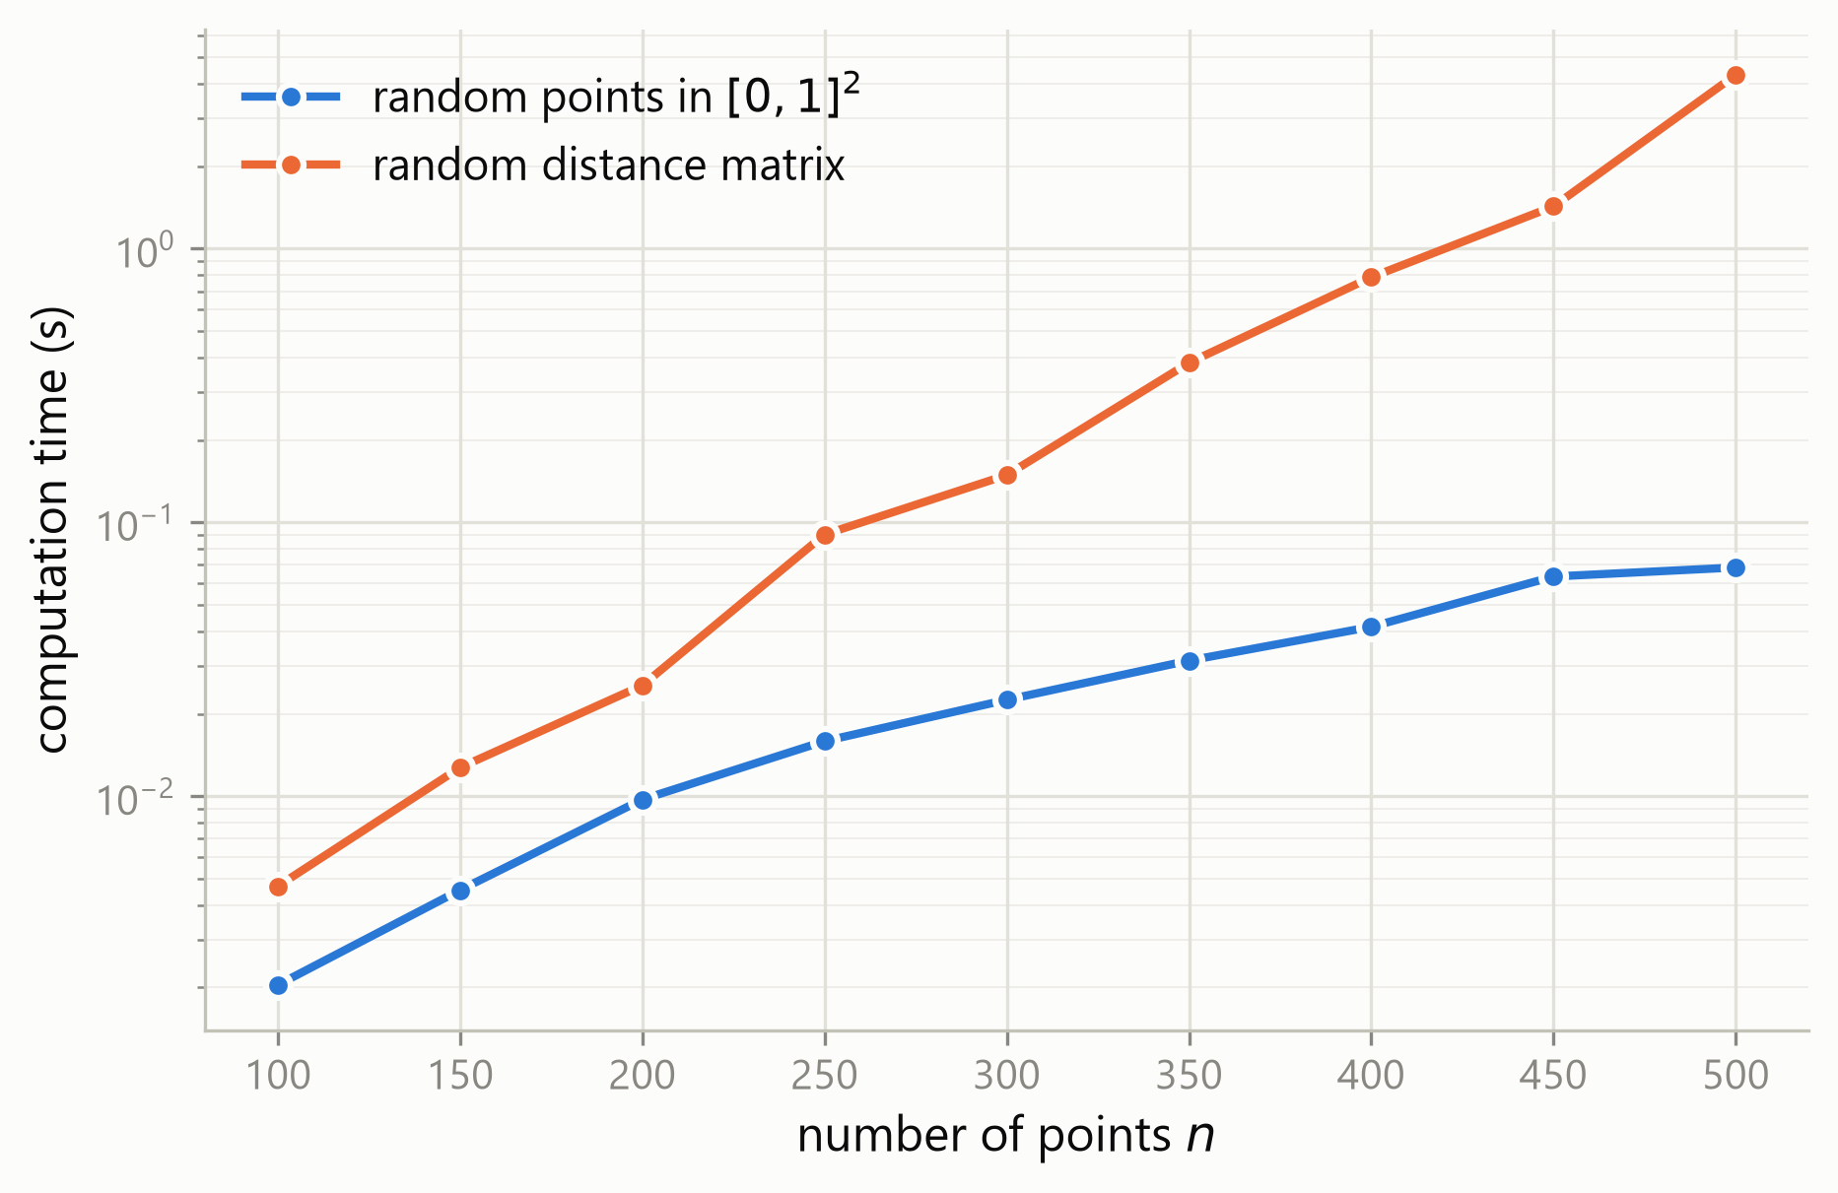
Non-metric setting
Vietoris-Rips persistence is also slow on non-metric data

Slide 17


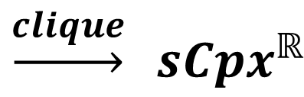
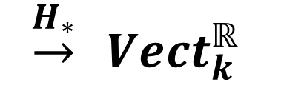

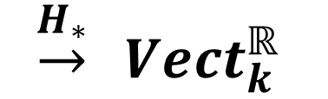
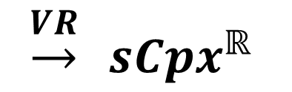
Non-metric setting
$$SemiMet$$
$$\underset{→}{VR} sCpx^{ℝ}$$
$$\underset{→}{H_{∗}} Vect_{k}^{ℝ}$$
$$→ Graph^{ℝ}$$
$$\underset{→}{clique} sCpx^{ℝ}$$
$$\underset{→}{H_{∗}} Vect_{k}^{ℝ}$$
$$SemiMet$$
Discrete Homology

Slide 18
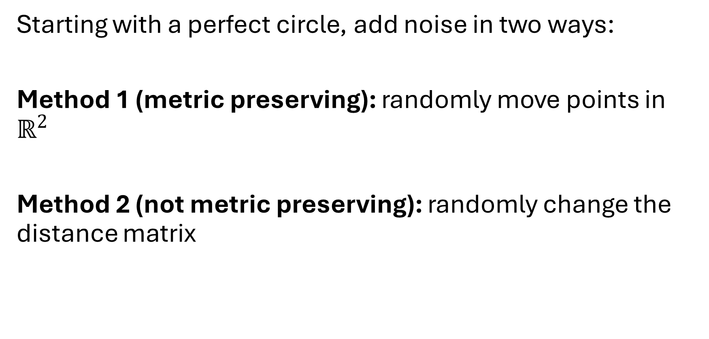
DH vs Rips filtration
Starting with a perfect circle, add noise in two ways:
Method 1 (metric preserving): randomly move points in $ℝ^{2}$
Method 2 (not metric preserving): randomly change the distance matrix

Slide 19
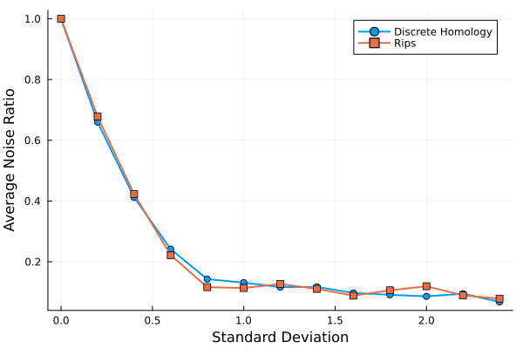
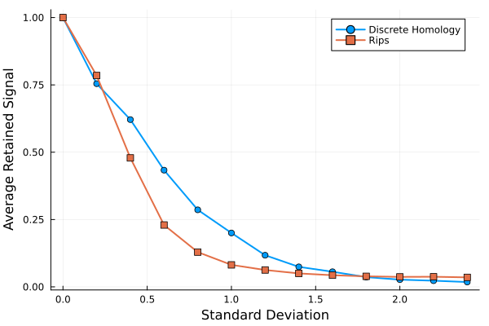
DH vs Rips filtration
Method 1
Method 2

Slide 20
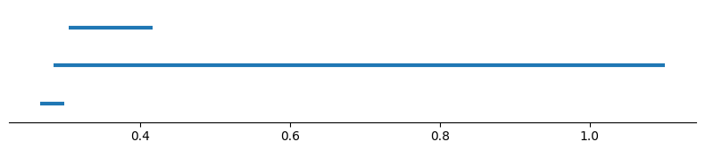
DH vs Rips filtration
Under method 2:
Simplicial homology
Discrete homology

Slide 21
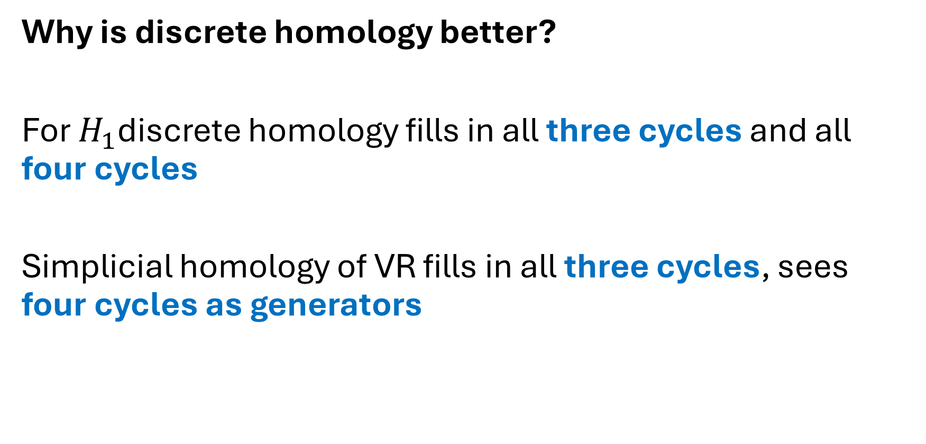
DH vs Rips filtration
Why is discrete homology better?
For $H_{1}$discrete homology fills in all three cycles and all four cycles
Simplicial homology of VR fills in all three cycles, sees four cycles as generators

Slide 22
DH vs Rips filtration
Why is discrete homology better?
Four cycles are easily created by noise
Metric data: triangle inequality fills in four cycles quickly
Non metric data: four cycles last arbitrarily long

Slide 23
DCH vs Rips filtration
To test time: compare RedZeD_VR to RedZeD_PDH
RedZeD_VR: fast Vietoris-Rips persistent homology using reduction to zero differentials and active enumeration (Kapulkin, Kershaw, 2026)
RedZeD_PDH: fast persistent discrete homology using same techniques (Ebel, Kapulkin, Kershaw, 2026)

Slide 24
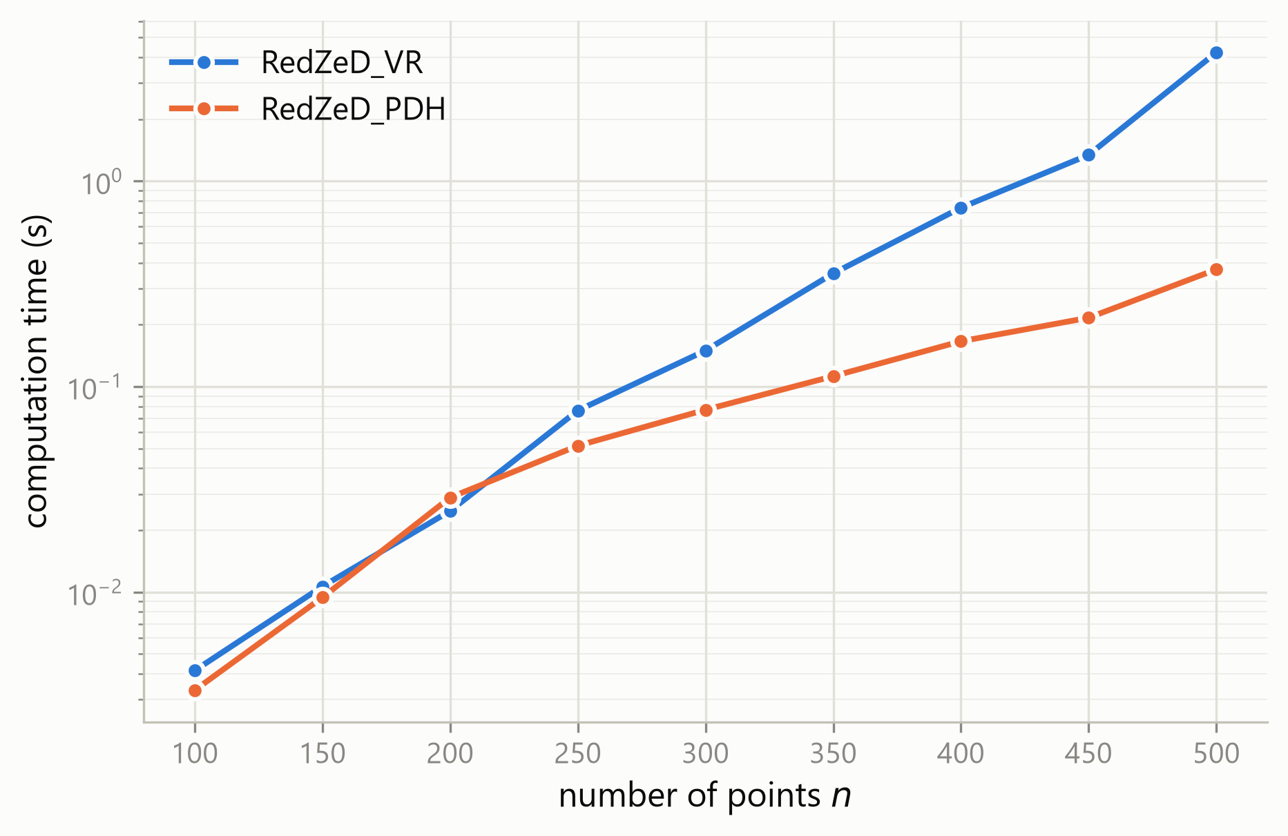
DH vs Rips filtration
Test both on random distance matrices:

Slide 25
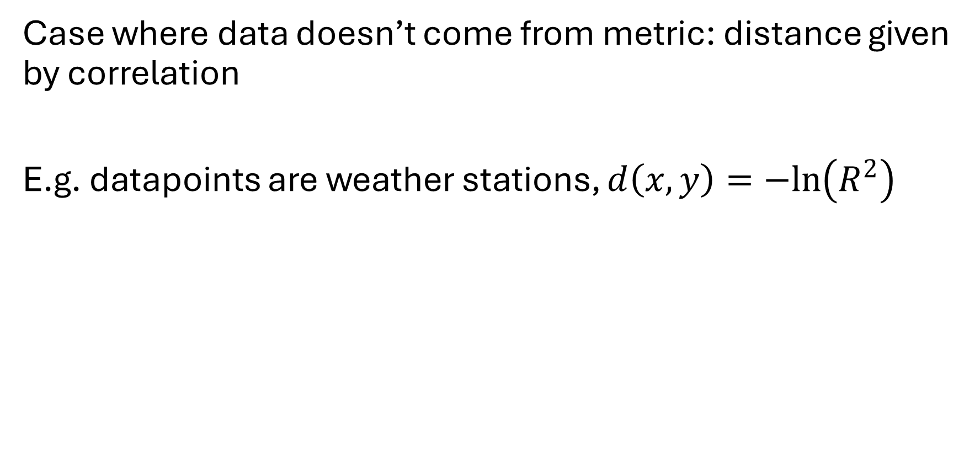
Results on data
Case where data doesn’t come from metric: distance given by correlation
E.g. datapoints are weather stations, $d\left(x,y\right)=−ln\left(R^{2}\right)$

Slide 26
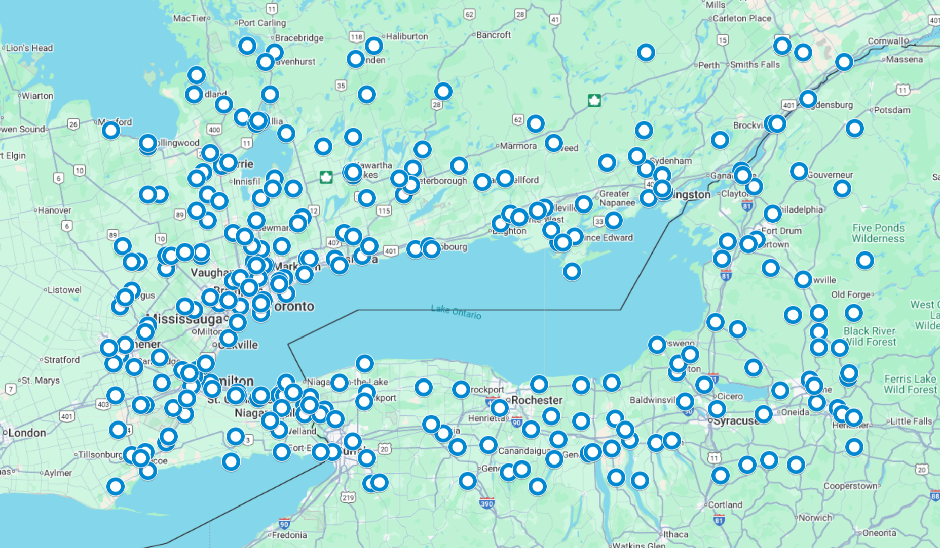
Results on data

Slide 27
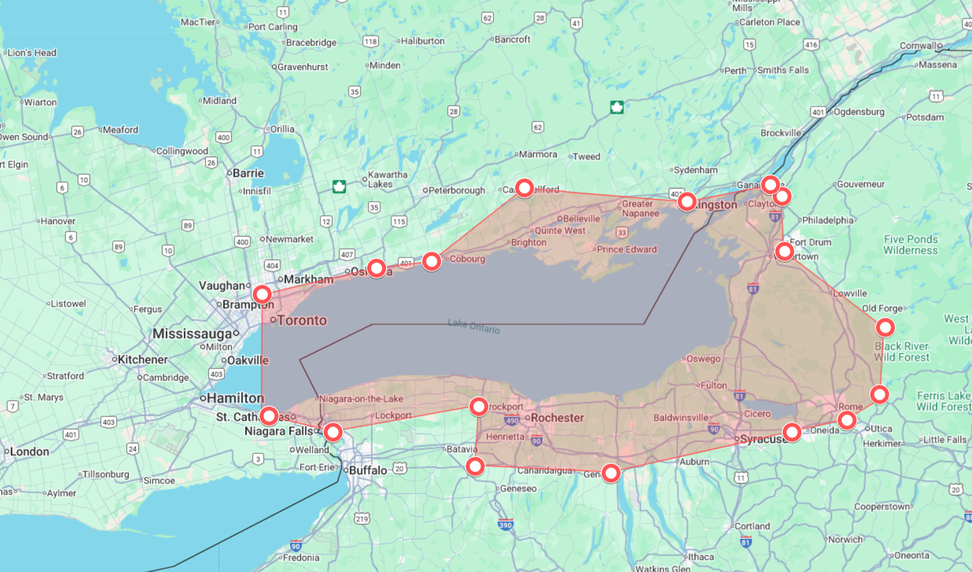
Results on data

Slide 28
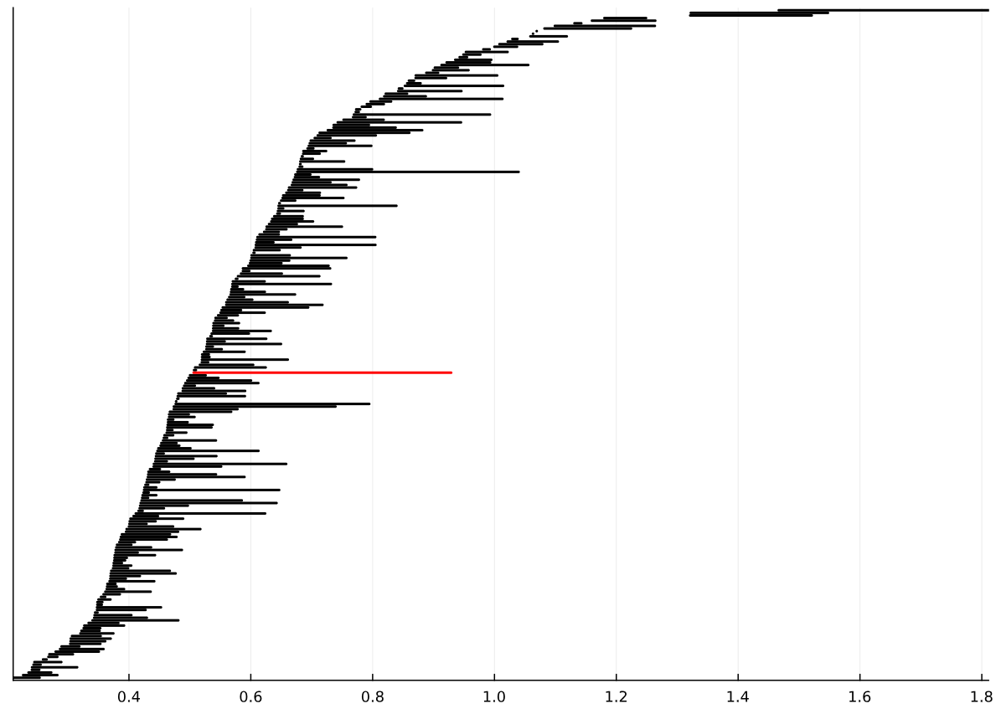
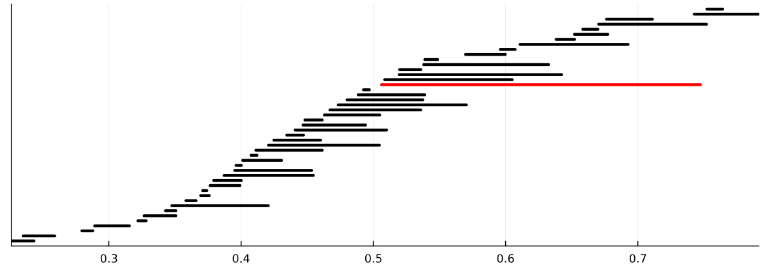
Results on data
Simplicial homology
Discrete homology

Slide 29
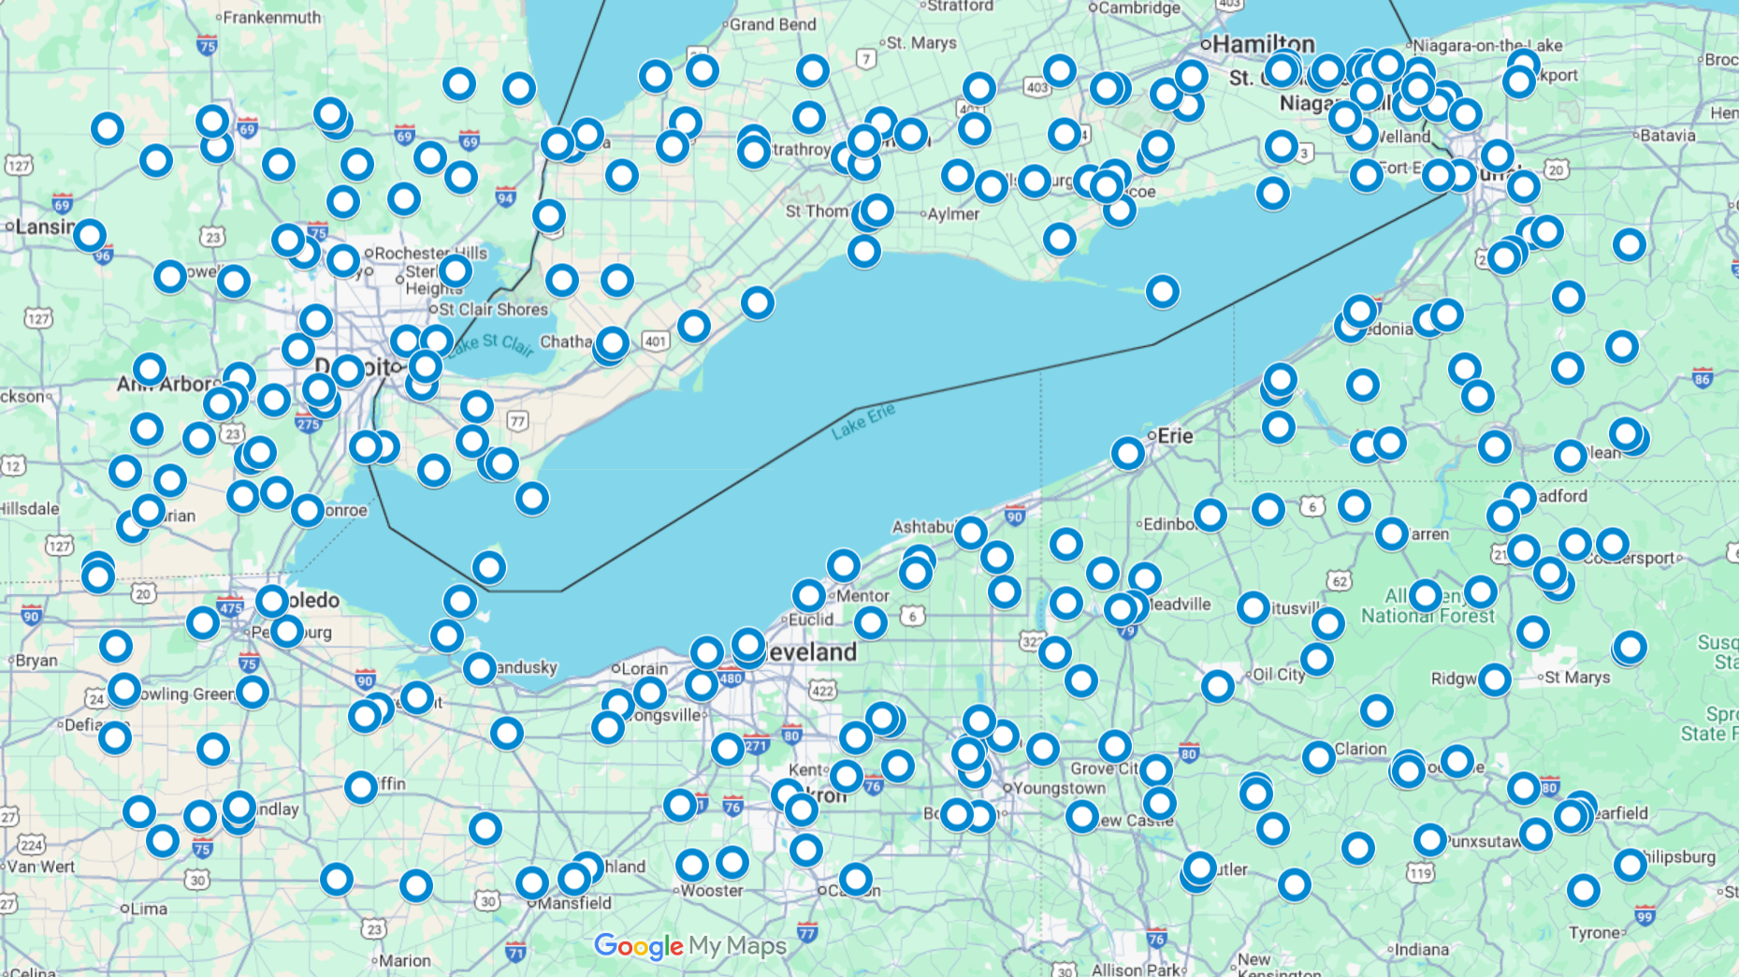
Results on data

Slide 30
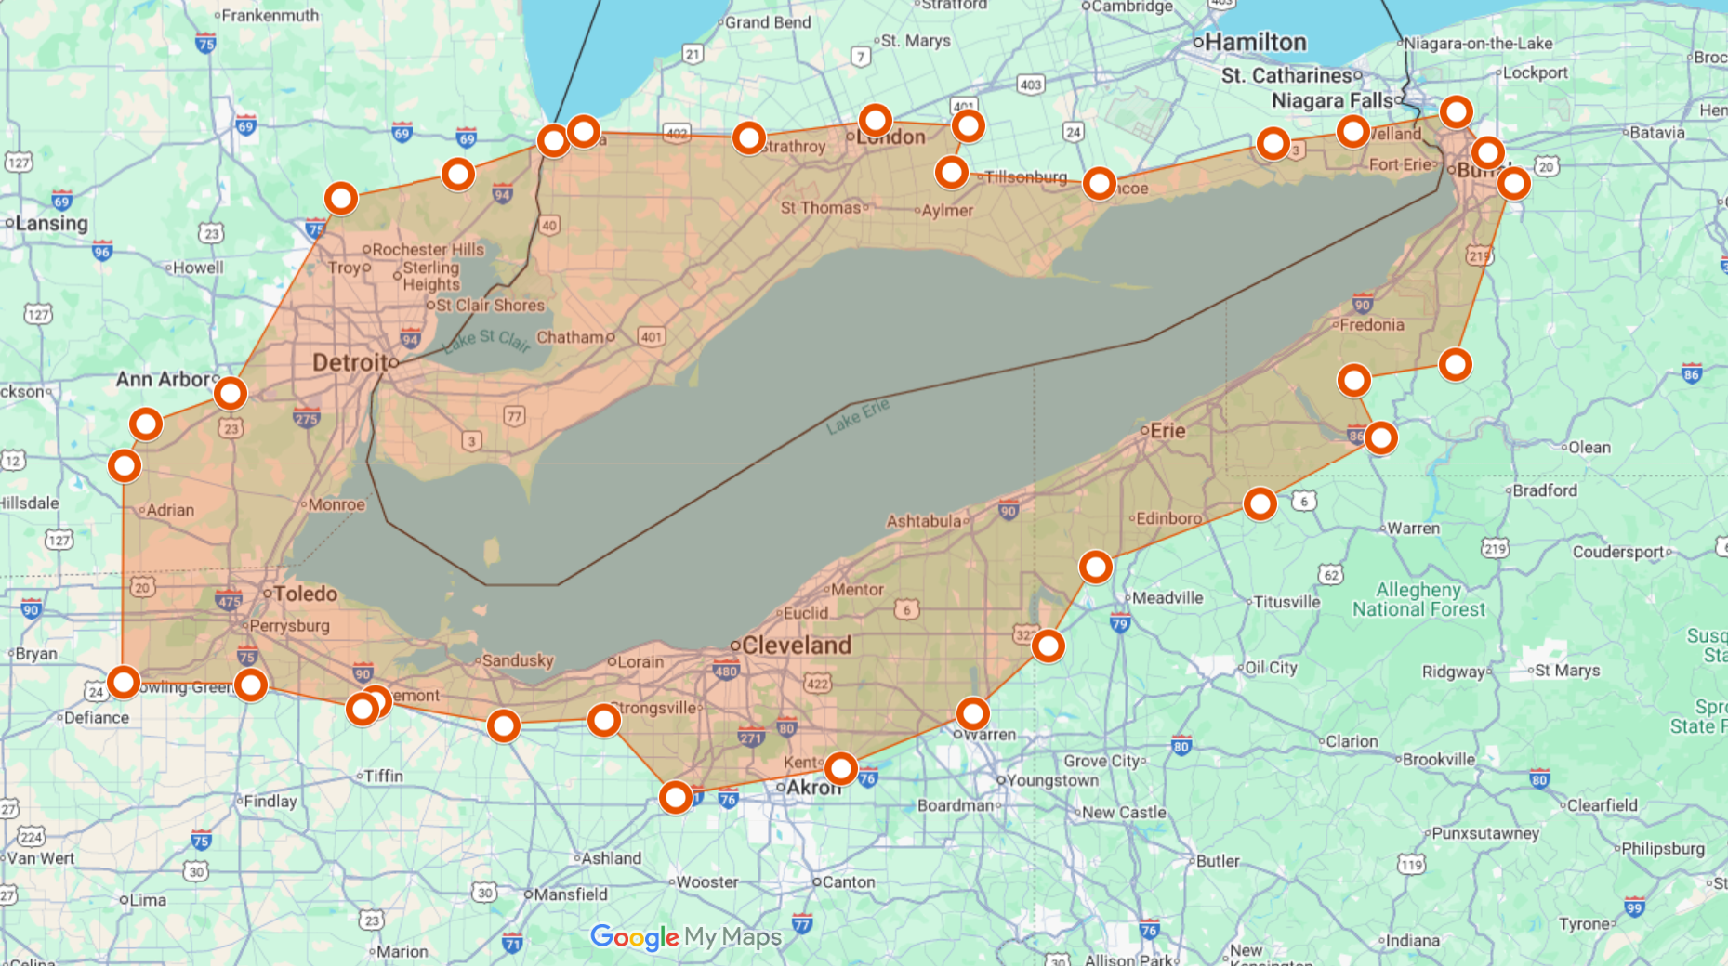
Results on data

Slide 31
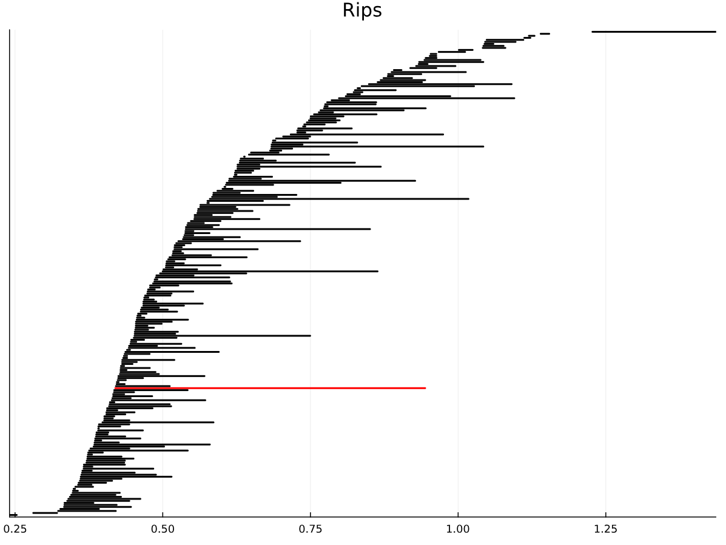
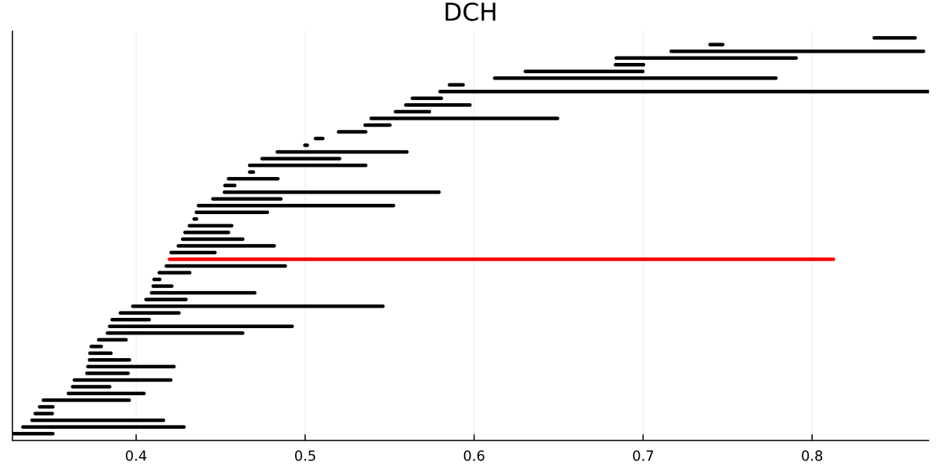
Results on data
Simplicial homology
Discrete homology

Slide 32
Conclusion
On non-metric data, VR persistence is not robust to noise and slow
Persistent discrete homology offers a noise resistant alternative
RedZeD and active enumeration can be applied to discrete homology, making it faster than VR in many non-metric cases

Slide 33


Available code
Fast (persistent) discrete homology
github.com/nkershaw01/Discrete-homology-with-RedZeD
Written in Julia
Fast VR persistent homology
github.com/nkershaw01/RedZeD
Written in Julia and C++ with a python package available

Slide 34
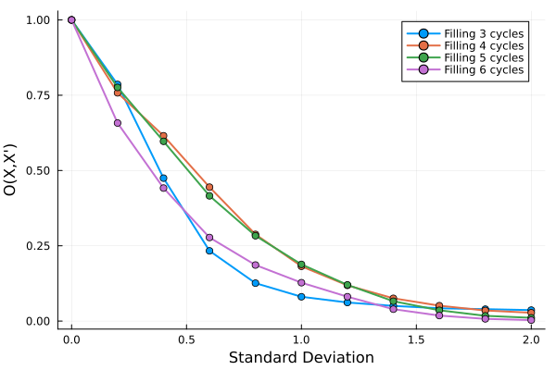
DH vs Rips filtration

Slide 35
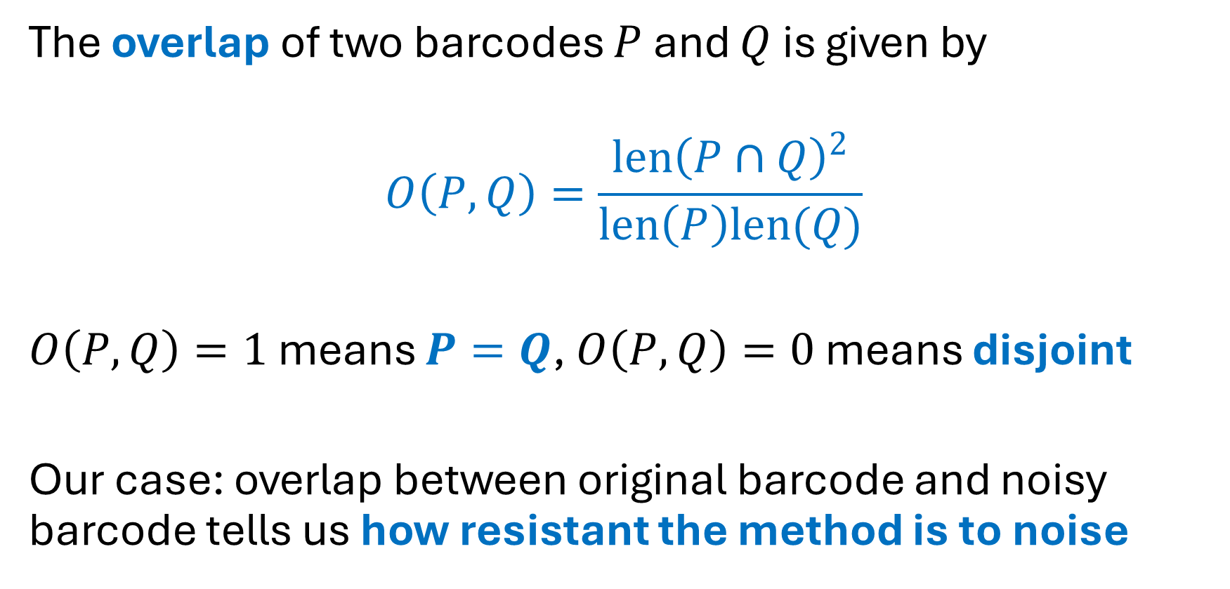
DH vs Rips filtration
The overlap of two barcodes $P$ and $Q$ is given by
$$O\left(P,Q\right)=\frac{len{\left(P∩Q\right)}^{2}}{len\left(P\right)len(Q)}$$
$O\left(P,Q\right)=1$ means $P=Q$, $O\left(P,Q\right)=0$ means disjoint
Our case: overlap between original barcode and noisy barcode tells us how resistant the method is to noise

