Slide 1

Topological Data Analysis Using Discrete Homology
Nathan Kershaw
Joint with Chris Kapulkin

Slide 2
References
Main reference:
C. Kapulkin and N. Kershaw, Data analysis using discrete cubical homology, 2025. https://arxiv.org/abs/2506.15020
Other references:
H. Barcelo, V. Capraro and J. A. White, Discrete homology theory for metric spaces, Bull. Lond. Math. Soc 46 (2014), no. 5, 889-905.
H. Barcelo, C. Greene, A. S. Jarrah, V. Welker, Discrete cubical and path homologies of graphs, Algebr. Comb. 2 (2019), no. 3, 417-437.
C. Kapulkin and N. Kershaw, Efficient computations of discrete cubical homology, 2024. arxiv.org/abs/2410.09939

Slide 3

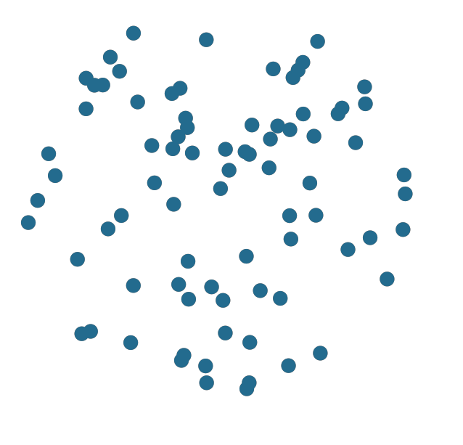
What is TDA?
Key insight: the shape of data carries relevant information worth studying
How can we differentiate between these datasets?

Slide 4


Determining shape
We can try and use the first homology group to differentiate these datasets
$$H_{1}\left(X\right)=0$$
$$H_{1}\left(X\right)=0$$

Slide 5
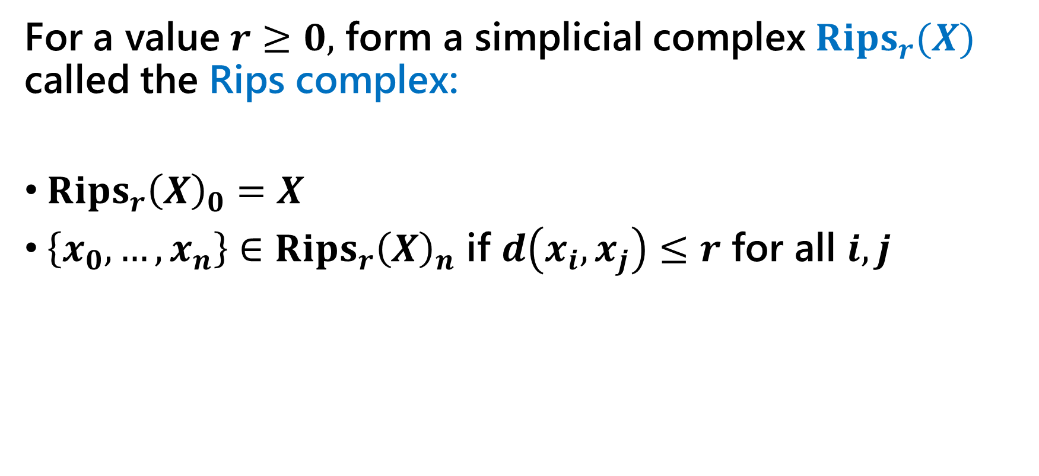
Fixing a scale
For a value $r≥0,$ form a simplicial complex $Rips_{r}(X)$ called the Rips complex:
$Rips_{r}{\left(X\right)}_{0}=X$
$\left\{x_{0},…, x_{n}\right\}∈Rips_{r}{\left(X\right)}_{n}$ if $d\left(x_{i},x_{j}\right)≤r$ for all $i,j$

Slide 6
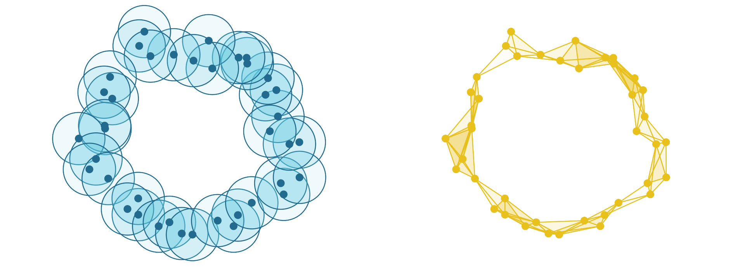

Fixing a scale
At scale $r=0.5$:

Slide 7
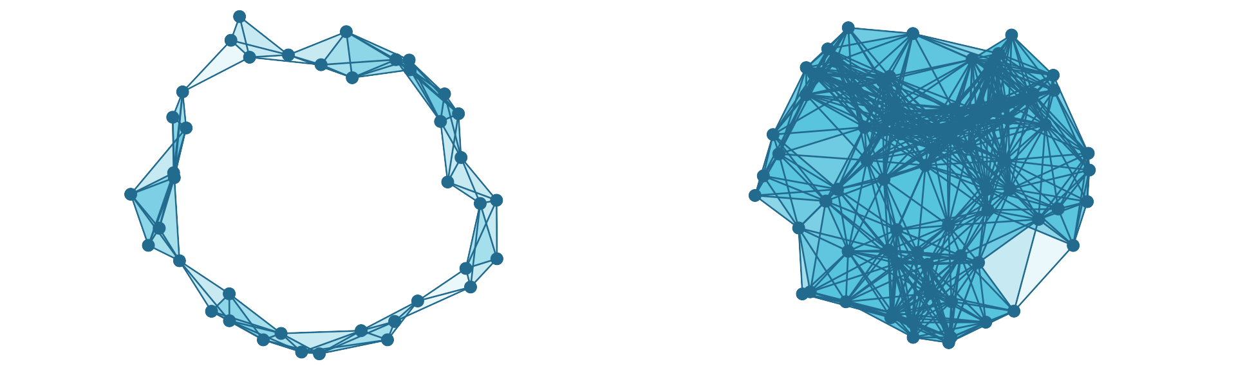


Fixing a scale
At scale $r=0.5$:
$$H_{1}\left(X\right)= ℤ$$
$$H_{1}\left(X\right)=0$$

Slide 8
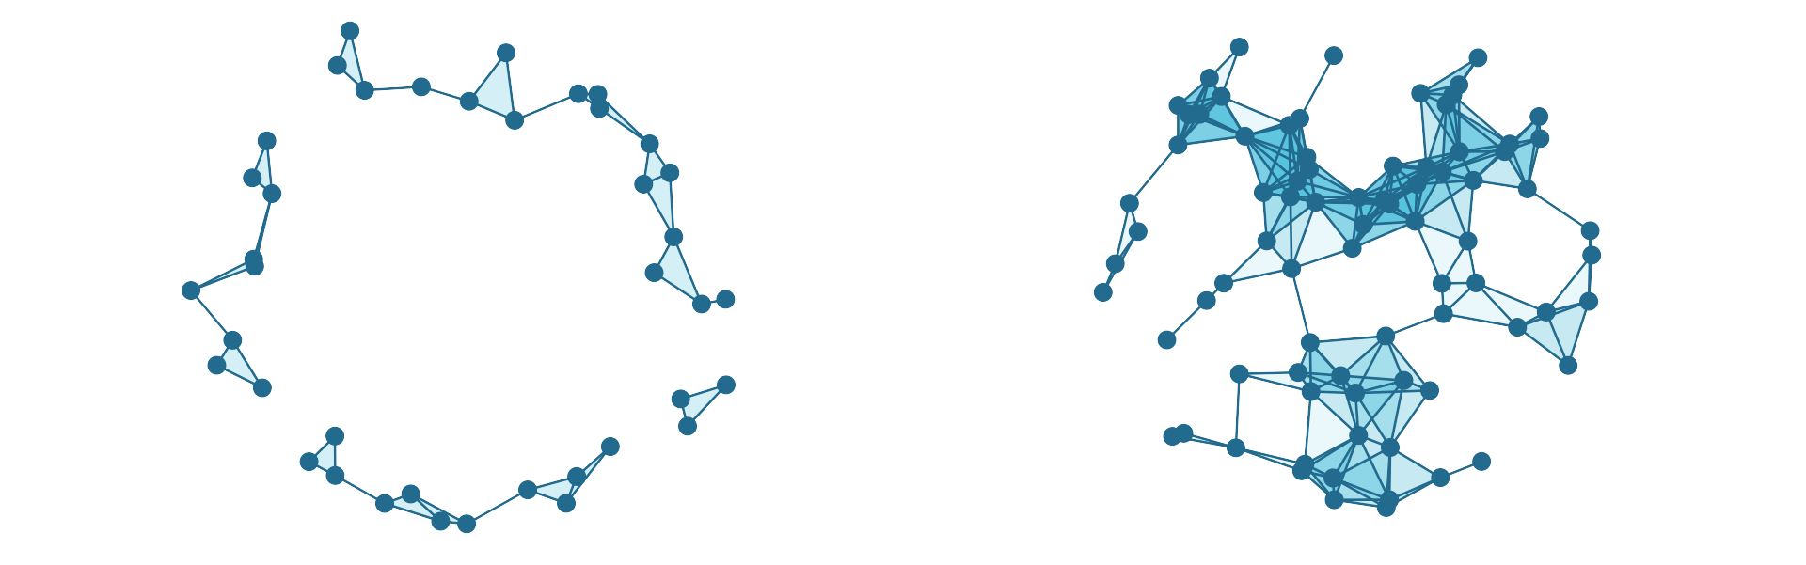


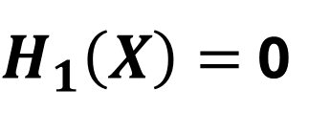
Fixing a scale
At scale $r=0.3$:
$H_{1}\left(X\right)=$ 0
$$H_{1}\left(X\right)=ℤ^{3}$$

Slide 9
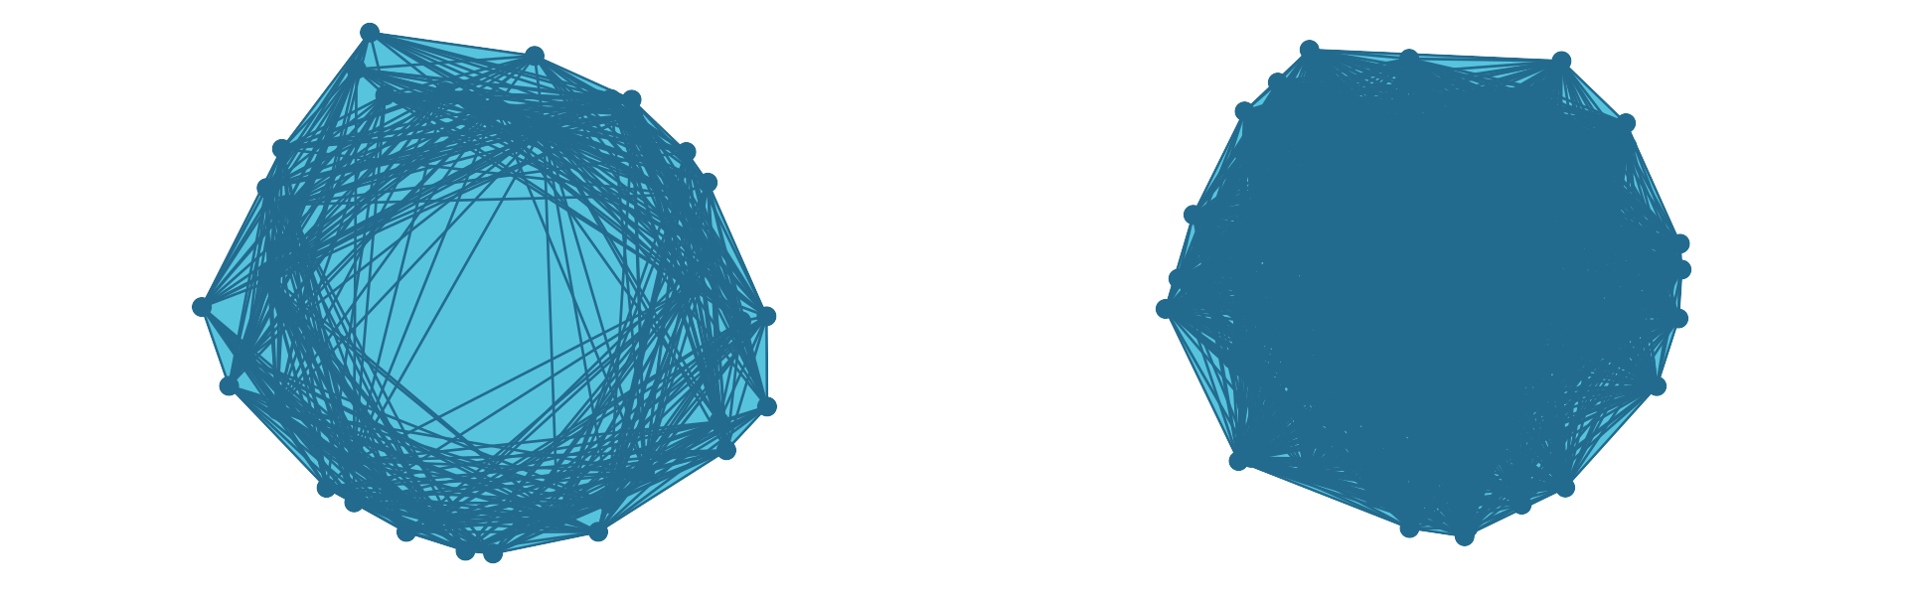


Fixing a scale
At scale $r=1.5$:
$$H_{1}\left(X\right)=0$$
$$H_{1}\left(X\right)=0$$

Slide 10
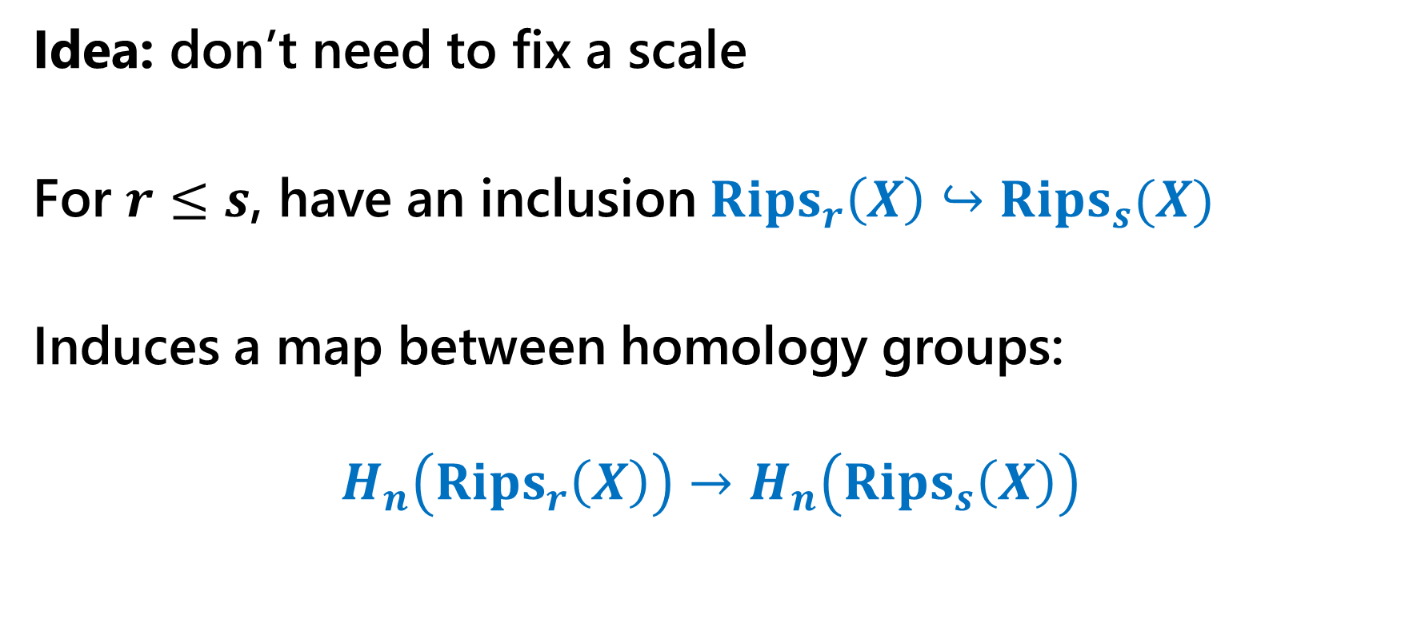
Persistent homology
Idea: don’t need to fix a scale
For $r≤s$, have an inclusion $Rips_{r}\left(X\right)↪Rips_{s}(X)$
Induces a map between homology groups:
$$H_{n}\left(Rips_{r}\left(X\right)\right)→H_{n}\left(Rips_{s}\left(X\right)\right)$$

Slide 11

Persistent homology

Slide 12
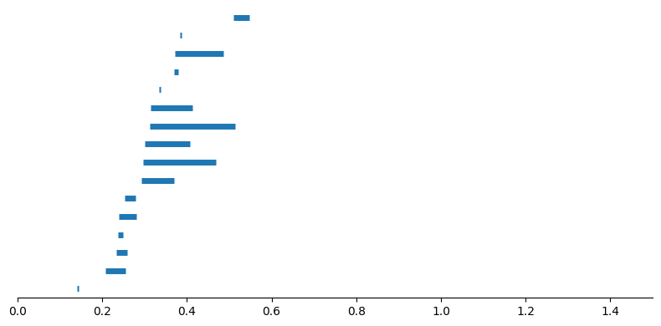
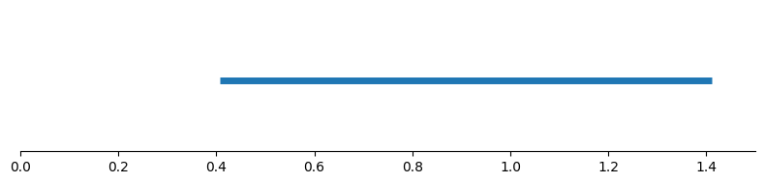
Persistent homology
Track when homology generators appear/disappear (are born/die) using a barcode

Slide 13

Non-metric setting
What if our data is equipped with a semimetric instead?

Slide 14
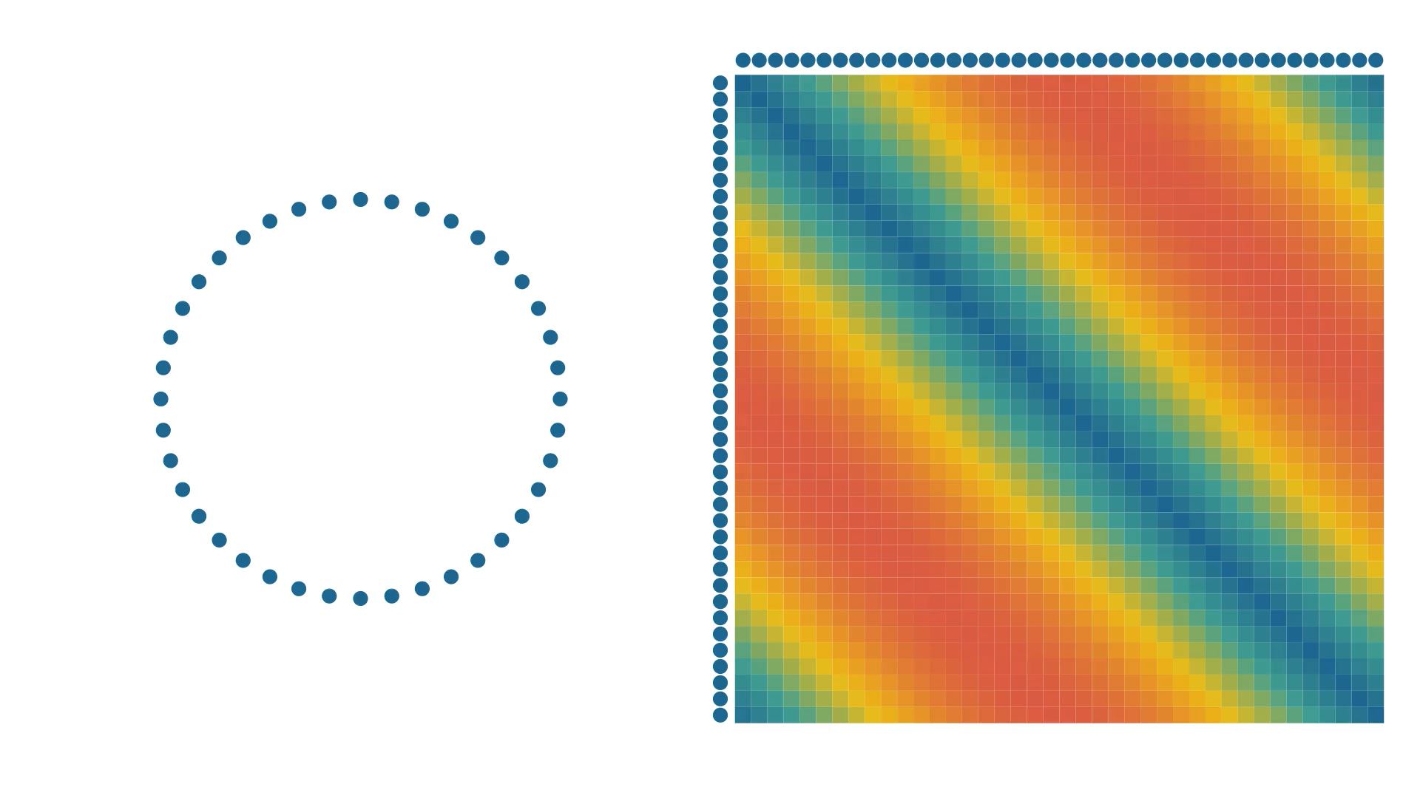
Non-metric setting
What if our data is equipped with a semimetric instead?

Slide 15
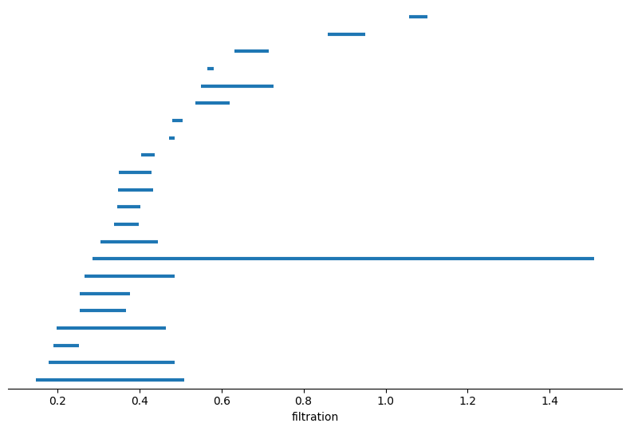
Non-metric setting
What if our data is equipped with a semimetric instead?
We thus need to develop more noise resistant methods

Slide 16
Discrete cubical homology
Discrete homology is a homology theory for simple, undirected graphs
Meant to detect different dimensional holes in graphs

Slide 17
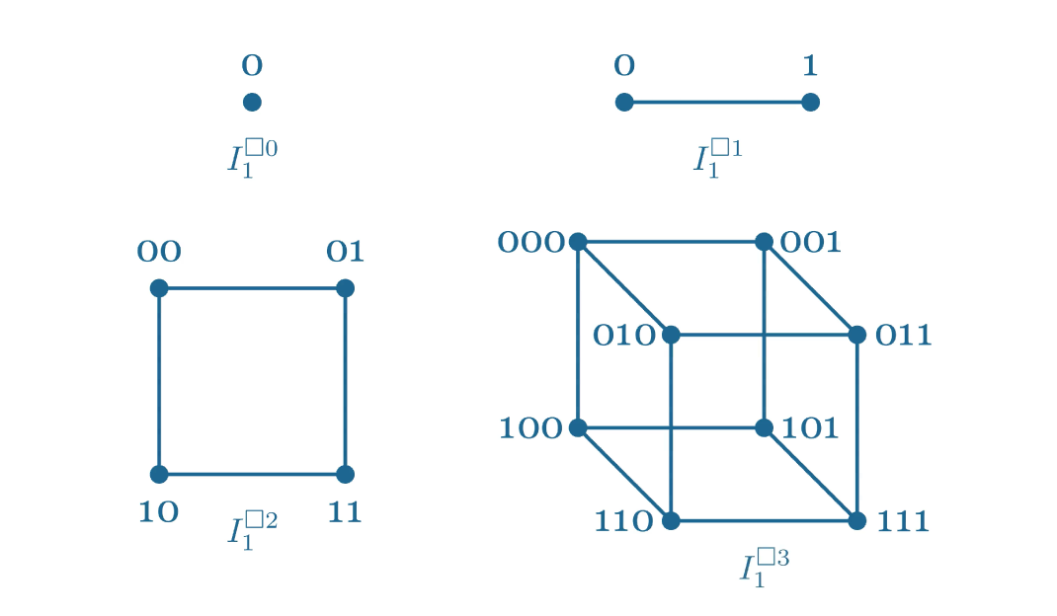

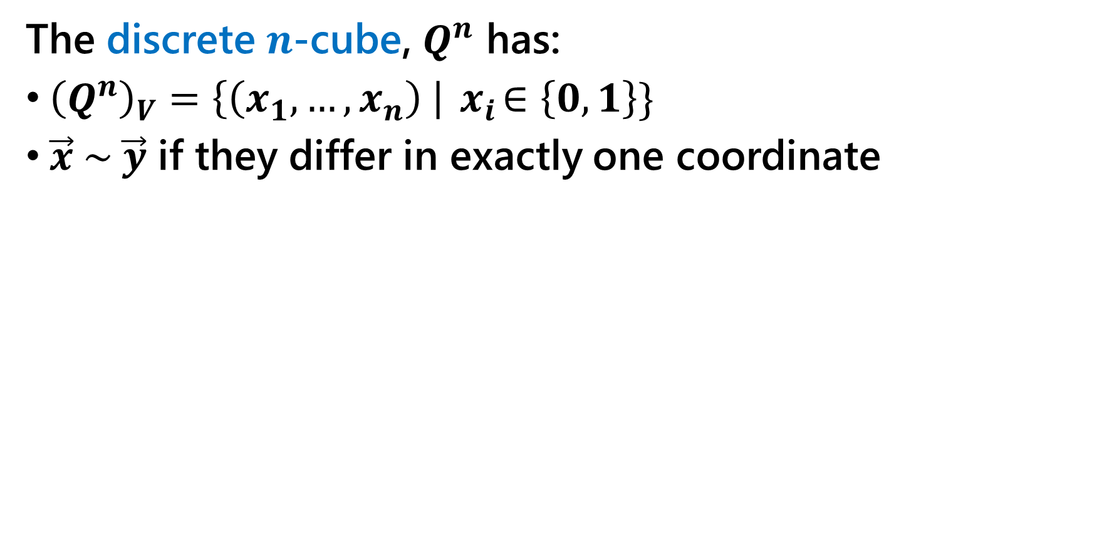



Discrete cubical homology
The discrete $n$-cube, $Q^{n}$ has:
${\left(Q^{n}\right)}_{V}=\left\{\left(x_{1},…, x_{n}\right) \right|{ x}_{i}∈\left\{0,1\right\}\}$
$\vec{x} \sim \vec{y}$ if they differ in exactly one coordinate
$$Q^{0}$$
$$Q^{1}$$
$$Q^{2}$$
$$Q^{3}$$

Slide 18
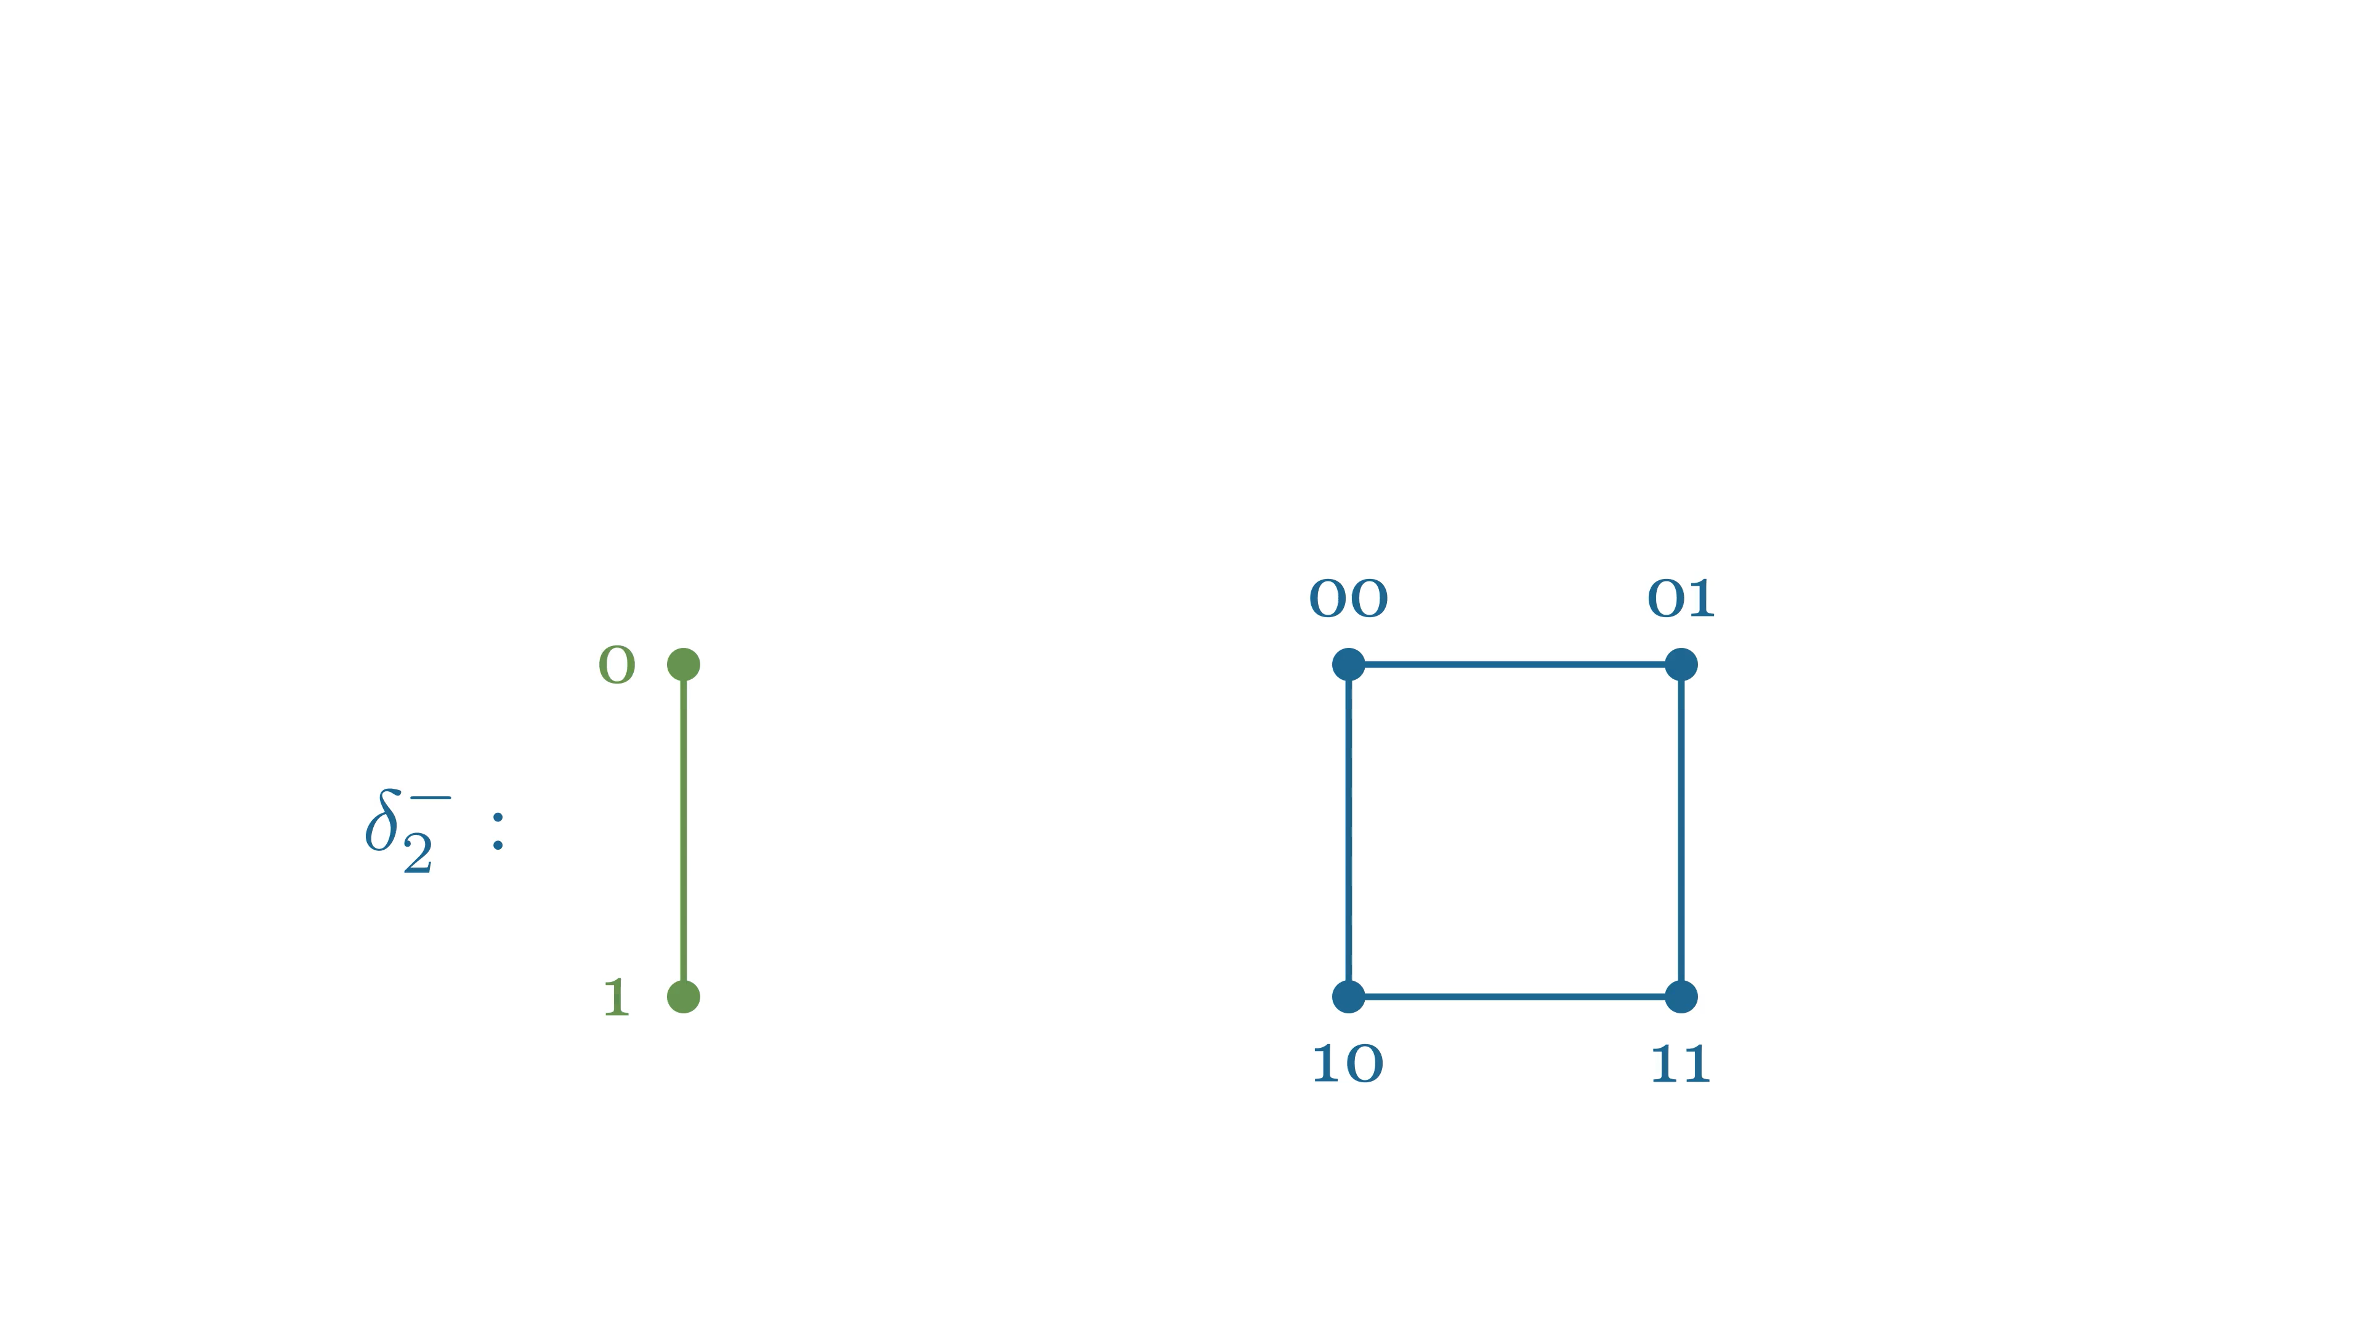
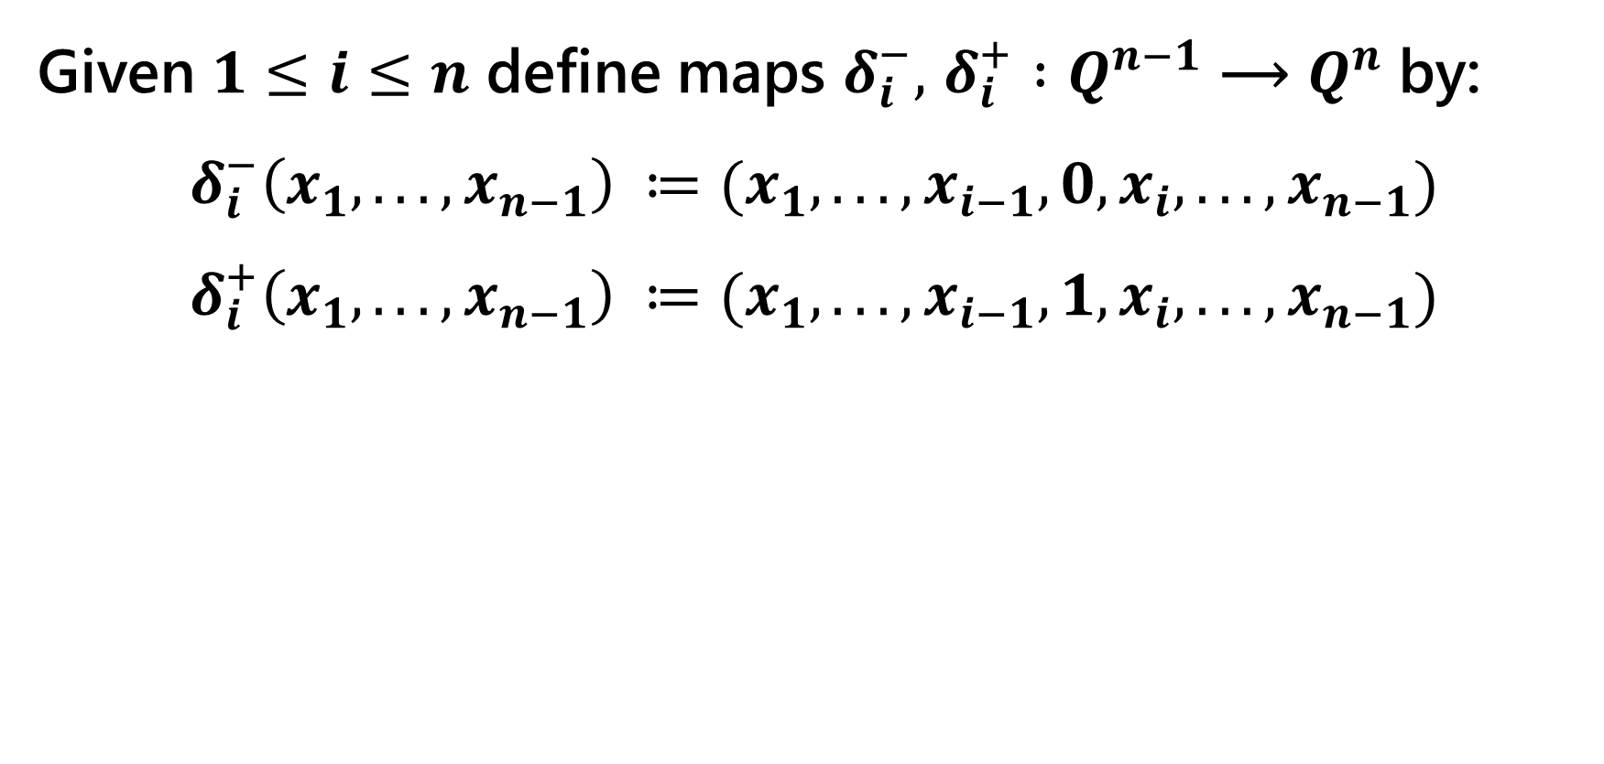
Discrete cubical homology
Given $1≤i≤n$ define maps $δ_{i}^{−},$ $δ_{i}^{+} :Q^{n−1} \text{⟶} Q^{n}$ by:
$$δ_{i}^{−}\left(x_{1}, . . . , x_{n−1}\right) ≔(x_{1}, . . . , x_{i−1}, 0, x_{i}, . . . , x_{n−1})$$
$$δ_{i}^{+}\left(x_{1}, . . . , x_{n−1}\right) ≔(x_{1}, . . . , x_{i−1}, 1, x_{i}, . . . , x_{n−1})$$

Slide 19
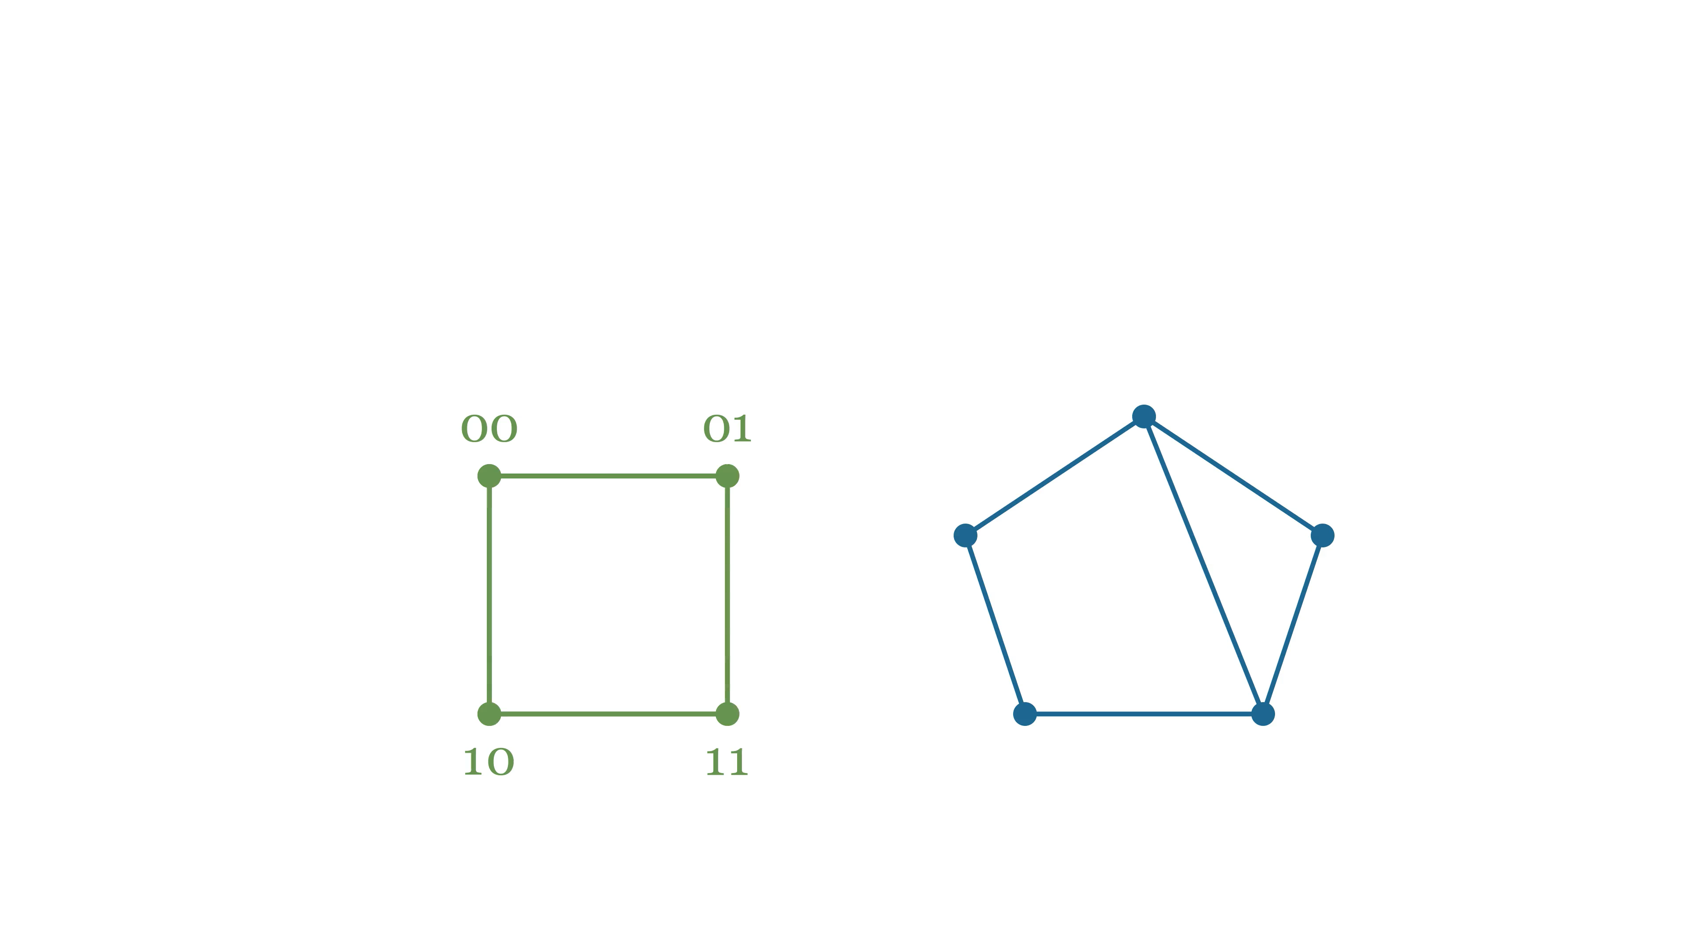
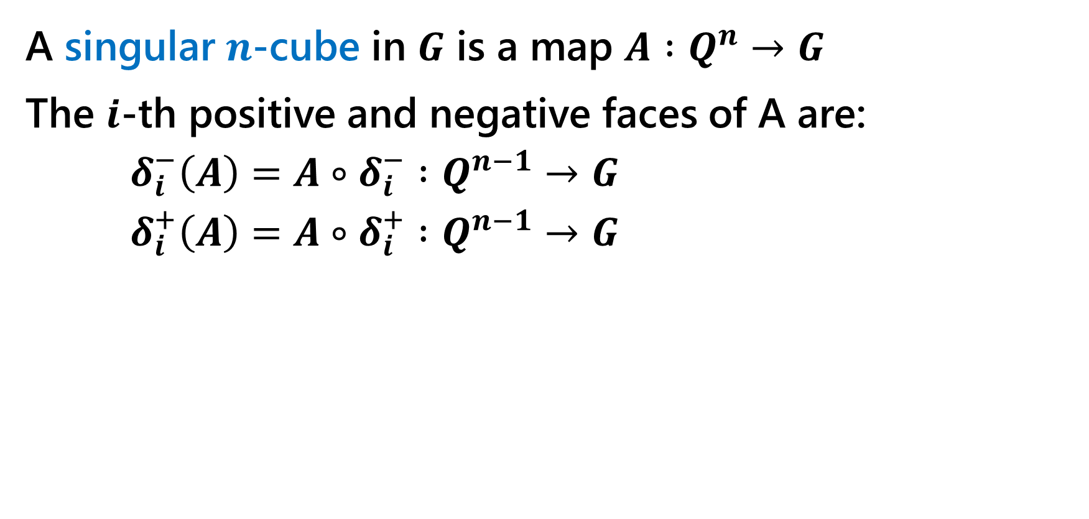
Discrete cubical homology
A singular $n$-cube in $G$ is a map $A :Q^{n}→G$
The $i$-th positive and negative faces of A are:
$δ_{i}^{−}\left(A\right)=A∘δ_{i}^{−} :Q^{n−1}→G$
$δ_{i}^{+}\left(A\right)=A∘δ_{i}^{+} :Q^{n−1}→G$

Slide 20
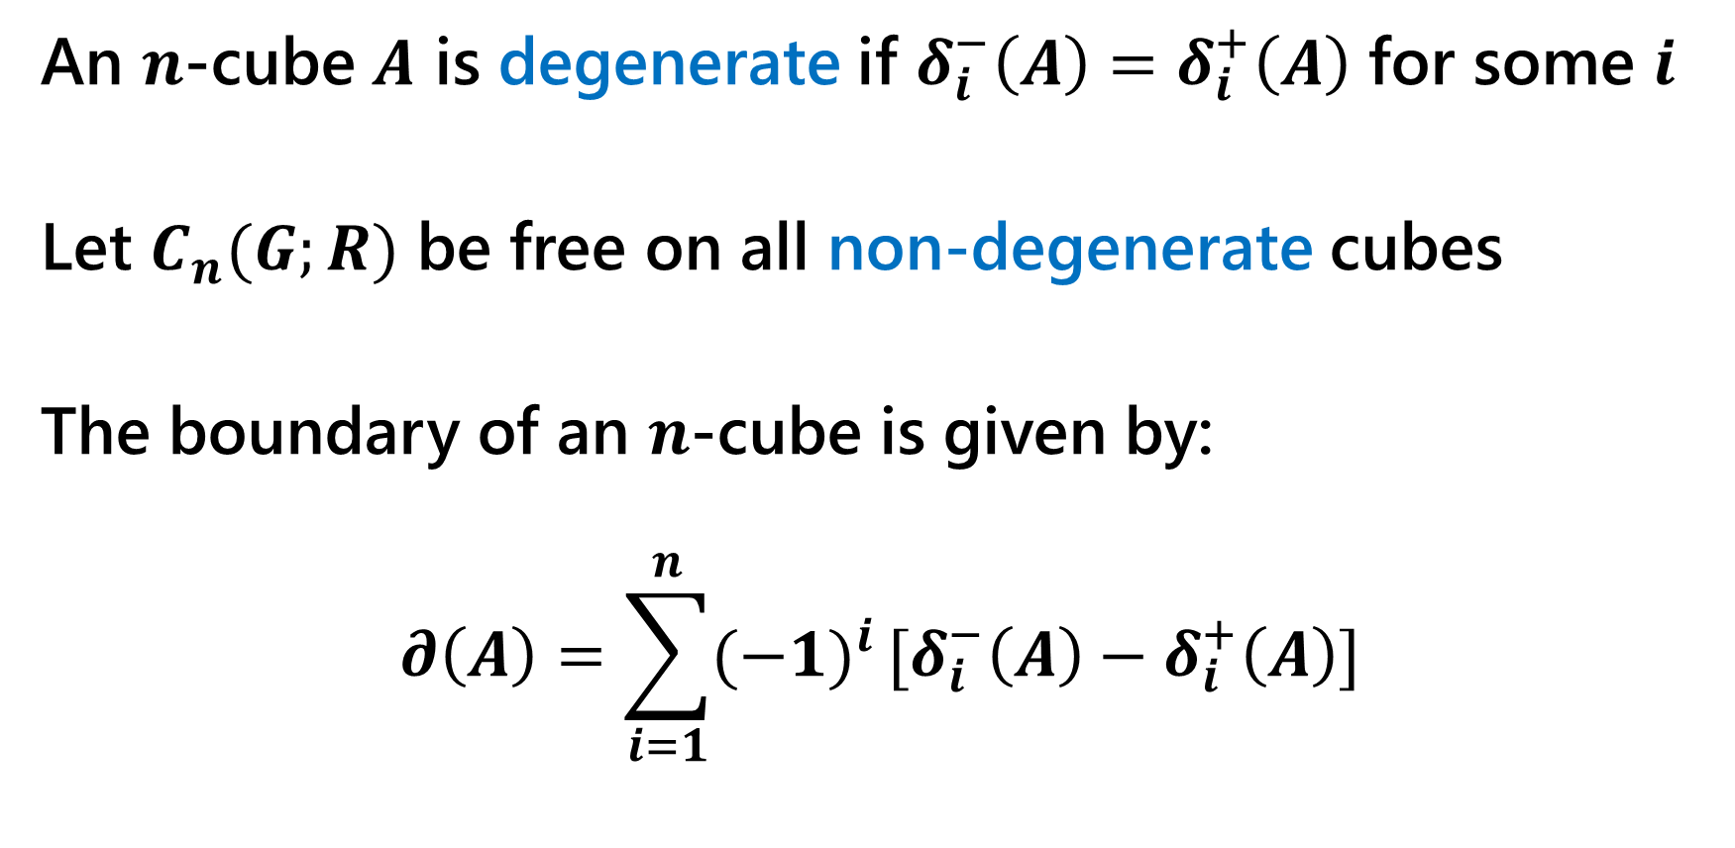
Discrete cubical homology
An $n$-cube $A$ is degenerate if $δ_{i}^{−}\left(A\right)=δ_{i}^{+}\left(A\right)$ for some $i$
Let $C_{n}(G;R)$ be free on all non-degenerate cubes
The boundary of an $n$-cube is given by:
$$∂\left(A\right)=\sum_{i=1}^{n}{(−1)^{i}}[δ_{i}^{−}\left(A\right)−δ_{i}^{+}\left(A\right)]$$

Slide 21
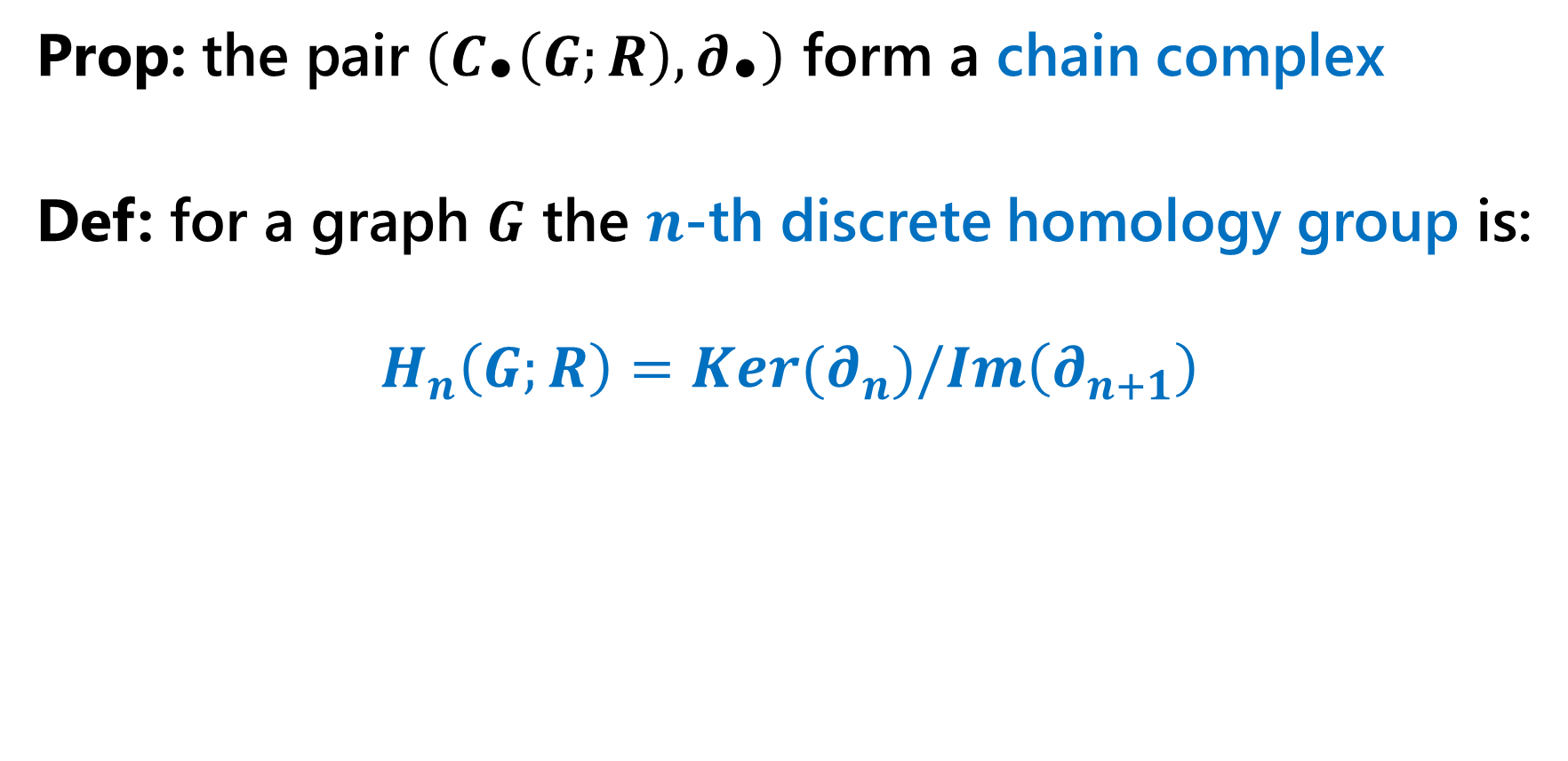
Discrete cubical homology
Prop: the pair $\left(C_{\text{•}}\left(G;R\right), ∂_{\text{•}}\right)$ form a chain complex
Def: for a graph $G$ the $n$-th discrete homology group is:
$$H_{n}\left(G;R\right)=Ker(∂_{n})/Im\left(∂_{n+1}\right)$$

Slide 22
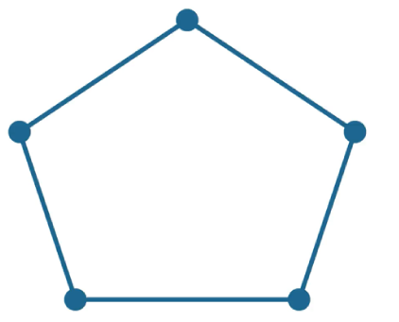
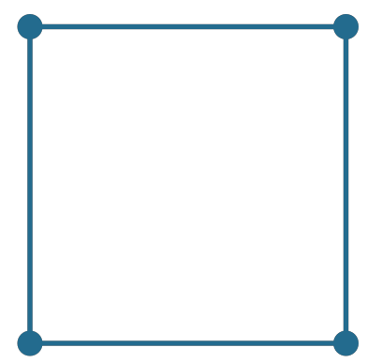
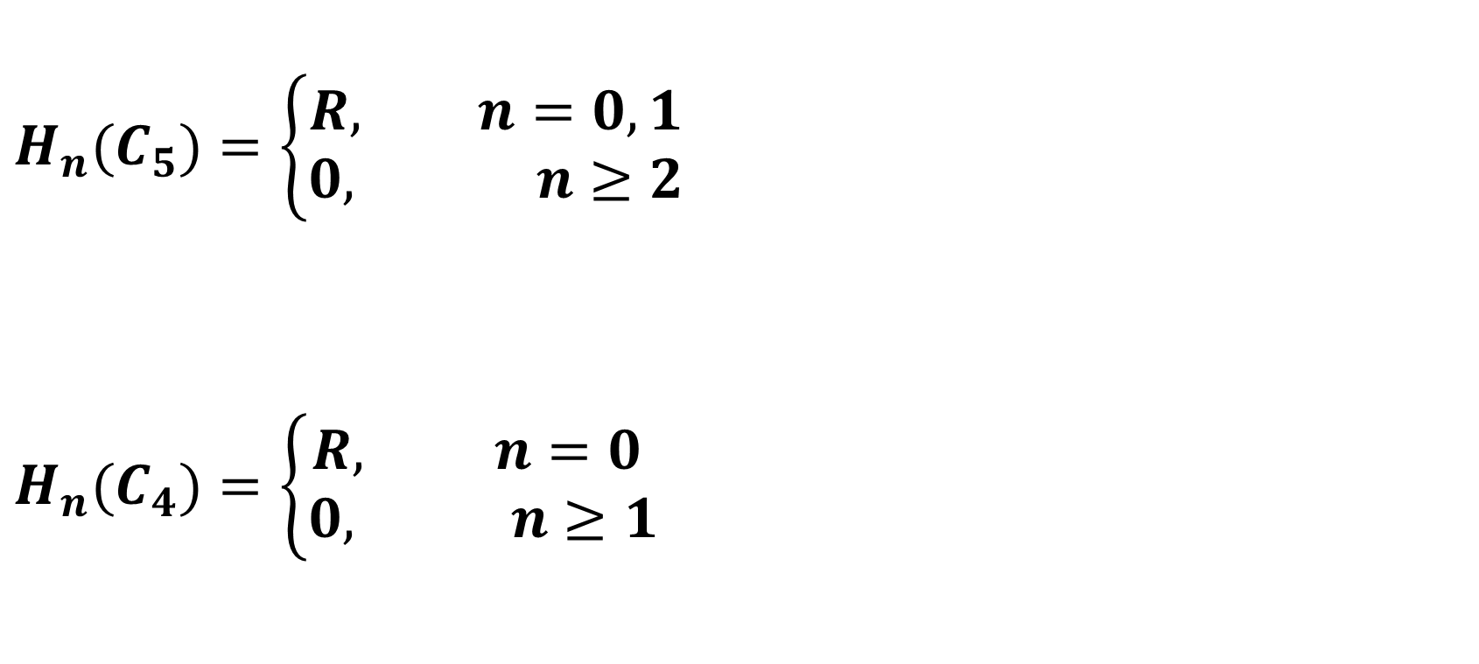
Discrete cubical homology
$$H_{n}(C_{5})=\left\{\begin{aligned}R, n=0,1 \\ &0, n≥2\end{aligned}\right.$$
$$H_{n}(C_{4})=\left\{\begin{aligned}R, n=0 \\ &0, n≥1\end{aligned}\right.$$

Slide 23
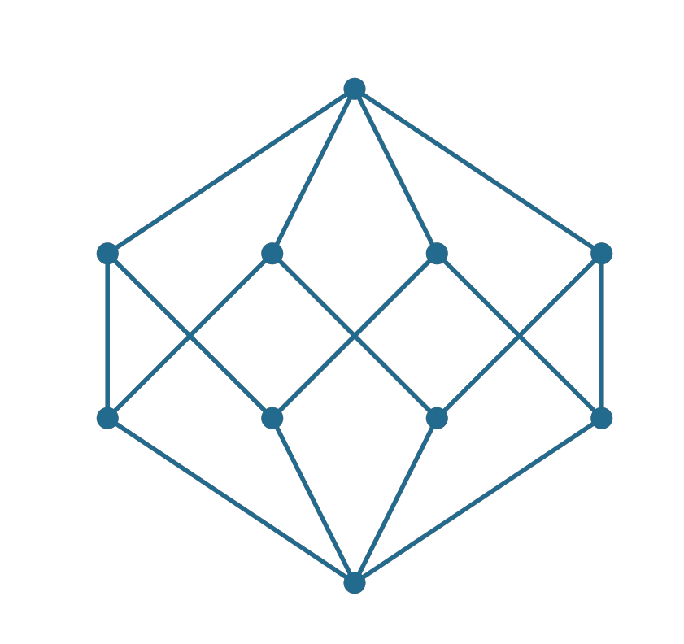
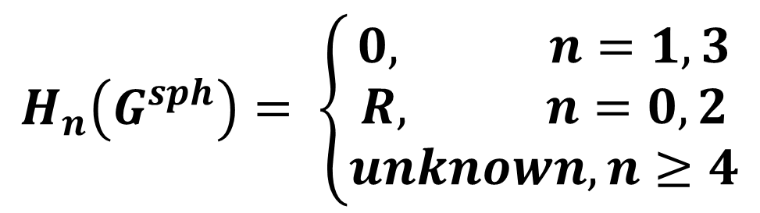
Discrete cubical homology
$$H_{n}\left(G^{sph}\right)= \left\{\begin{aligned}0, n=1,3 \\ R, n=0,2 \\ unknown, n≥4\end{aligned}\right.$$

Slide 24
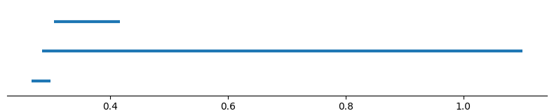
DCH vs Rips filtration
In the non-metric setting:
Simplicial homology
Discrete homology

Slide 25
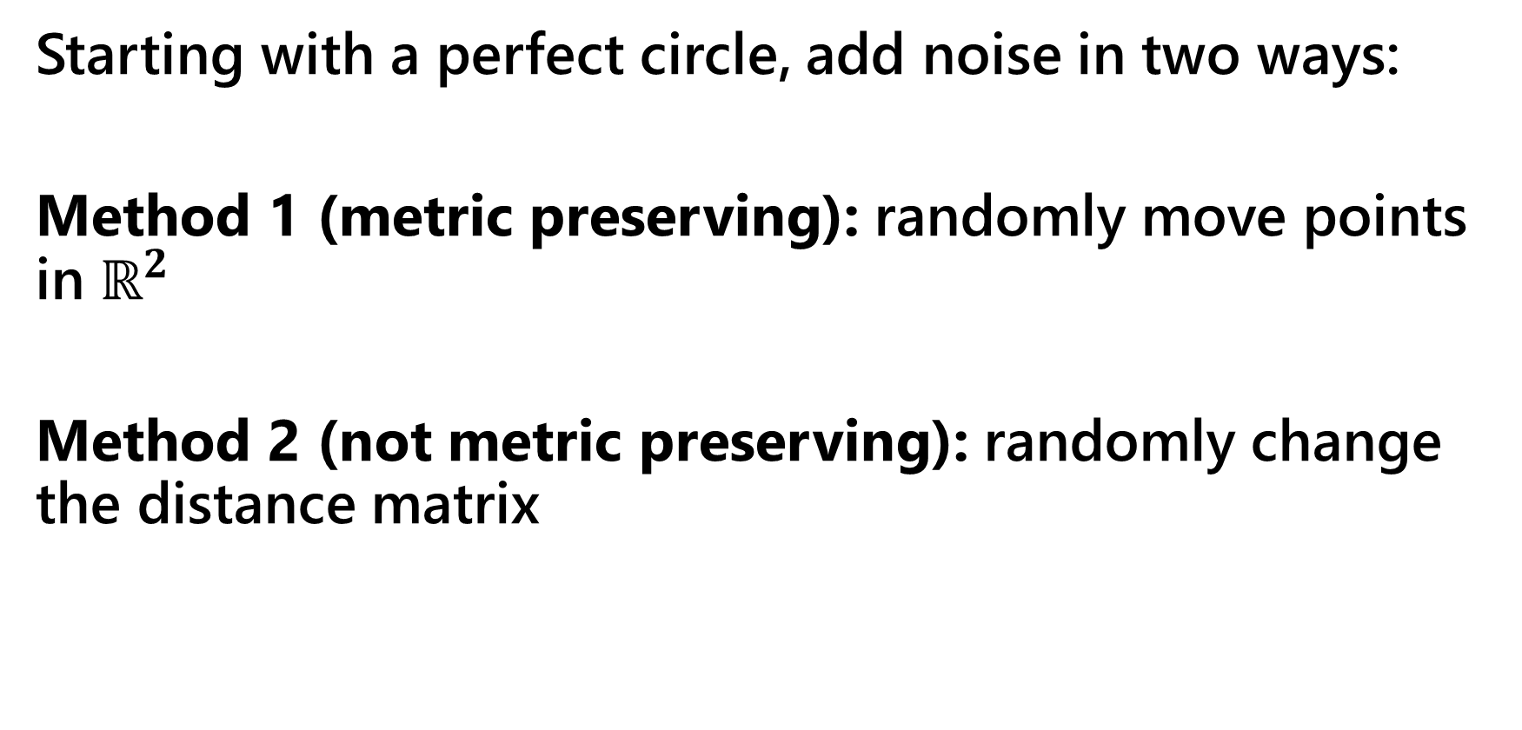
DCH vs Rips filtration
Starting with a perfect circle, add noise in two ways:
Method 1 (metric preserving): randomly move points in $ℝ^{2}$
Method 2 (not metric preserving): randomly change the distance matrix

Slide 26
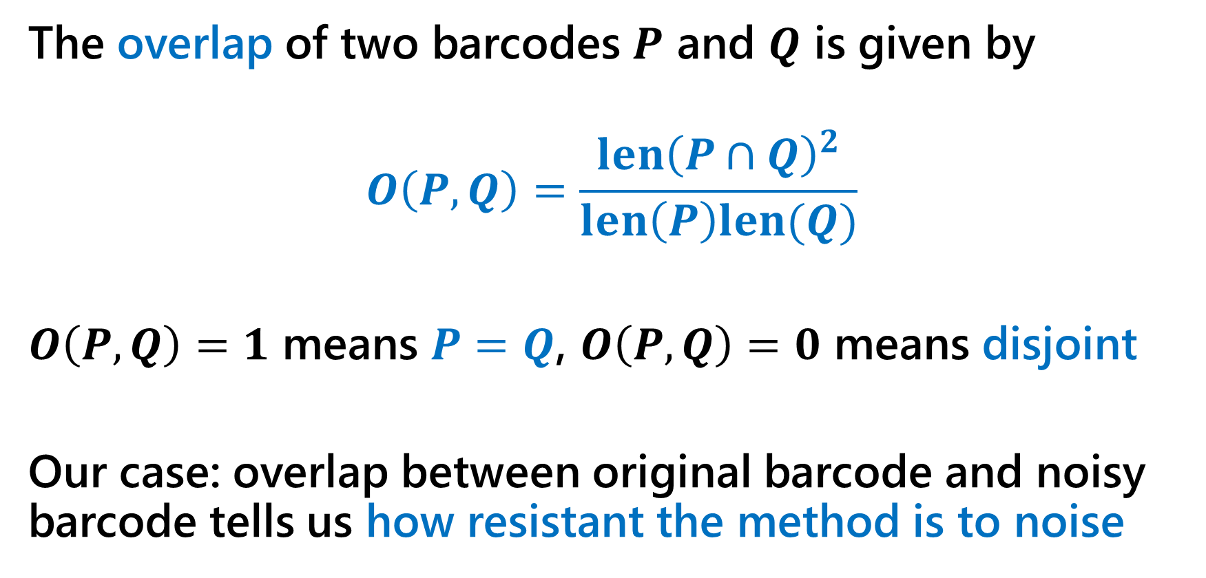
DCH vs Rips filtration
The overlap of two barcodes $P$ and $Q$ is given by
$$O\left(P,Q\right)=\frac{len{\left(P∩Q\right)}^{2}}{len\left(P\right)len(Q)}$$
$O\left(P,Q\right)=1$ means $P=Q$, $O\left(P,Q\right)=0$ means disjoint
Our case: overlap between original barcode and noisy barcode tells us how resistant the method is to noise

Slide 27
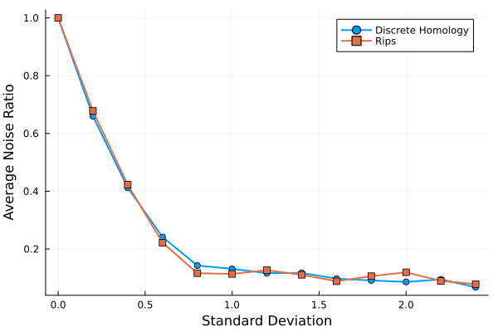
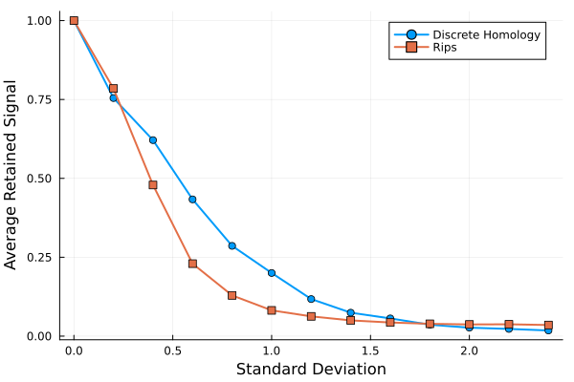
DCH vs Rips filtration
Method 1
Method 2

Slide 28
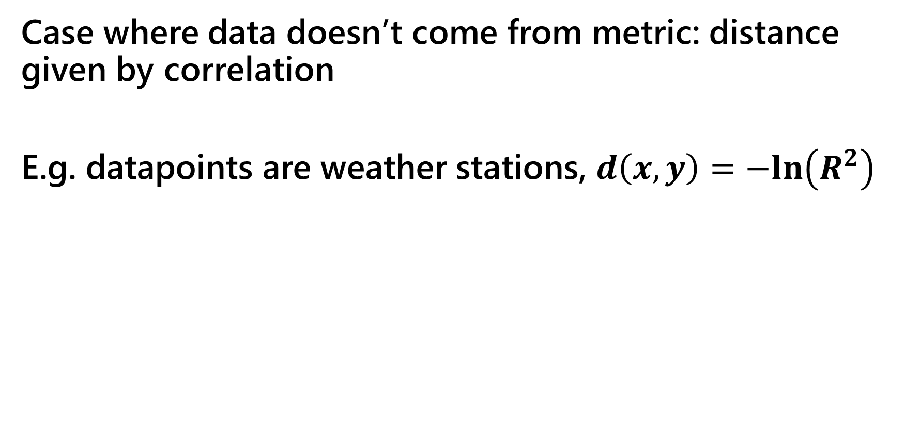
Results on data
Case where data doesn’t come from metric: distance given by correlation
E.g. datapoints are weather stations, $d\left(x,y\right)=−ln\left(R^{2}\right)$

Slide 29
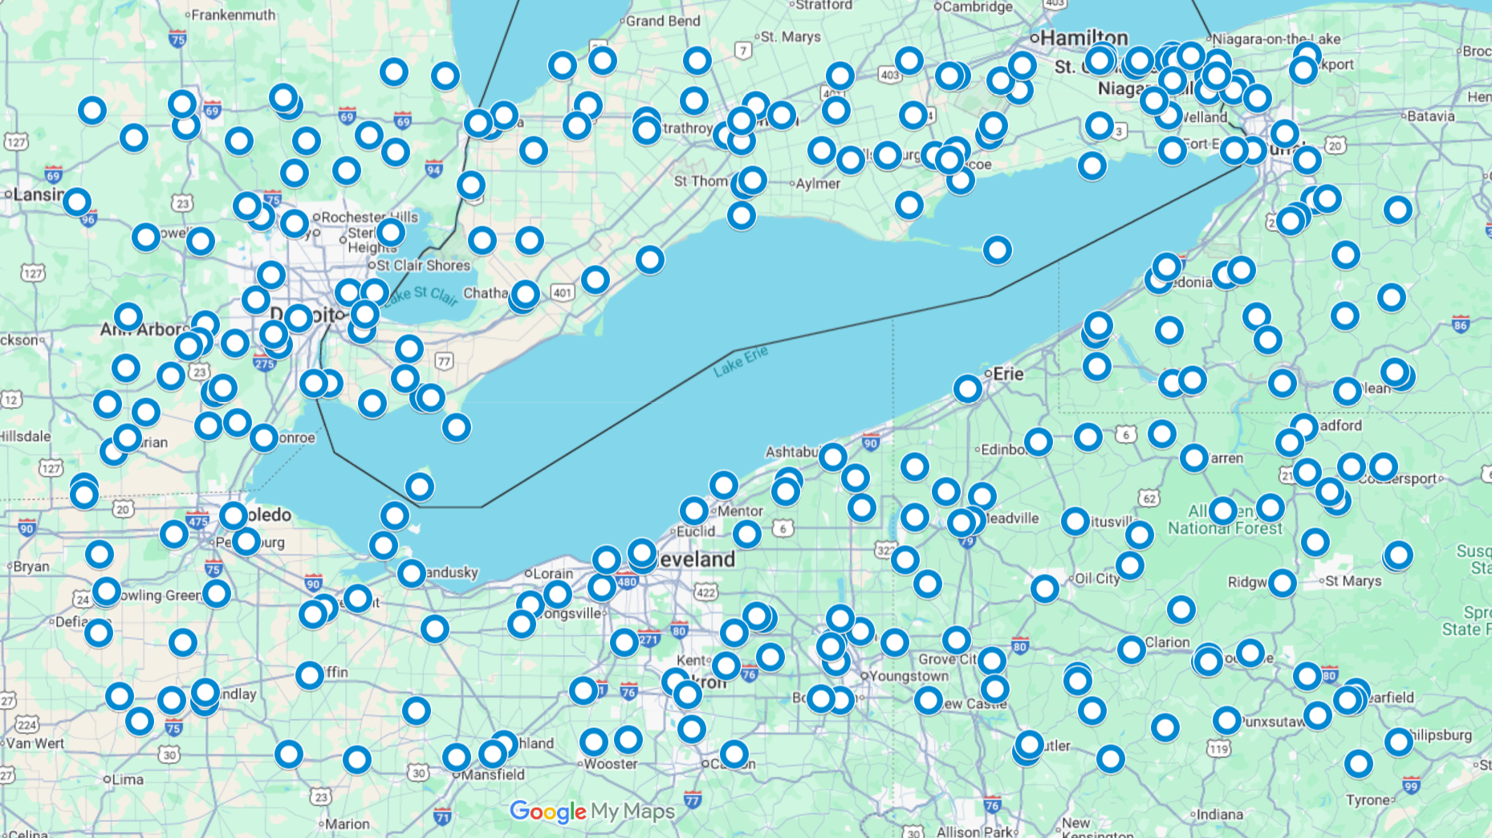
Results on data

Slide 30
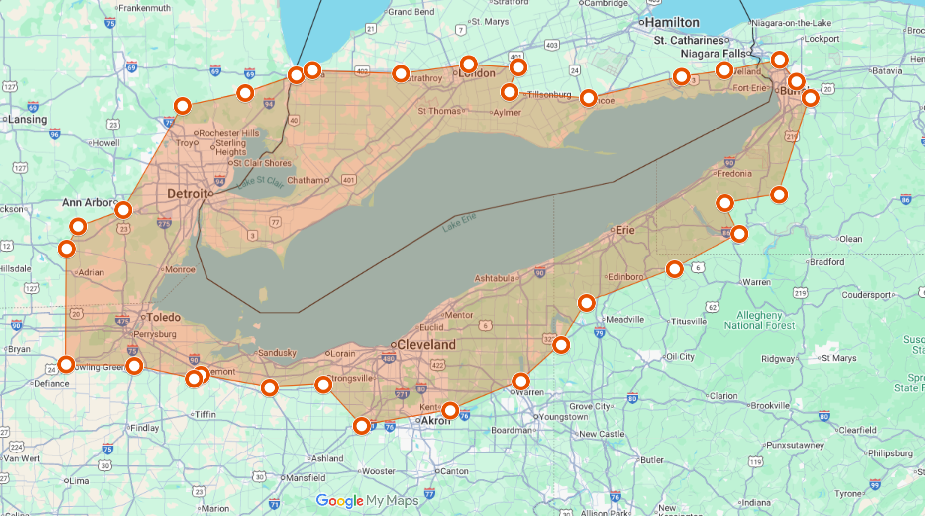
Results on data

Slide 31
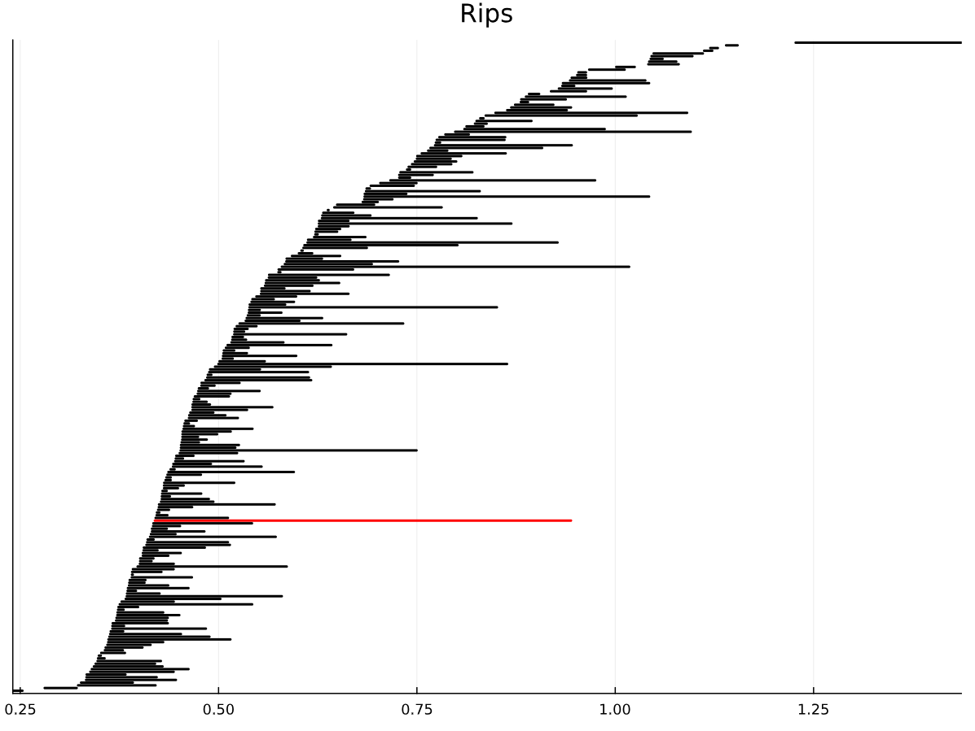
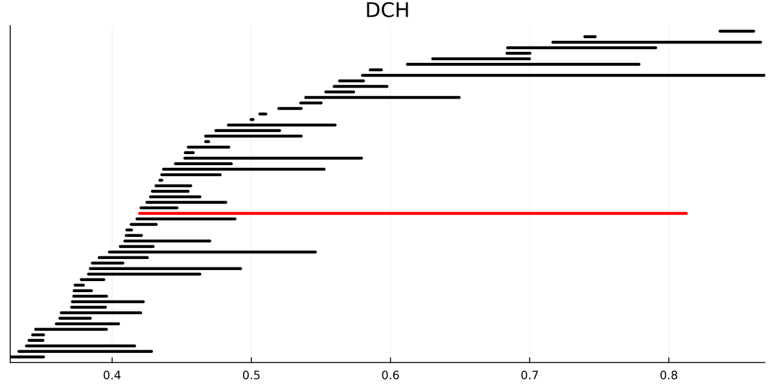
Results on data
Simplicial homology
Discrete homology

