Slide 1

Discrete Cubical Homology for Data Analysis
Nathan Kershaw
Joint with Chris Kapulkin
University of Western Ontario

Slide 2
References
Main reference:
C. Kapulkin and N. Kershaw, Data analysis using discrete cubical homology, 2025. https://arxiv.org/abs/2506.15020
Other references:
H. Barcelo, V. Capraro and J. A. White, Discrete homology theory for metric spaces, Bull. Lond. Math. Soc 46 (2014), no. 5, 889-905.
H. Barcelo, C. Greene, A. S. Jarrah, V. Welker, Discrete cubical and path homologies of graphs, Algebr. Comb. 2 (2019), no. 3, 417-437.
C. Kapulkin and N. Kershaw, Efficient computations of discrete cubical homology, 2024. arxiv.org/abs/2410.09939
Nathan Kershaw - Discrete homology for data analysis - University of Western Ontario
1

Slide 3

Discrete Cubical Homology
Topology:
Nathan Kershaw - Discrete homology for data analysis - University of Western Ontario
2

Slide 4
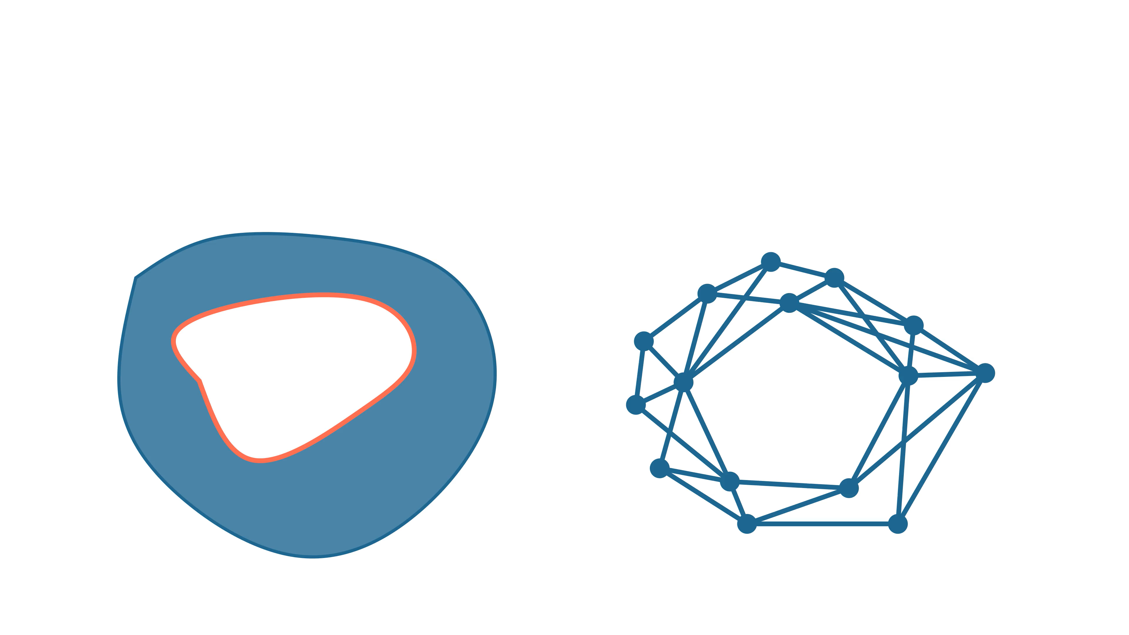
Discrete Cubical Homology
Topology:
Graphs:
Nathan Kershaw - Discrete homology for data analysis - University of Western Ontario
2

Slide 5
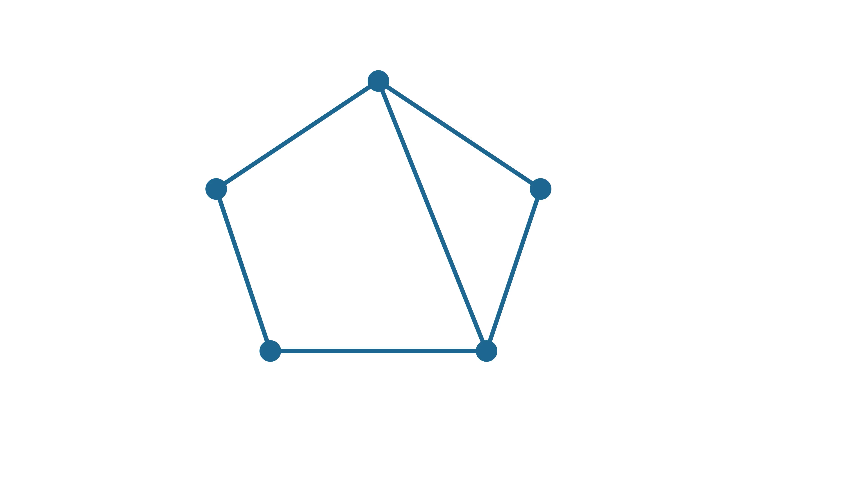
Discrete Cubical Homology
Def: a graph $G$ consists of a vertex set $G_{V}$ along with a symmetric reflexive relation $G_{E}⊆G_{V}×G_{V}$
Nathan Kershaw - Discrete homology for data analysis - University of Western Ontario
3

Slide 6
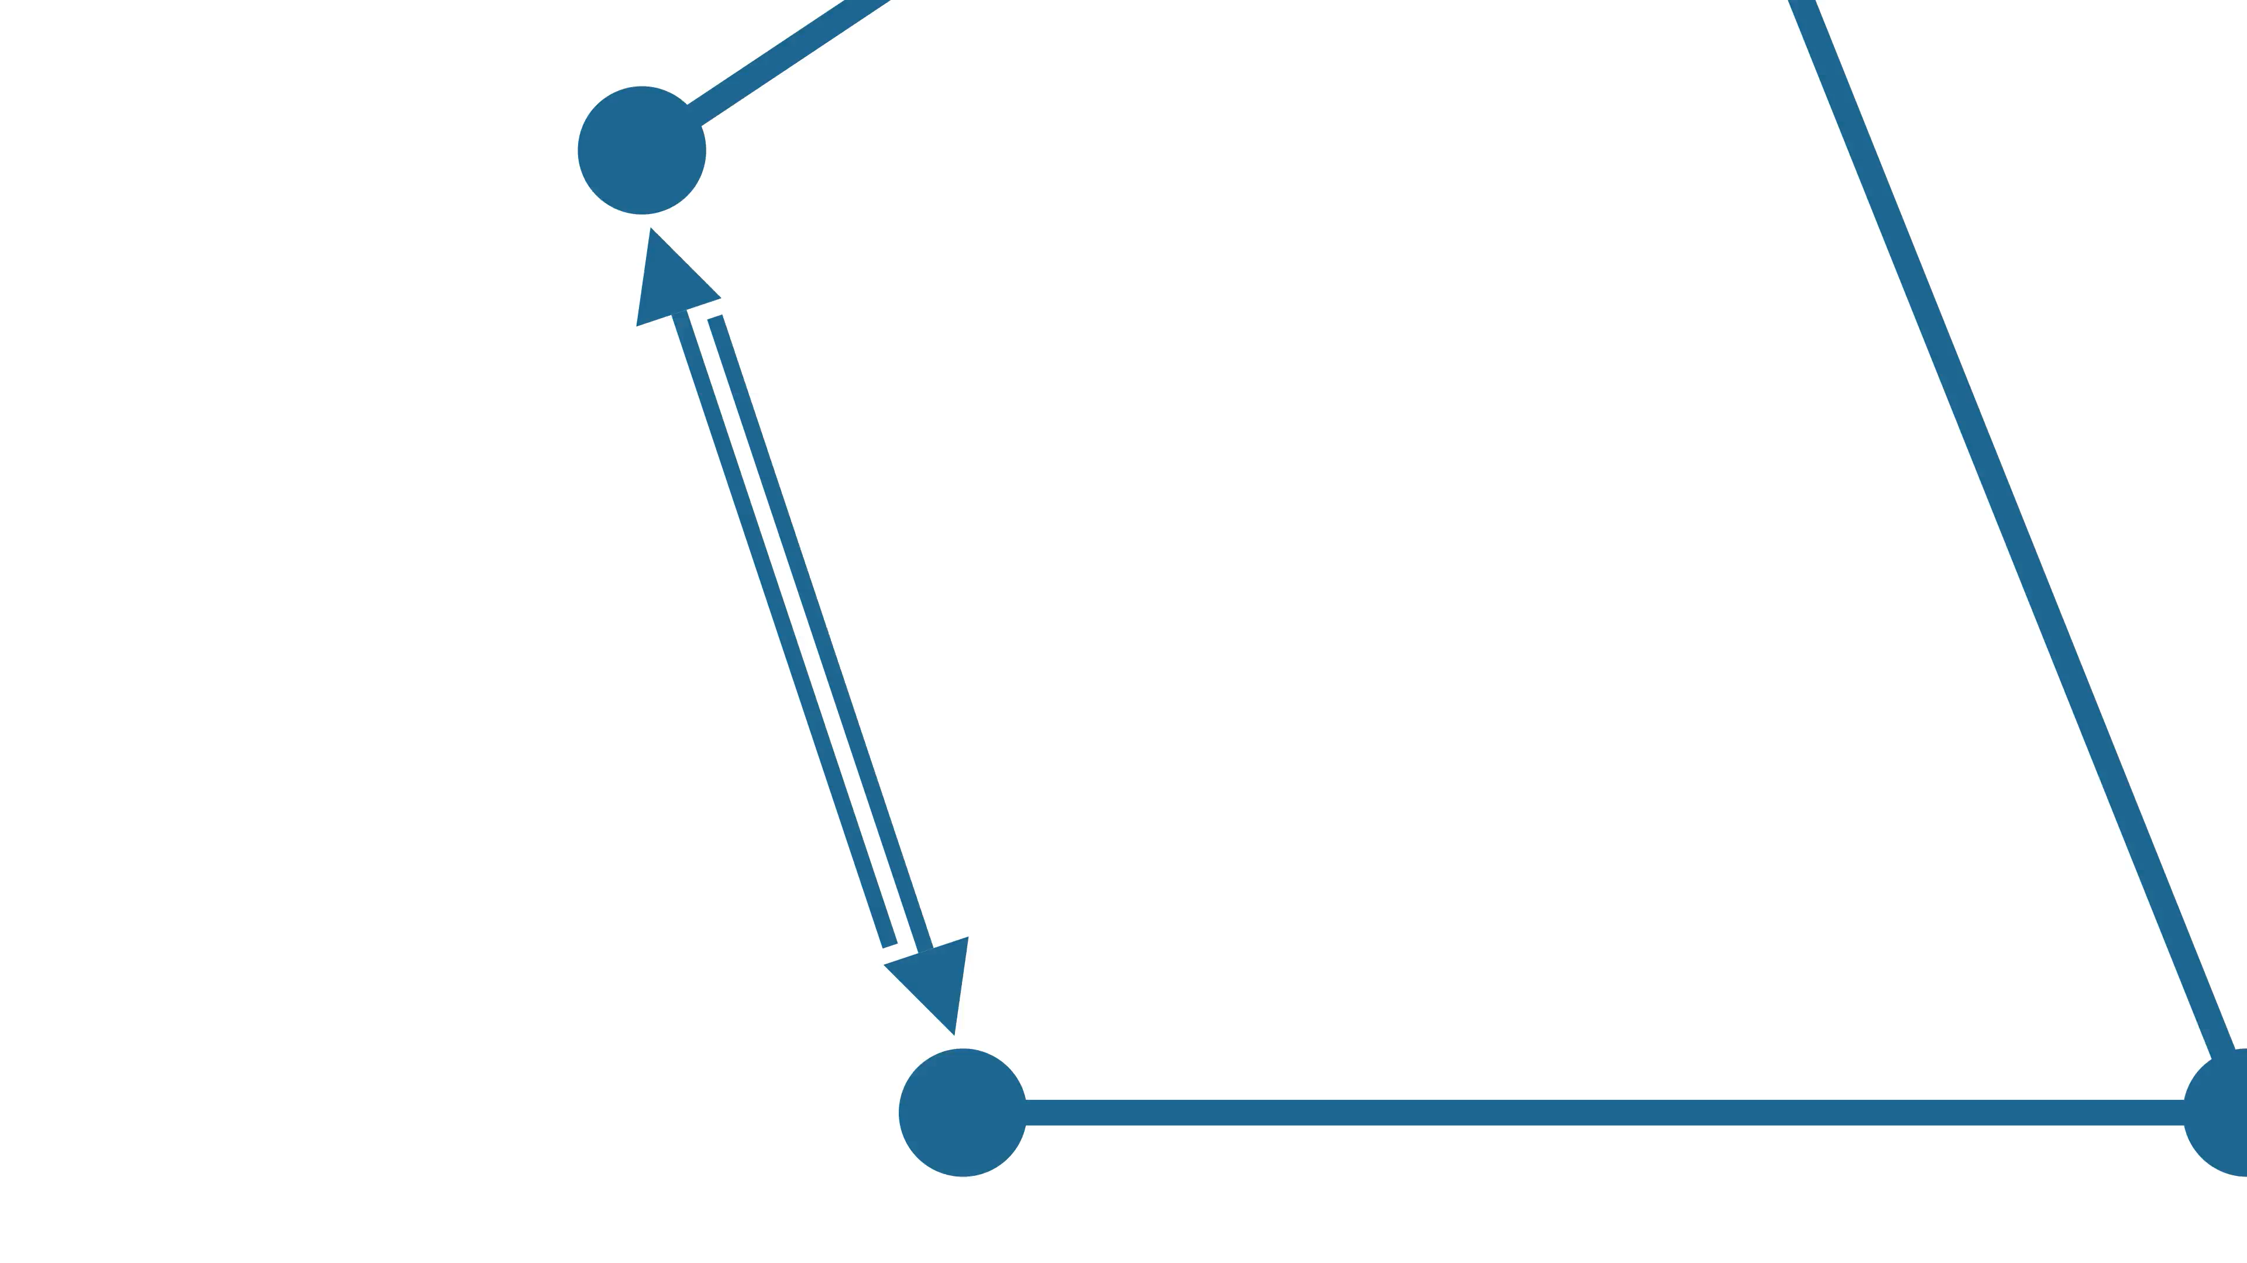
Discrete Cubical Homology
Def: a graph $G$ consists of a vertex set $G_{V}$ along with a symmetric reflexive relation $G_{E}⊆G_{V}×G_{V}$
Nathan Kershaw - Discrete homology for data analysis - University of Western Ontario
3

Slide 7
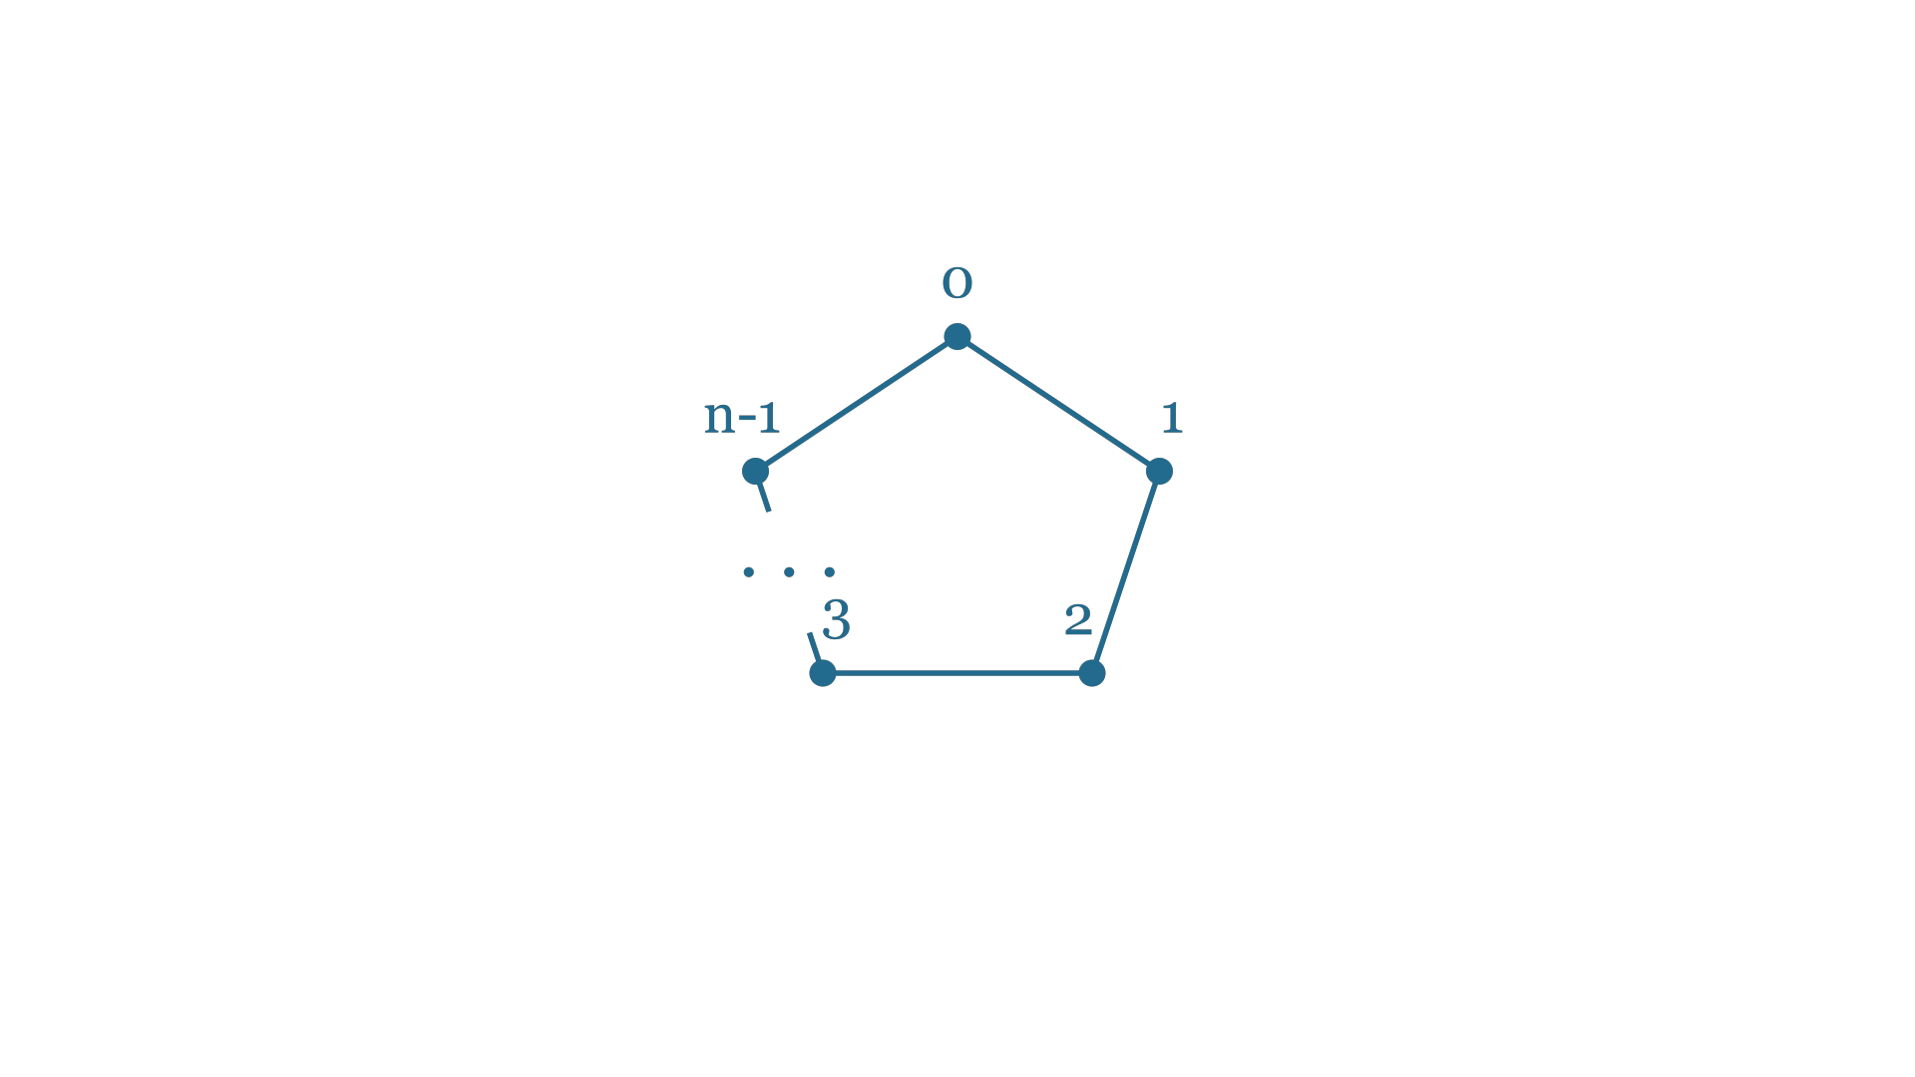
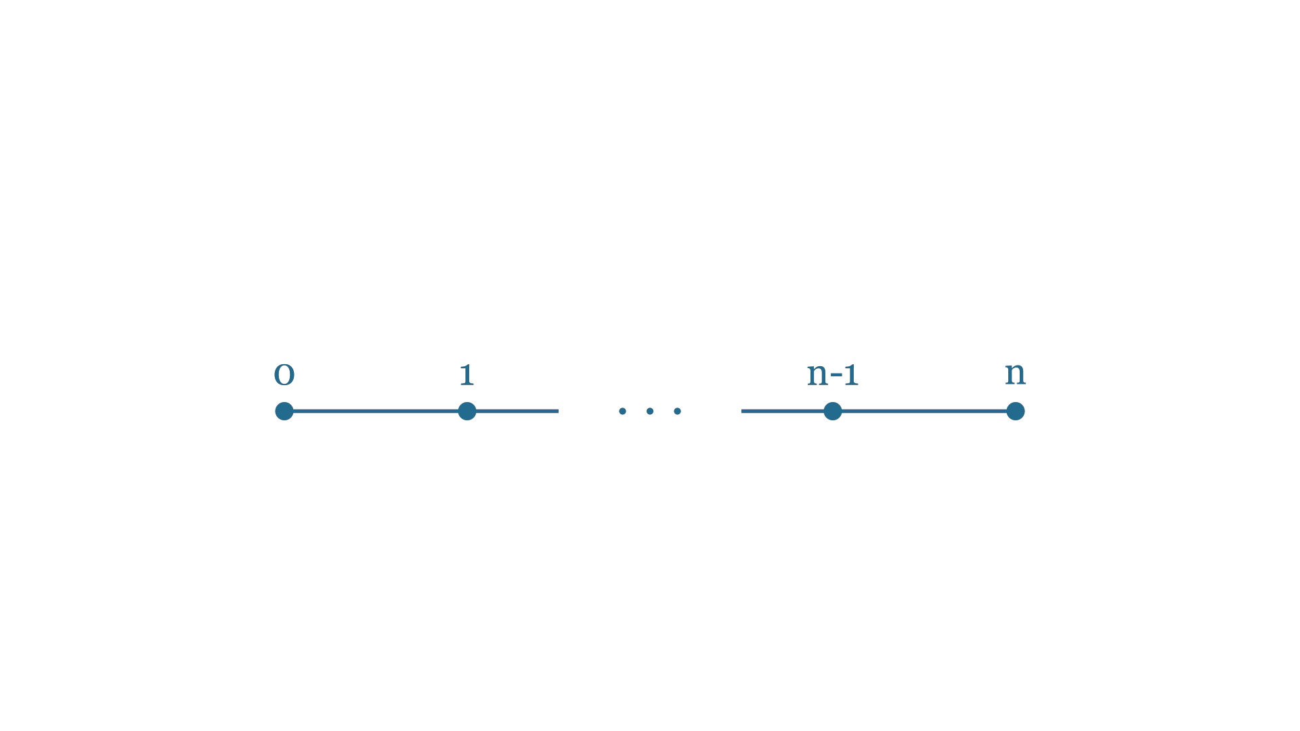
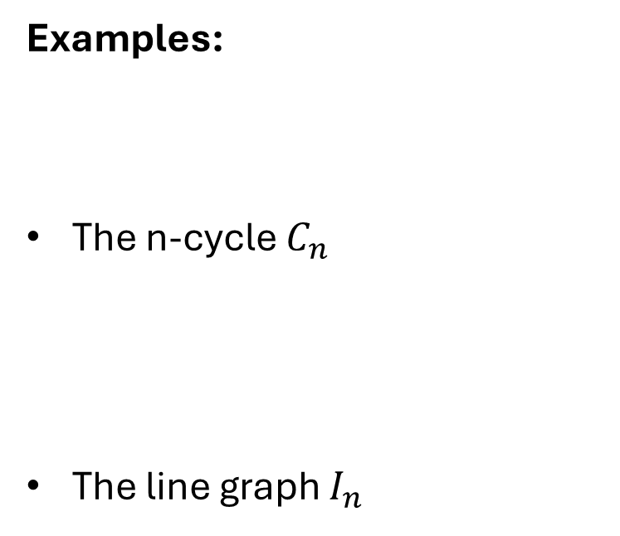
Discrete Cubical Homology
Examples:
The n-cycle $C_{n}$
The line graph $I_{n}$
Nathan Kershaw - Discrete homology for data analysis - University of Western Ontario
4

Slide 8
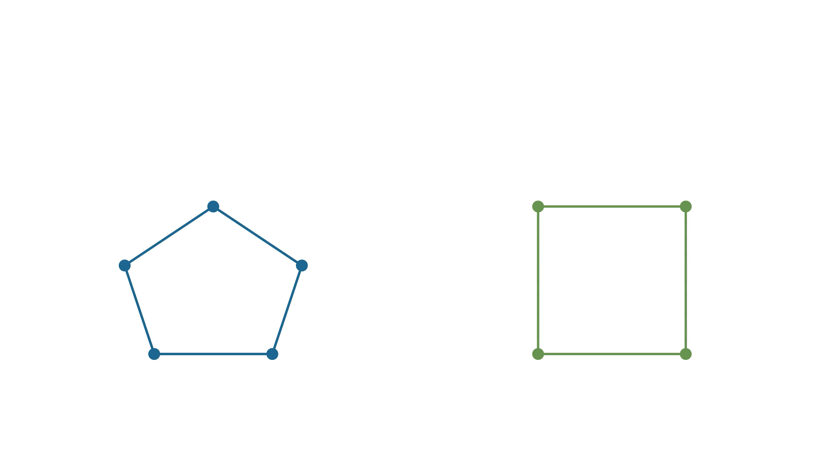
Discrete Cubical Homology
Def: a graph map $f : G \text{⟶} H$ is a function $f : G_{V} \text{⟶} H_{V}$ that preserves the edge relation
Nathan Kershaw - Discrete homology for data analysis - University of Western Ontario
5

Slide 9
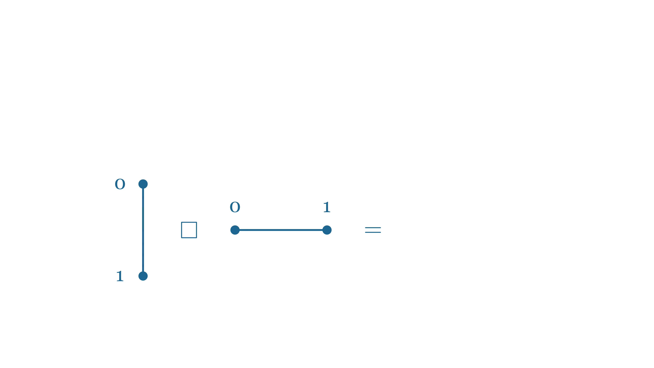
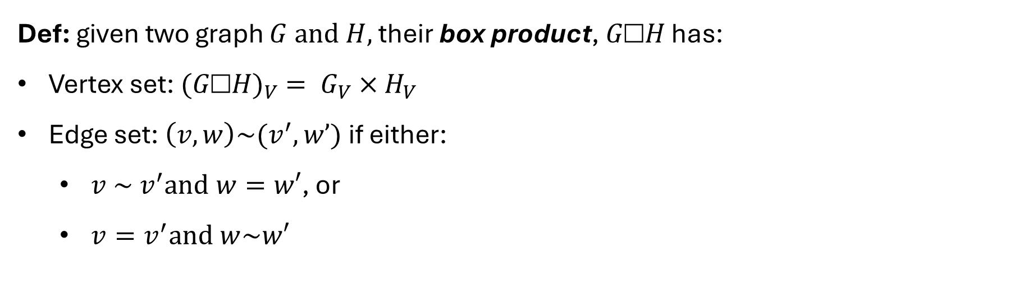
Discrete Cubical Homology
Def: given two graph $G and H,$ their box product, $G\text{□}H$ has:
Vertex set: ${(G\text{□}H)}_{V} = G_{V}×H_{V}$
Edge set: $\left(v,w\right)\sim (v^{′},w’)$ if either:
  $v \sim v^{′}and w=w′$, or
  $v=v^{′}and w\sim w′$
Nathan Kershaw - Discrete homology for data analysis - University of Western Ontario
6

Slide 10

Discrete Cubical Homology
Def: The discrete n-cube is $I_{1}^{n}$
Nathan Kershaw - Discrete homology for data analysis - University of Western Ontario
7

Slide 11
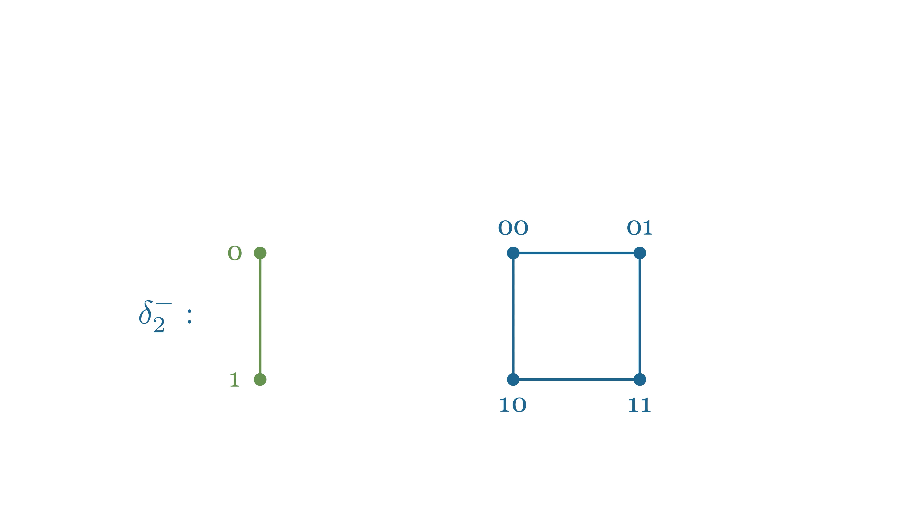
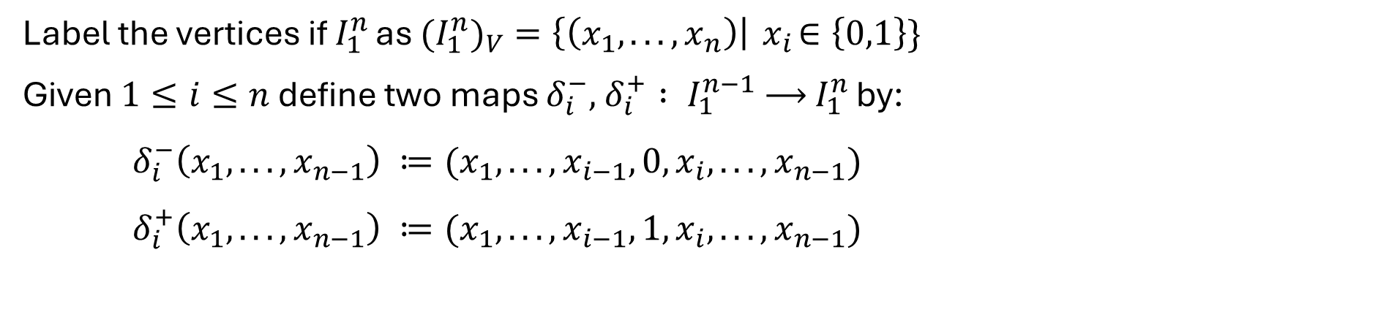
Discrete Cubical Homology
Label the vertices if $I_{1}^{n}$ as ${{(I}_{1}^{n})}_{V}=\left\{\left(x_{1}, . . . , x_{n}\right)\right|{ x}_{i}∈\left\{0,1\right\}\}$
Given $1≤i≤n$ define two maps $δ_{i}^{−},$ $δ_{i}^{+} : I_{1}^{n−1} \text{⟶} I_{1}^{n}$ by:
$δ_{i}^{−}\left(x_{1}, . . . , x_{n−1}\right) ≔(x_{1}, . . . , x_{i−1}, 0, x_{i}, . . . , x_{n−1})$
$δ_{i}^{+}\left(x_{1}, . . . , x_{n−1}\right) ≔(x_{1}, . . . , x_{i−1}, 1, x_{i}, . . . , x_{n−1})$
Nathan Kershaw - Discrete homology for data analysis - University of Western Ontario
8

Slide 12
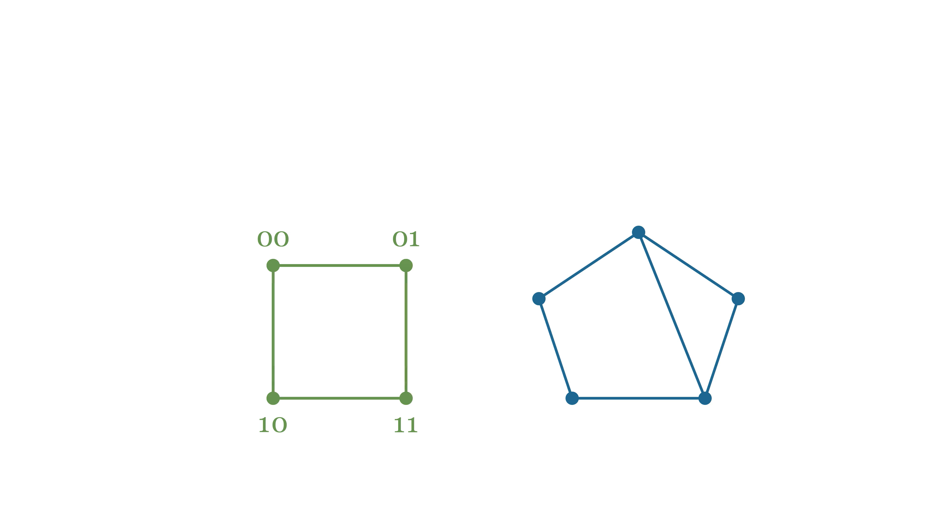
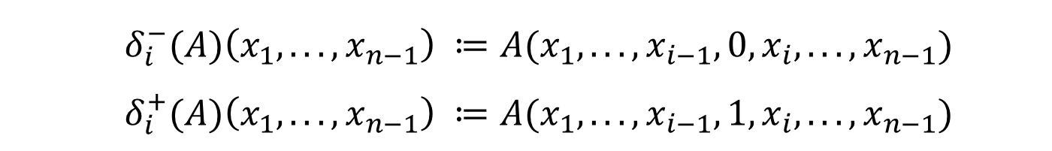
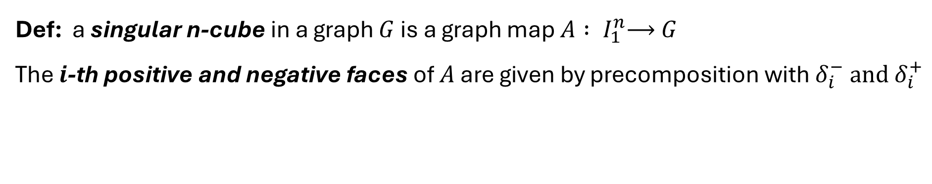
Discrete Cubical Homology
Def: a singular n-cube in a graph $G$ is a graph map $A : I_{1}^{n}\text{⟶} G$
The $i$-th positive and negative faces of $A$ are given by precomposition with $δ_{i}^{−} and$ $δ_{i}^{+}$
$δ_{i}^{−}(A)\left(x_{1}, . . . , x_{n−1}\right) ≔A(x_{1}, . . . , x_{i−1}, 0, x_{i}, . . . , x_{n−1})$
$δ_{i}^{+}(A)\left(x_{1}, . . . , x_{n−1}\right) ≔A(x_{1}, . . . , x_{i−1}, 1, x_{i}, . . . , x_{n−1})$
Nathan Kershaw - Discrete homology for data analysis - University of Western Ontario
9

Slide 13
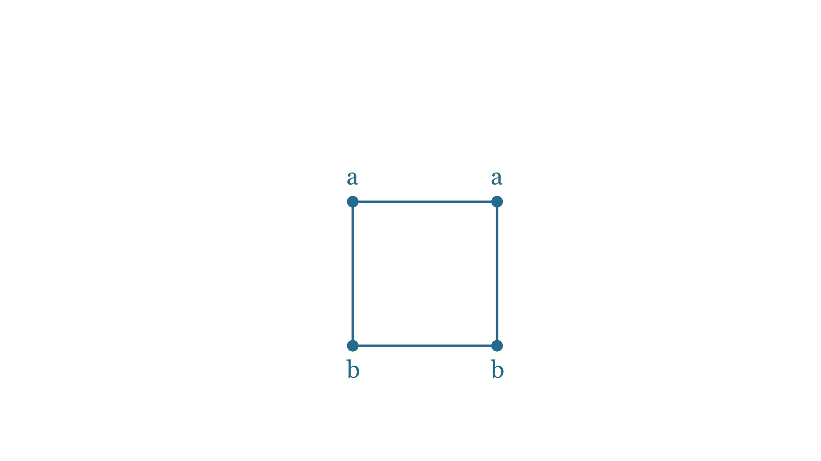
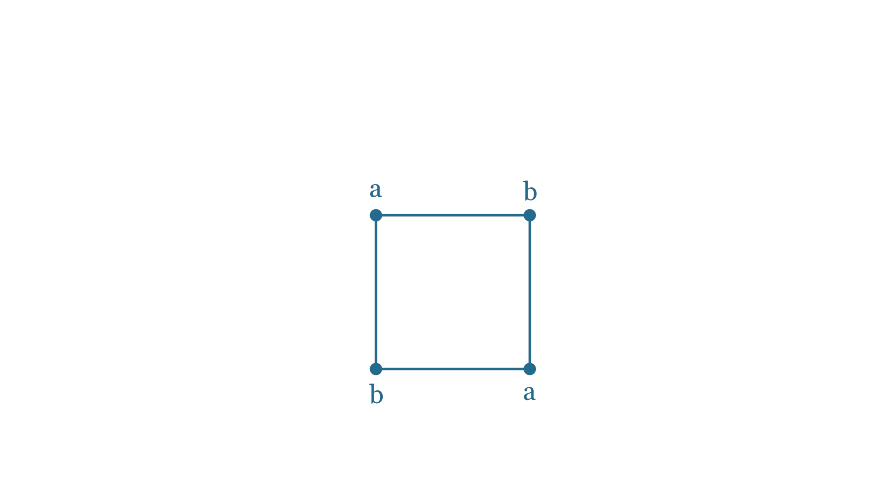
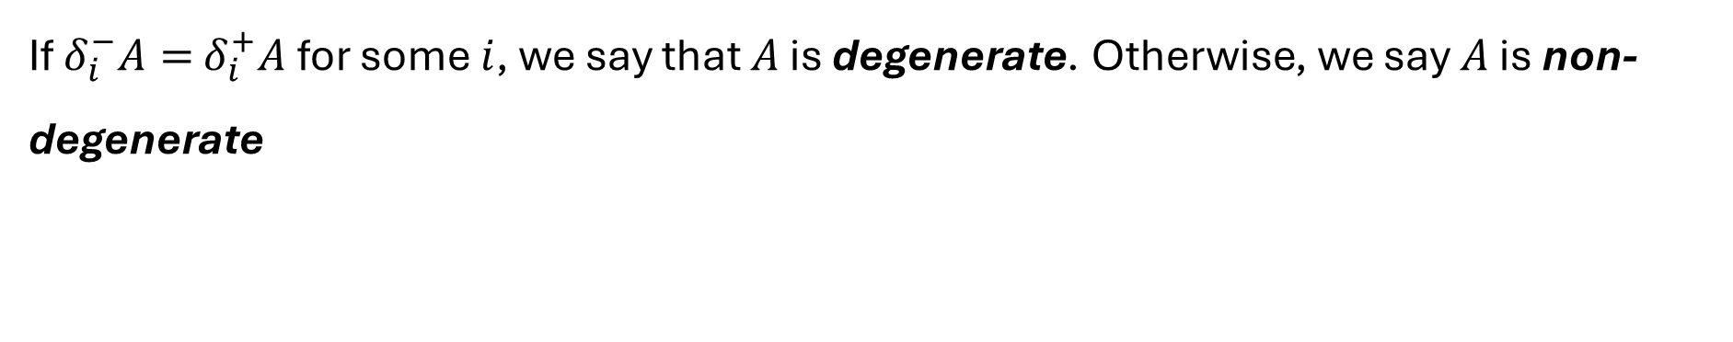
Discrete Cubical Homology
If $δ_{i}^{−}A=$ $δ_{i}^{+}A$ for some $i$, we say that $A$ is degenerate. Otherwise, we say $A$ is non-degenerate
Nathan Kershaw - Discrete homology for data analysis - University of Western Ontario
10

Slide 14
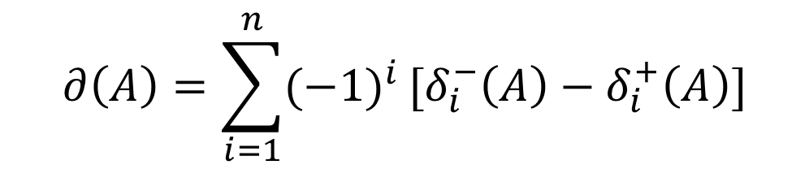
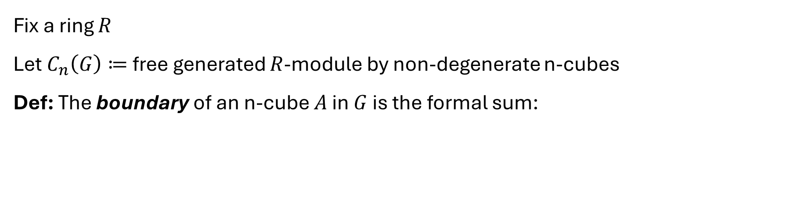
Discrete Cubical Homology
Fix a ring $R$
Let $C_{n}\left(G\right)≔$free generated $R$-module by non-degenerate n-cubes
Def: The boundary of an n-cube $A$ in $G$ is the formal sum:
$$∂\left(A\right)=\sum_{i=1}^{n}{(−1)^{i}}[δ_{i}^{−}\left(A\right)−δ_{i}^{+}\left(A\right)]$$
Prop: The pair $(C_{\text{•}}\left(G\right),∂_{\text{•}})$ form a valid chain complex
Nathan Kershaw - Discrete homology for data analysis - University of Western Ontario
11

Slide 15

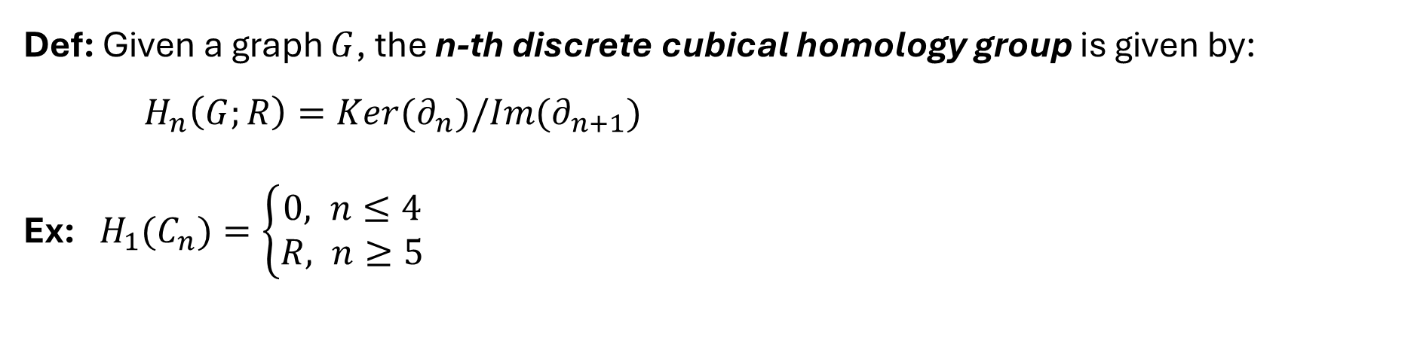
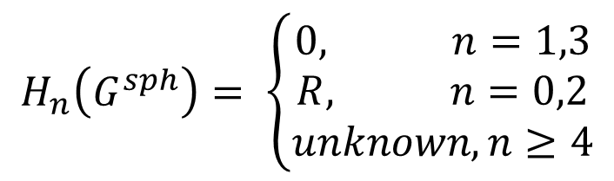
Discrete Cubical Homology
Def: Given a graph $G$, the n-th discrete cubical homology group is given by:
$H_{n}\left(G;R\right)=Ker(∂_{n})/Im(∂_{n+1})$
Ex: $H_{1}(C_{n})=\left\{\begin{aligned}0, n≤4 \\ &R, n≥5\end{aligned}\right.$
$$H_{n}\left(G^{sph}\right)= \left\{\begin{aligned}0, n=1,3 \\ R, n=0,2 \\ unknown, n≥4\end{aligned}\right.$$
Nathan Kershaw - Discrete homology for data analysis - University of Western Ontario
12

Slide 16
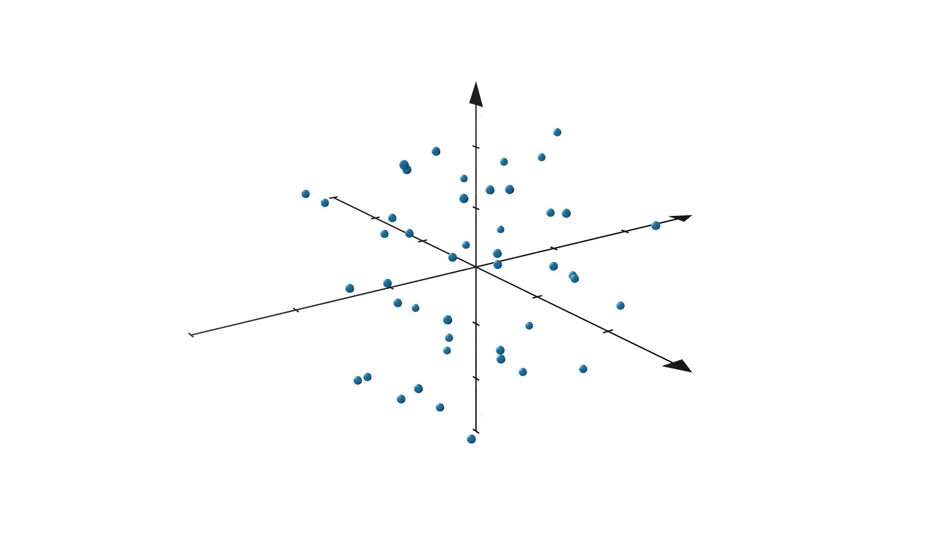
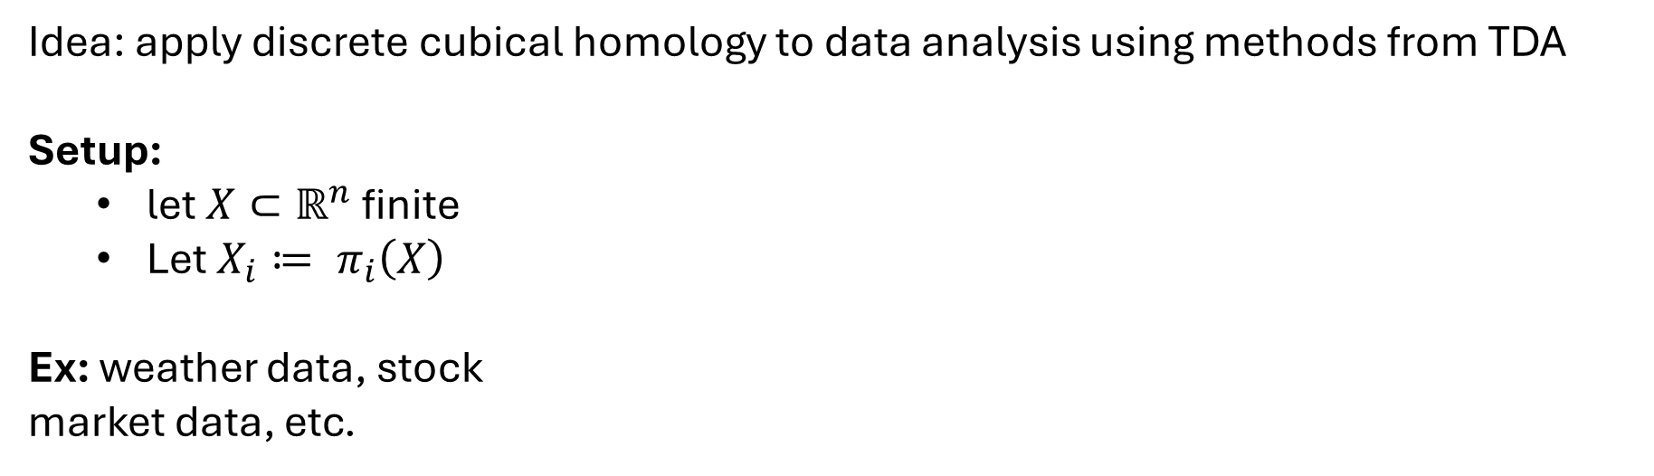
Applications to Data Analysis
Idea: apply discrete cubical homology to data analysis using methods from TDA
Setup:
  let $X⊂ℝ^{n}$ finite
  Let $X_{i}≔ π_{i}\left(X\right)$
Ex: weather data, stock
market data, etc.
Nathan Kershaw - Discrete homology for data analysis - University of Western Ontario
13

Slide 17
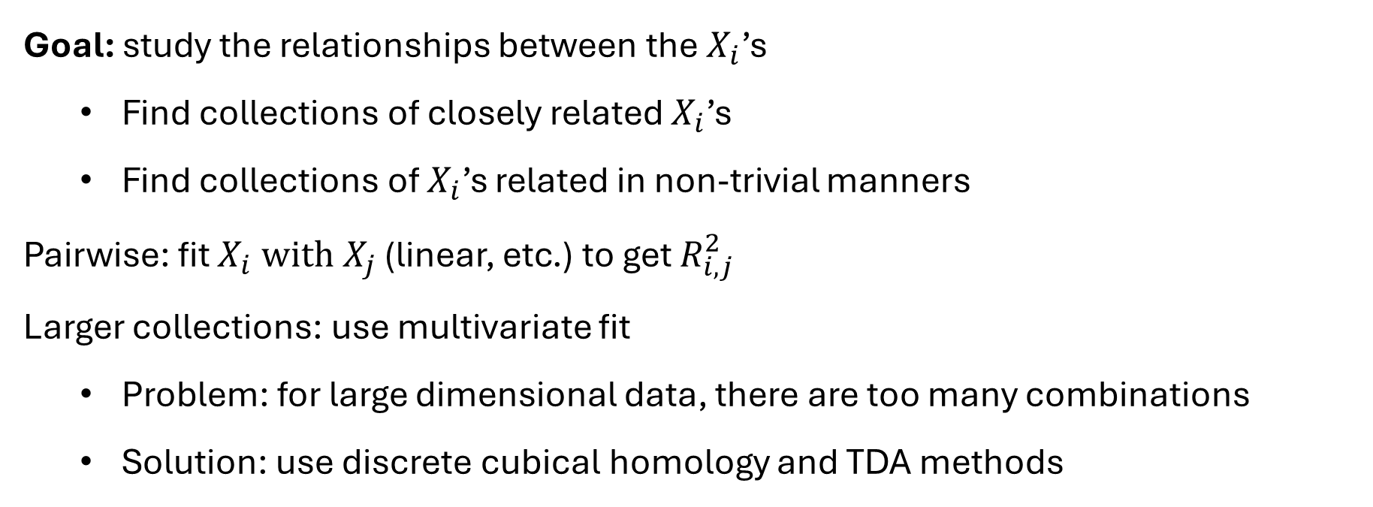
Applications to Data Analysis
Goal: study the relationships between the${ X}_{i}$’s
  Find collections of closely related $X_{i}$’s
  Find collections of $X_{i}$’s related in non-trivial manners
Pairwise: fit $X_{i} with X_{j}$ (linear, etc.) to get $R_{i,j}^{2}$
Larger collections: use multivariate fit
  Problem: for large dimensional data, there are too many combinations
  Solution: use discrete cubical homology and TDA methods
Nathan Kershaw - Discrete homology for data analysis - University of Western Ontario
14

Slide 18
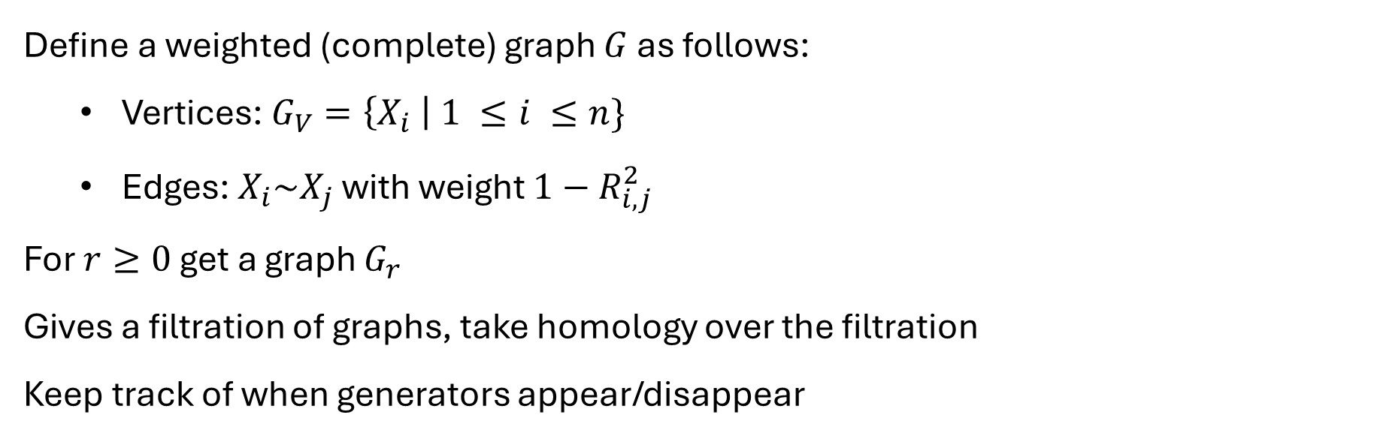
Applications to Data Analysis
Define a weighted (complete) graph $G$ as follows:
  Vertices: $G_{V}=\left\{X_{i} \right| 1 ≤i ≤n\}$
  Edges: $X_{i}\sim X_{j}$ with weight $1−R_{i,j}^{2}$
For $r≥0$ get a graph $G_{r}$
Gives a filtration of graphs, take homology over the filtration
Keep track of when generators appear/disappear
Nathan Kershaw - Discrete homology for data analysis - University of Western Ontario
15

Slide 19
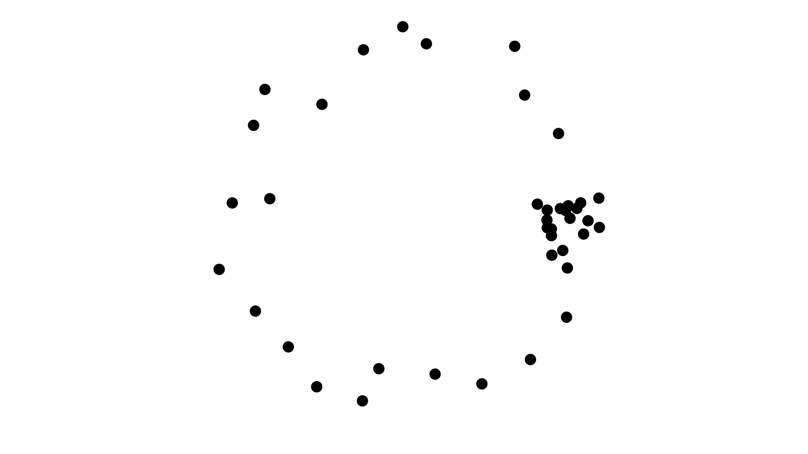
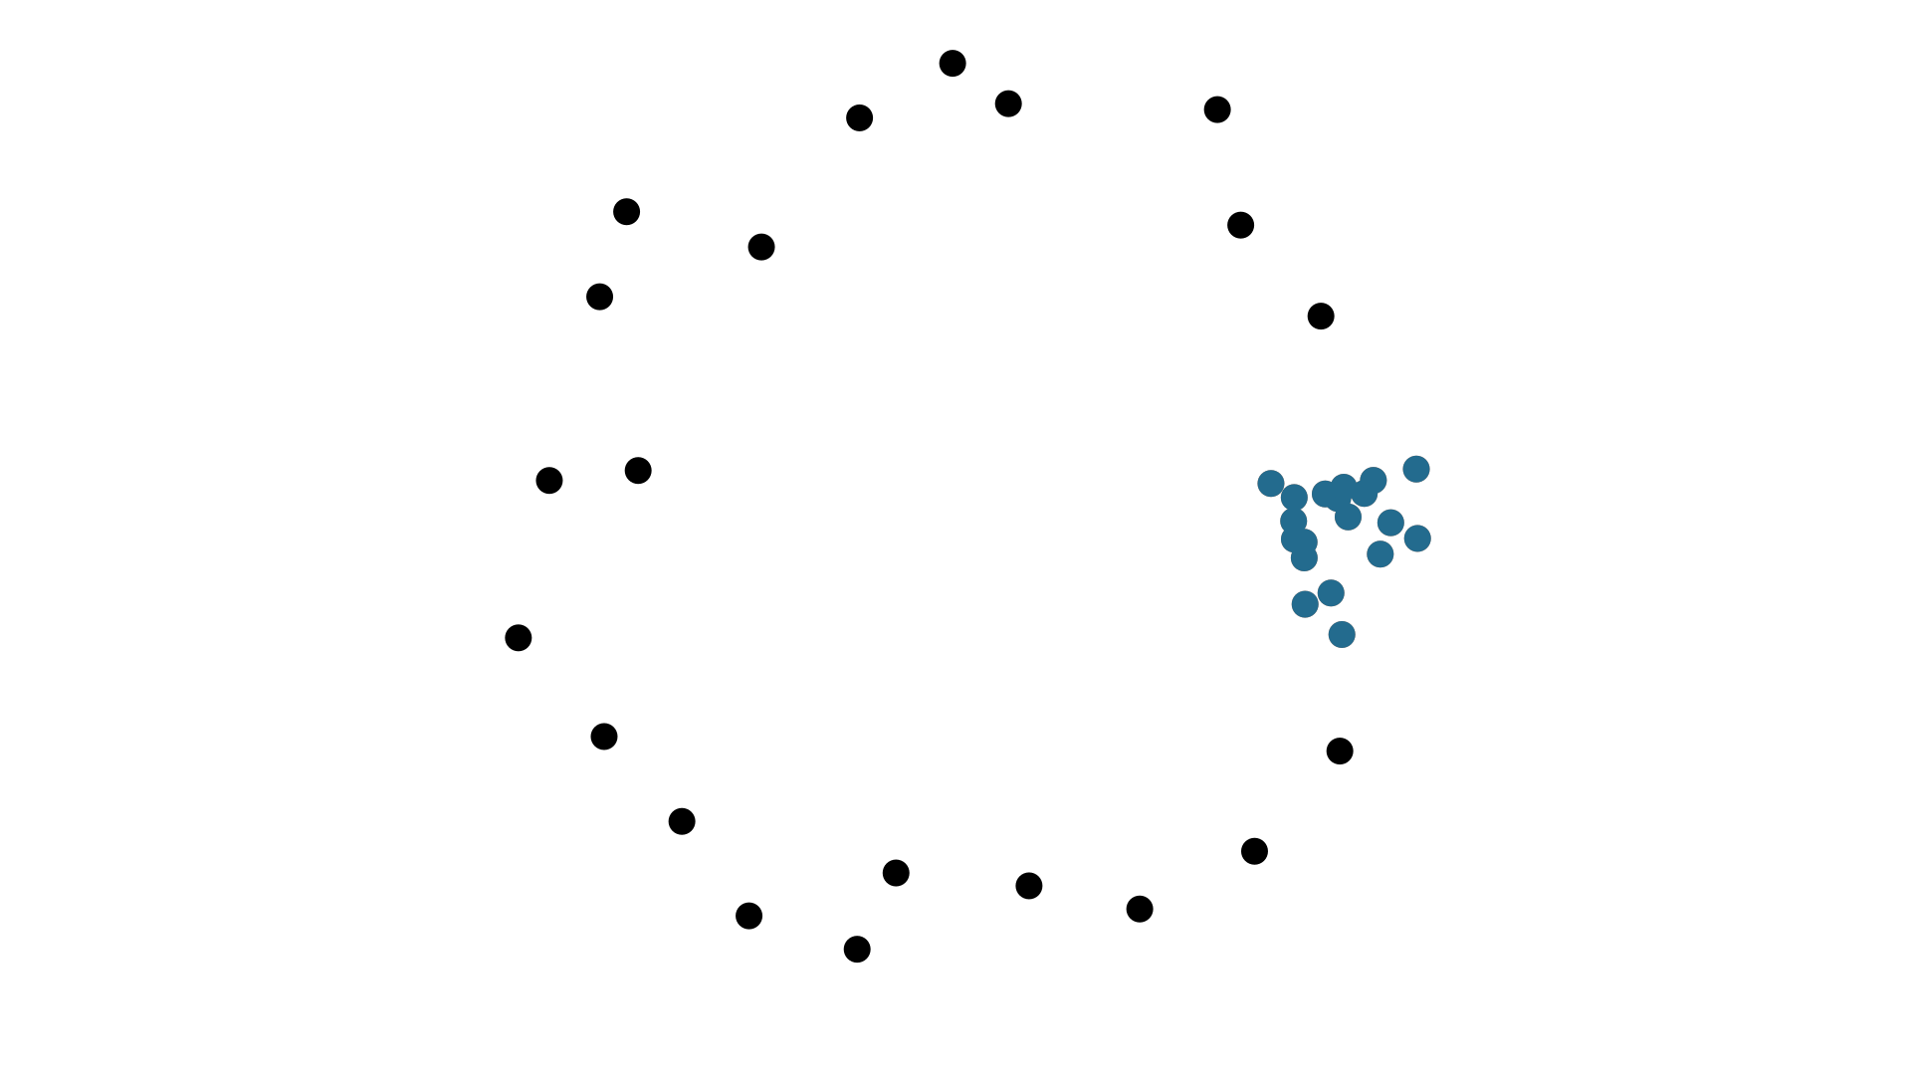
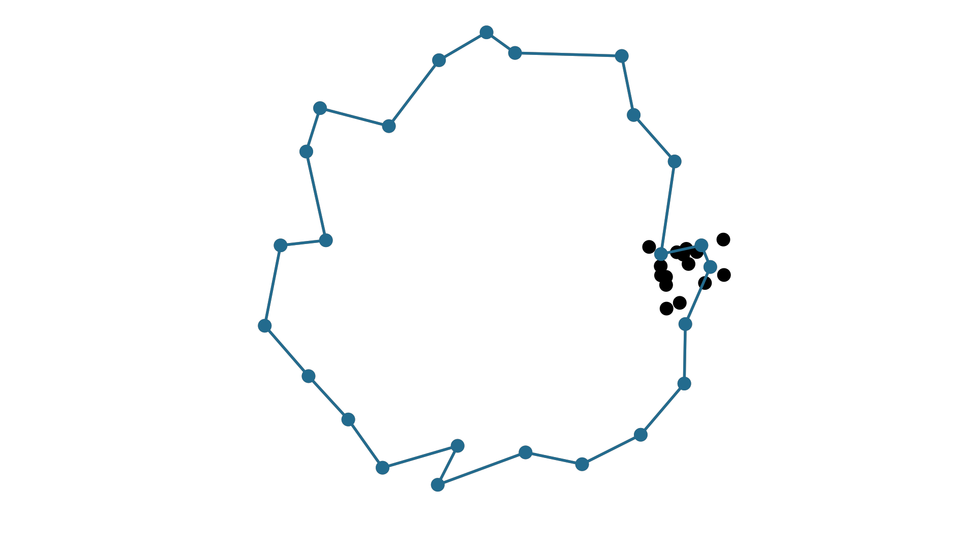
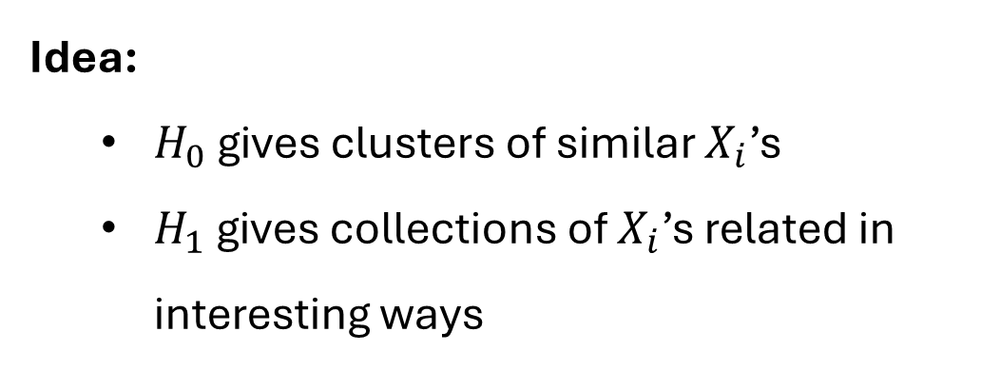
Applications to Data Analysis
Idea:
  $H_{0}$ gives clusters of similar $X_{i}$’s
  $H_{1}$ gives collections of $X_{i}$’s related in interesting ways
Nathan Kershaw - Discrete homology for data analysis - University of Western Ontario
15

Slide 20
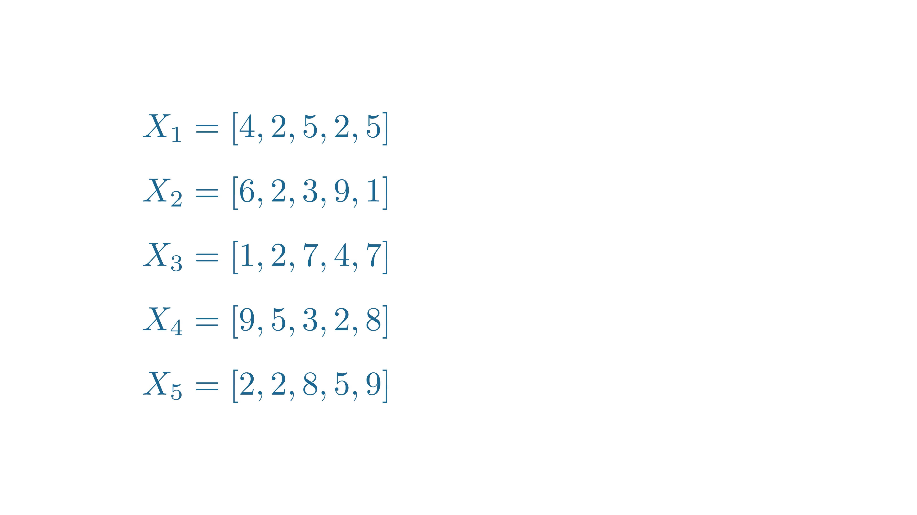
Applications to Data Analysis
Nathan Kershaw - Discrete homology for data analysis - University of Western Ontario
16

Slide 21
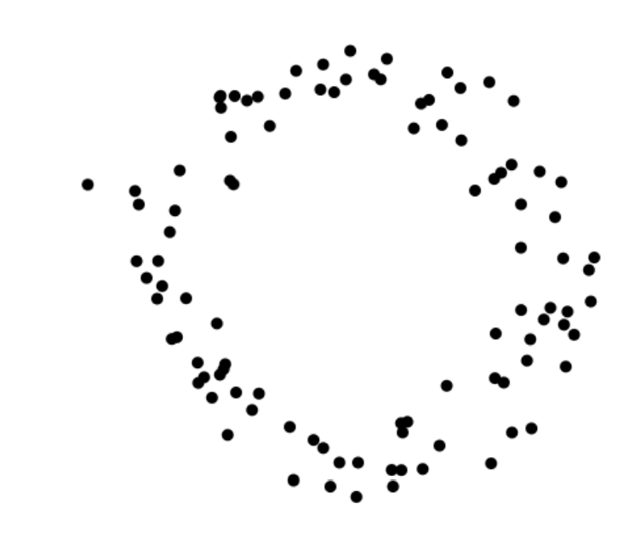
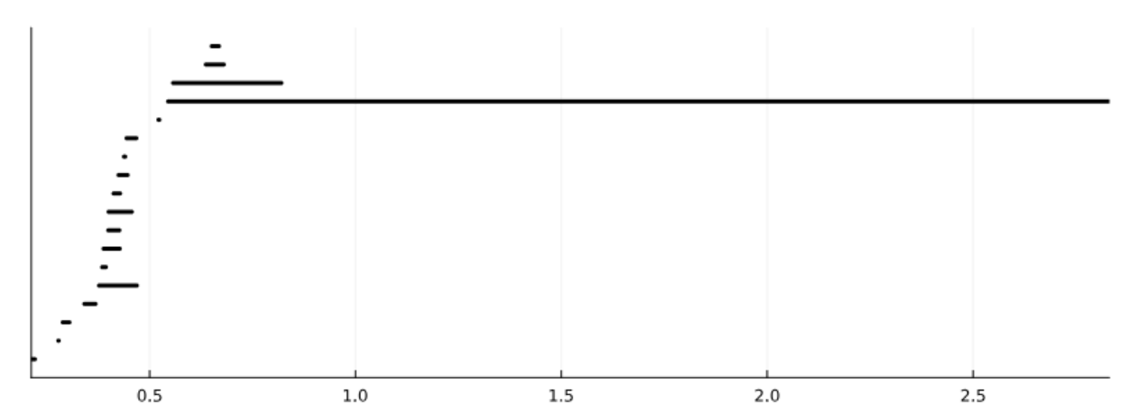
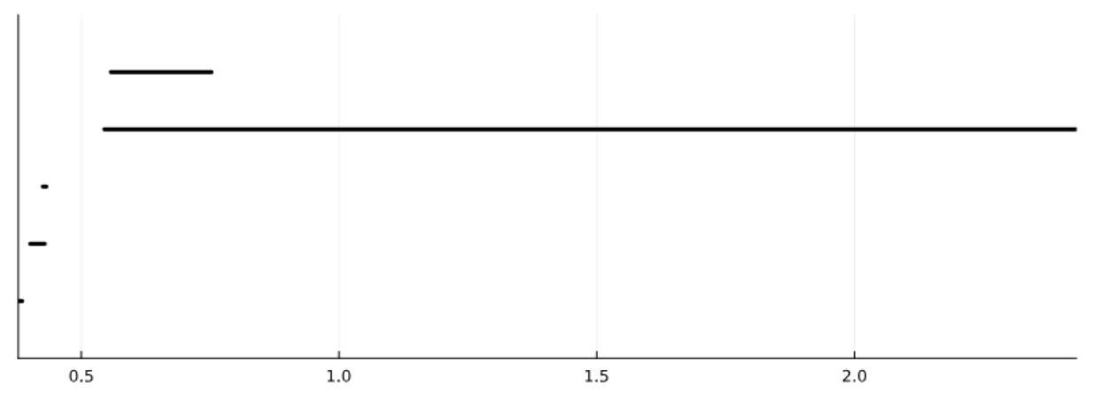
Why discrete homology?
Discrete homology gives cleaner barcodes than usual TDA methods (clique complex)
Barcode using clique complex
Barcode using discrete homology
Nathan Kershaw - Discrete homology for data analysis - University of Western Ontario
17

Slide 22
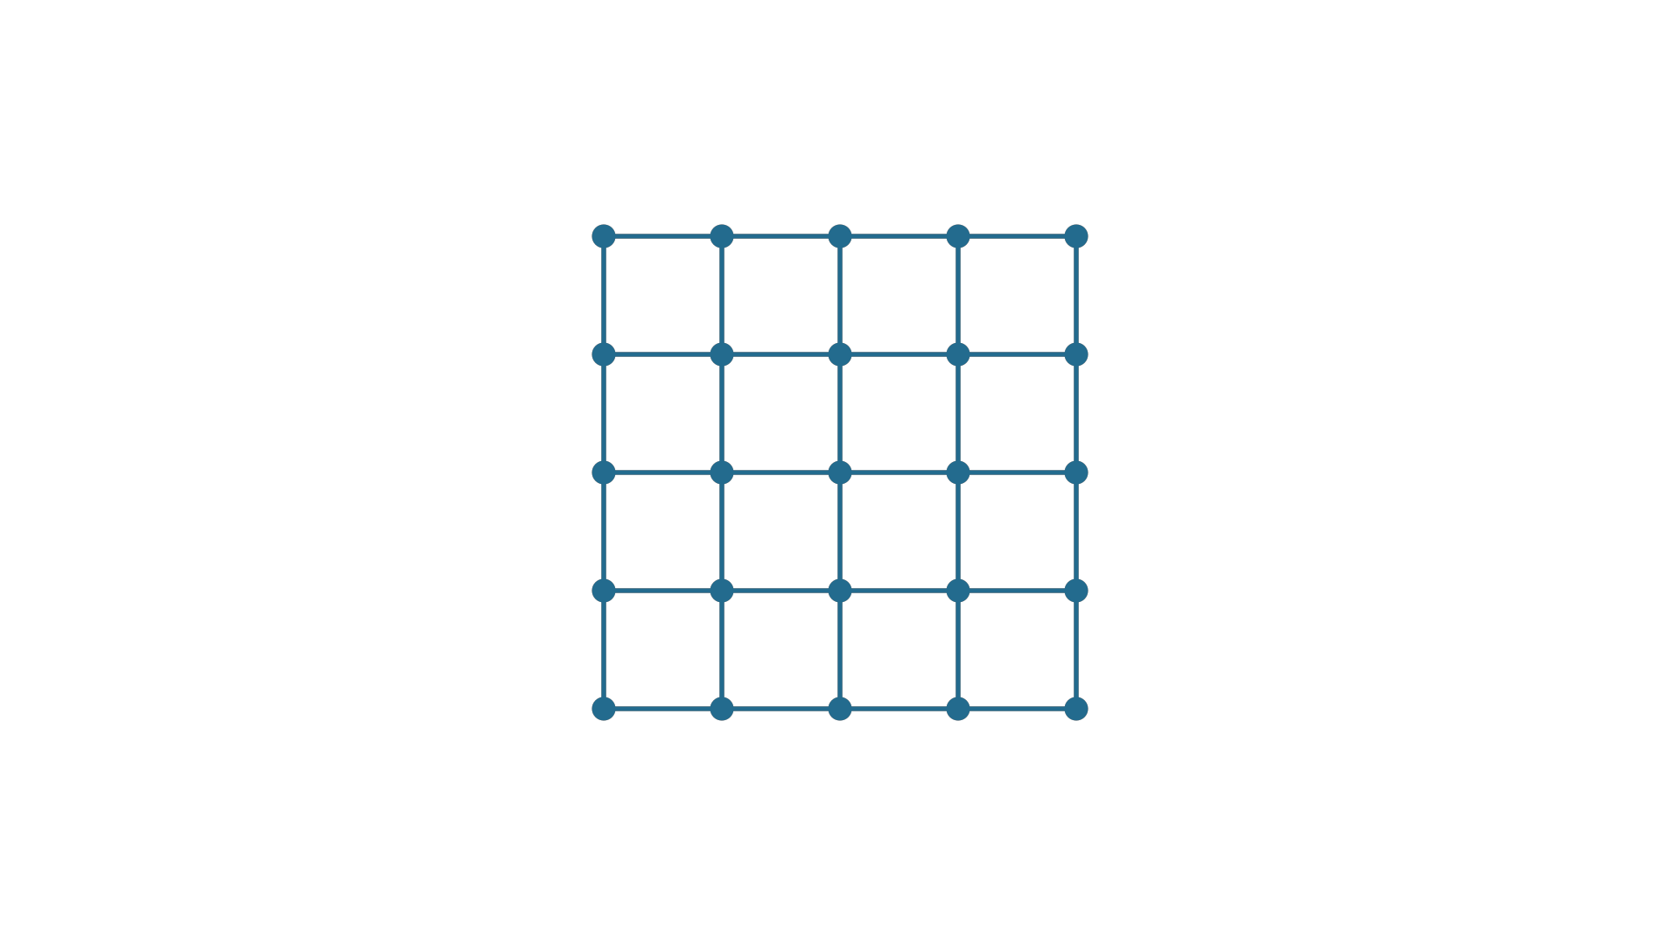
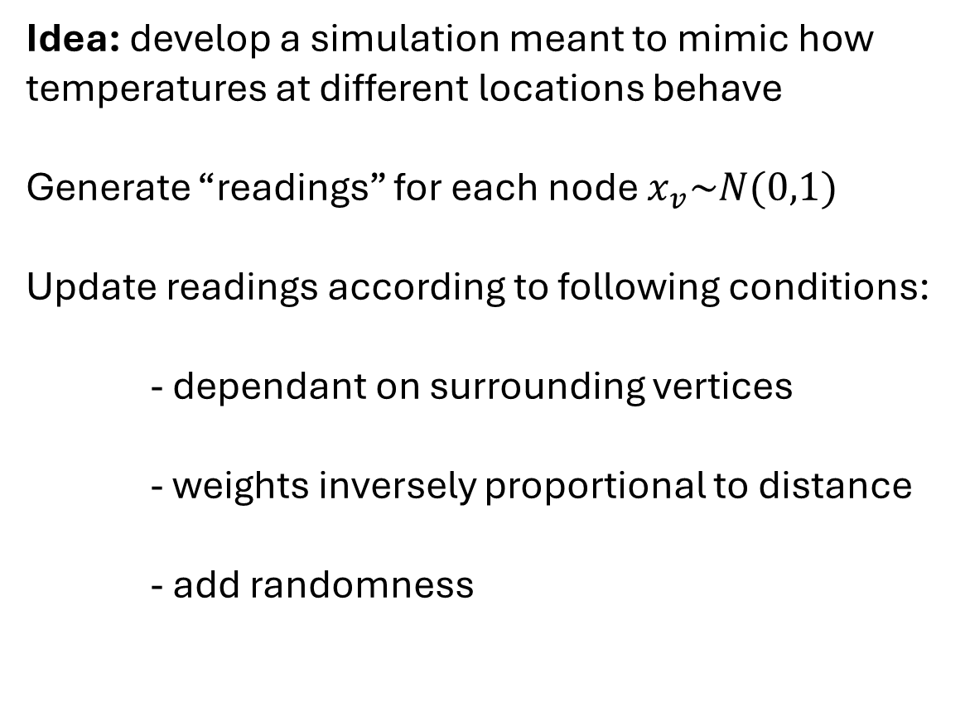
Weather (like) simulation
Idea: develop a simulation meant to mimic how temperatures at different locations behave
Generate “readings” for each node $x_{v}\sim N(0,1)$
Update readings according to following conditions:
- dependant on surrounding vertices
- weights inversely proportional to distance
- add randomness
Nathan Kershaw - Discrete homology for data analysis - University of Western Ontario
18

Slide 23
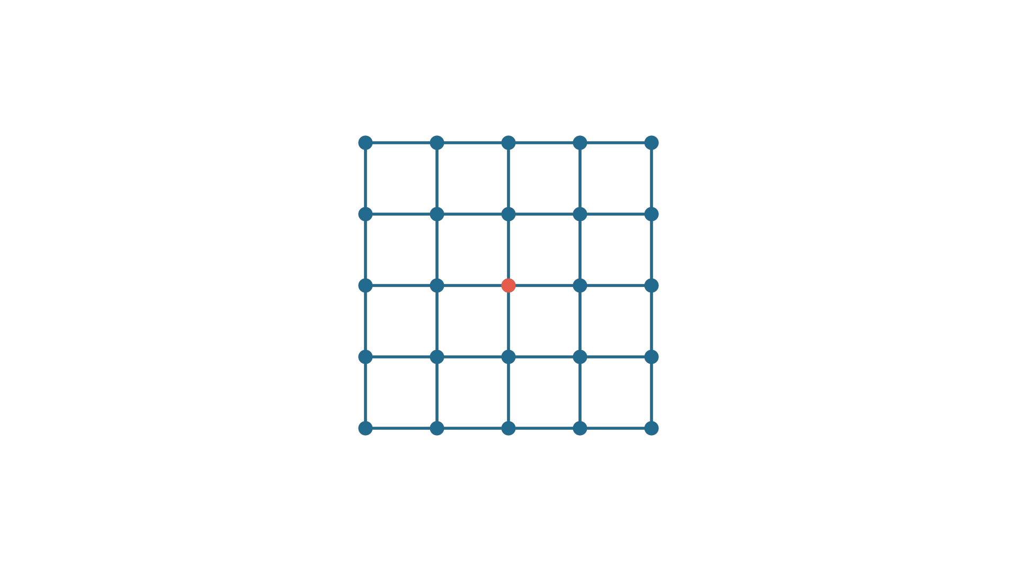
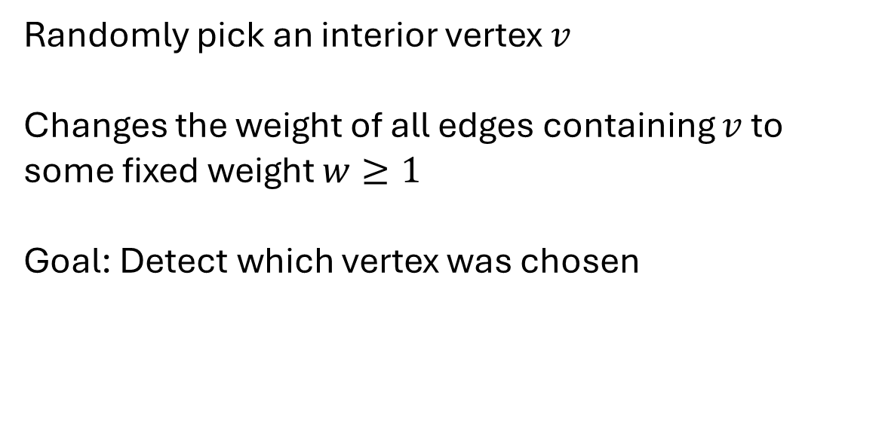
Weather (like) simulation
Randomly pick an interior vertex $v$
Changes the weight of all edges containing $v$ to some fixed weight $w≥1$
Goal: Detect which vertex was chosen
Nathan Kershaw - Discrete homology for data analysis - University of Western Ontario
19

Slide 24

Weather (like) simulation
Randomly pick an interior vertex $v$
Changes the weight of all edges containing $v$ to some fixed weight $w≥1$
Goal: Detect which vertex was chosen
Nathan Kershaw - Discrete homology for data analysis - University of Western Ontario
19

Slide 25
Weather (like) simulation
Expected vs actual model
“Naïve” approach, most similar to techniques used for similar problems
For each interior vertex, compare their expected readings (given the previous ones) to their actual readings
Vertex with the highest sum of the absolute difference gets chosen
Nathan Kershaw - Discrete homology for data analysis - University of Western Ontario
20

Slide 26
Weather (like) simulation
Discrete homology model
Use techniques from this presentation
Fit the readings at each node to get weighted graph, take homology
  Look at longest lasting generator, find interior point(s)
  Tiebreaks: use expected vs actual
Nathan Kershaw - Discrete homology for data analysis - University of Western Ontario
21

Slide 27
Weather (like) simulation
Classical TDA model
Use same methods as discrete homology model
Instead of discrete homology of the graph, use clique complex and take homology of the simplicial complex
Nathan Kershaw - Discrete homology for data analysis - University of Western Ontario
22

Slide 28
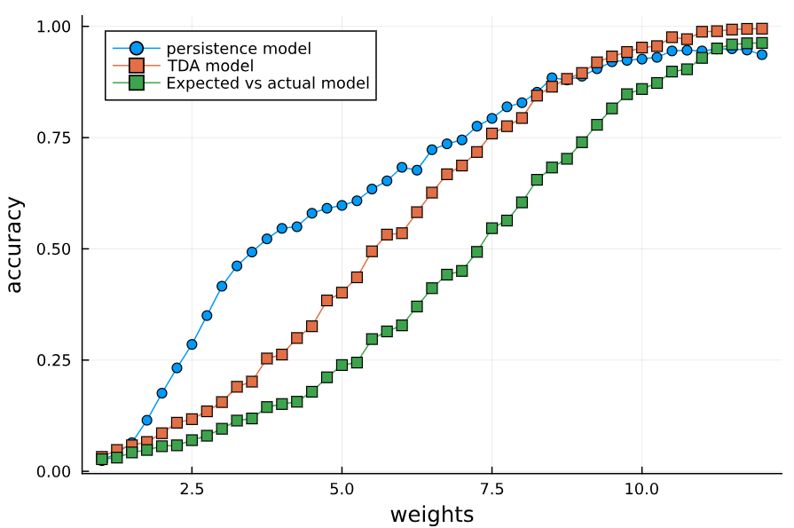
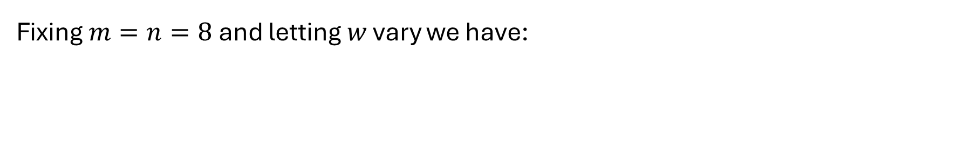
Weather (like) simulation
Fixing $m=n=8$and letting $w$ vary we have:
Nathan Kershaw - Discrete homology for data analysis - University of Western Ontario
23

Slide 29
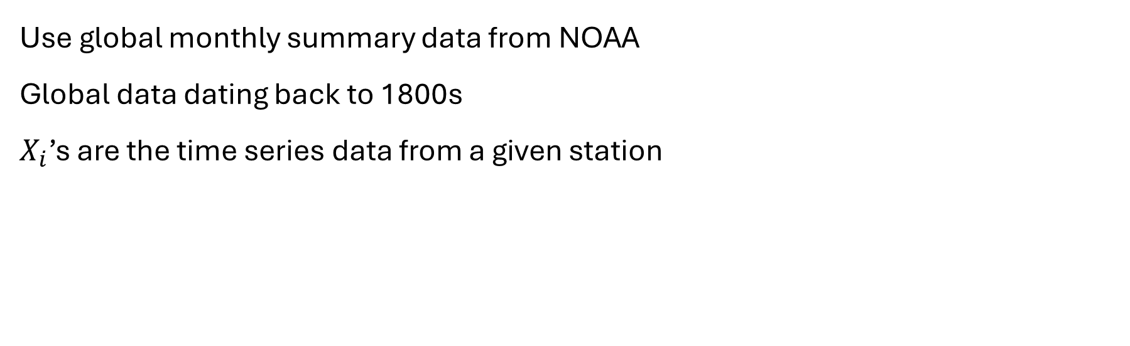
Real-world data
Use global monthly summary data from NOAA
Global data dating back to 1800s
$X_{i}$’s are the time series data from a given station
Nathan Kershaw - Discrete homology for data analysis - University of Western Ontario
24

Slide 30
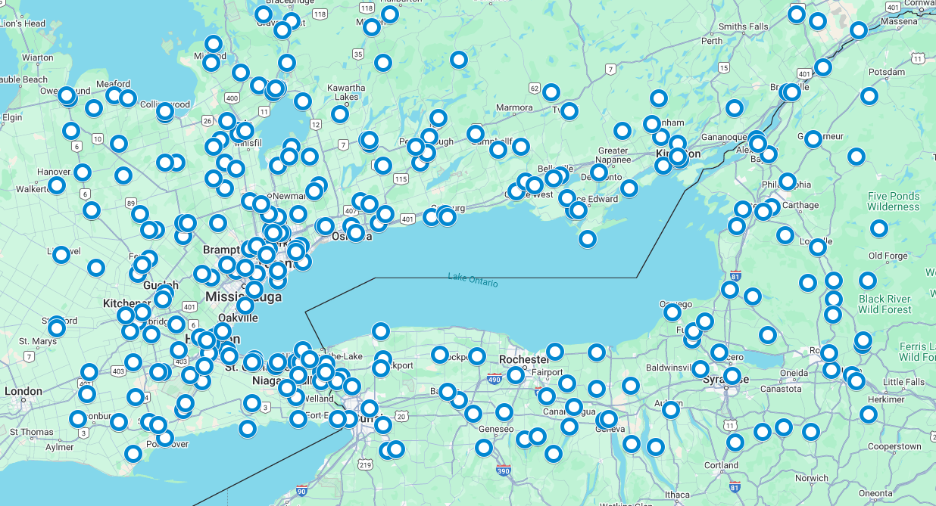
Real-world data
Nathan Kershaw - Discrete homology for data analysis - University of Western Ontario
25

Slide 31
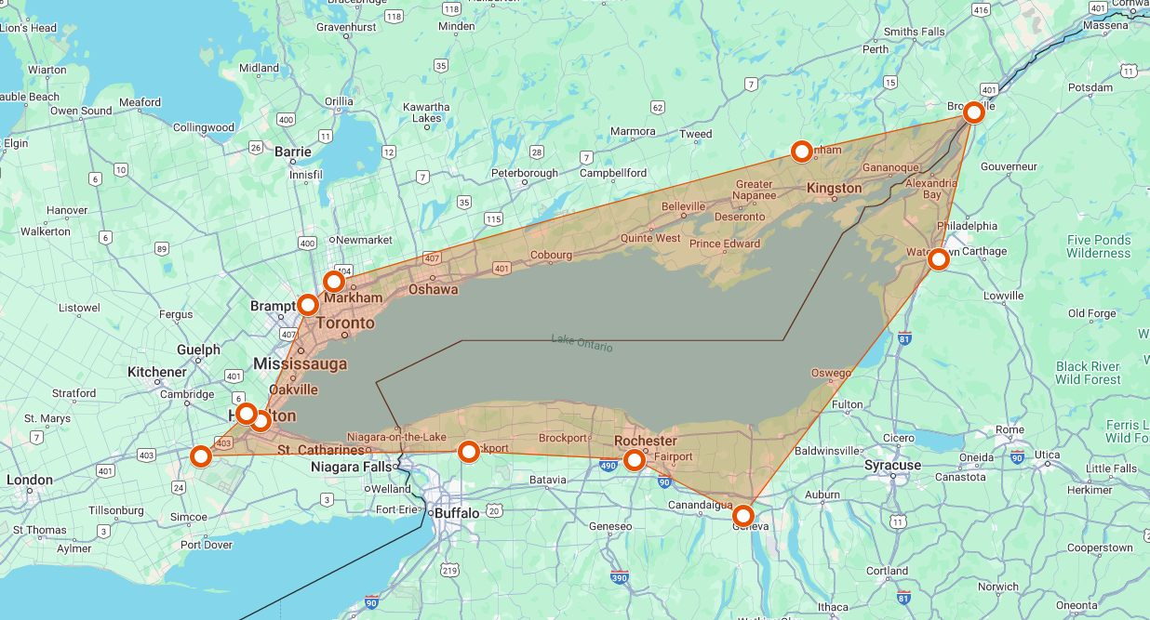
Real-world data
Nathan Kershaw - Discrete homology for data analysis - University of Western Ontario
26

