Slide 1

Categorical Foundations of Discrete Dynamical Systems
Nathan Kershaw
Joint with D. Carranza, C. Kapulkin, R. Laubenbacher, and M. Wheeler
University of Western Ontario

Slide 2
References
D. Carranza, K. Kapulkin, N. Kershaw, R. Laubenbacher, M. Wheeler, 2025. Categorical foundations of discrete dynamical systems. https://arxiv.org/abs/2506.05190
K. Kadelka, M. Wheeler, A. Veliz-Cuba, D. Murrugarra, and R. Laubenbacher, 2023. Modularity of biological systems: a link between structure and function J. R. Soc. Interface. 20: 20230505
1
Nathan Kershaw - Categorical Discrete Dynamical Systems - University of Western Ontario
Notes:
Use this as leading example, convert to state space and trajectories, say we want to figure out where things end up and which vertices are more stable
- Easy to find for this example, there is only two vertices, but for 100 genes there would be 2^100 vertices, so we need to develop new tools to analyze this than just brute force computations

Slide 3

Biological Motivation
Example: Gene regulatory networks
Gene 1
Gene 2
Gene 4
Gene 3
2
Nathan Kershaw - Categorical Discrete Dynamical Systems - University of Western Ontario

Slide 4
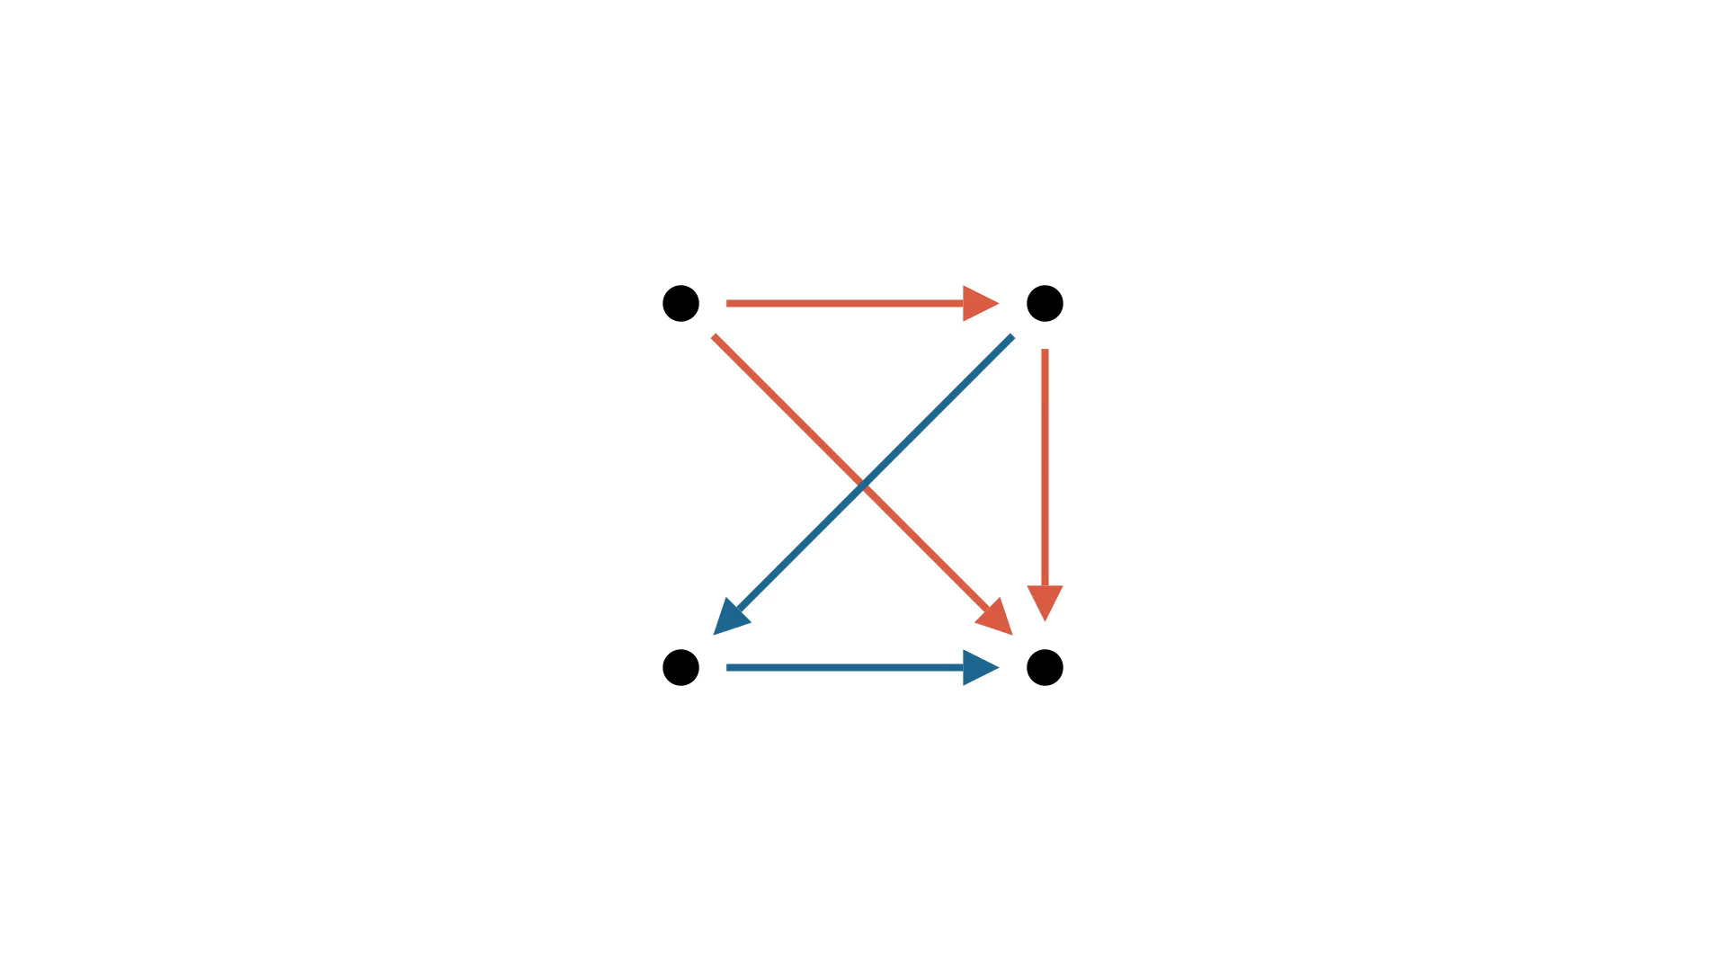
Biological Motivation
Example: Gene regulatory networks
2
Nathan Kershaw - Categorical Discrete Dynamical Systems - University of Western Ontario

Slide 5
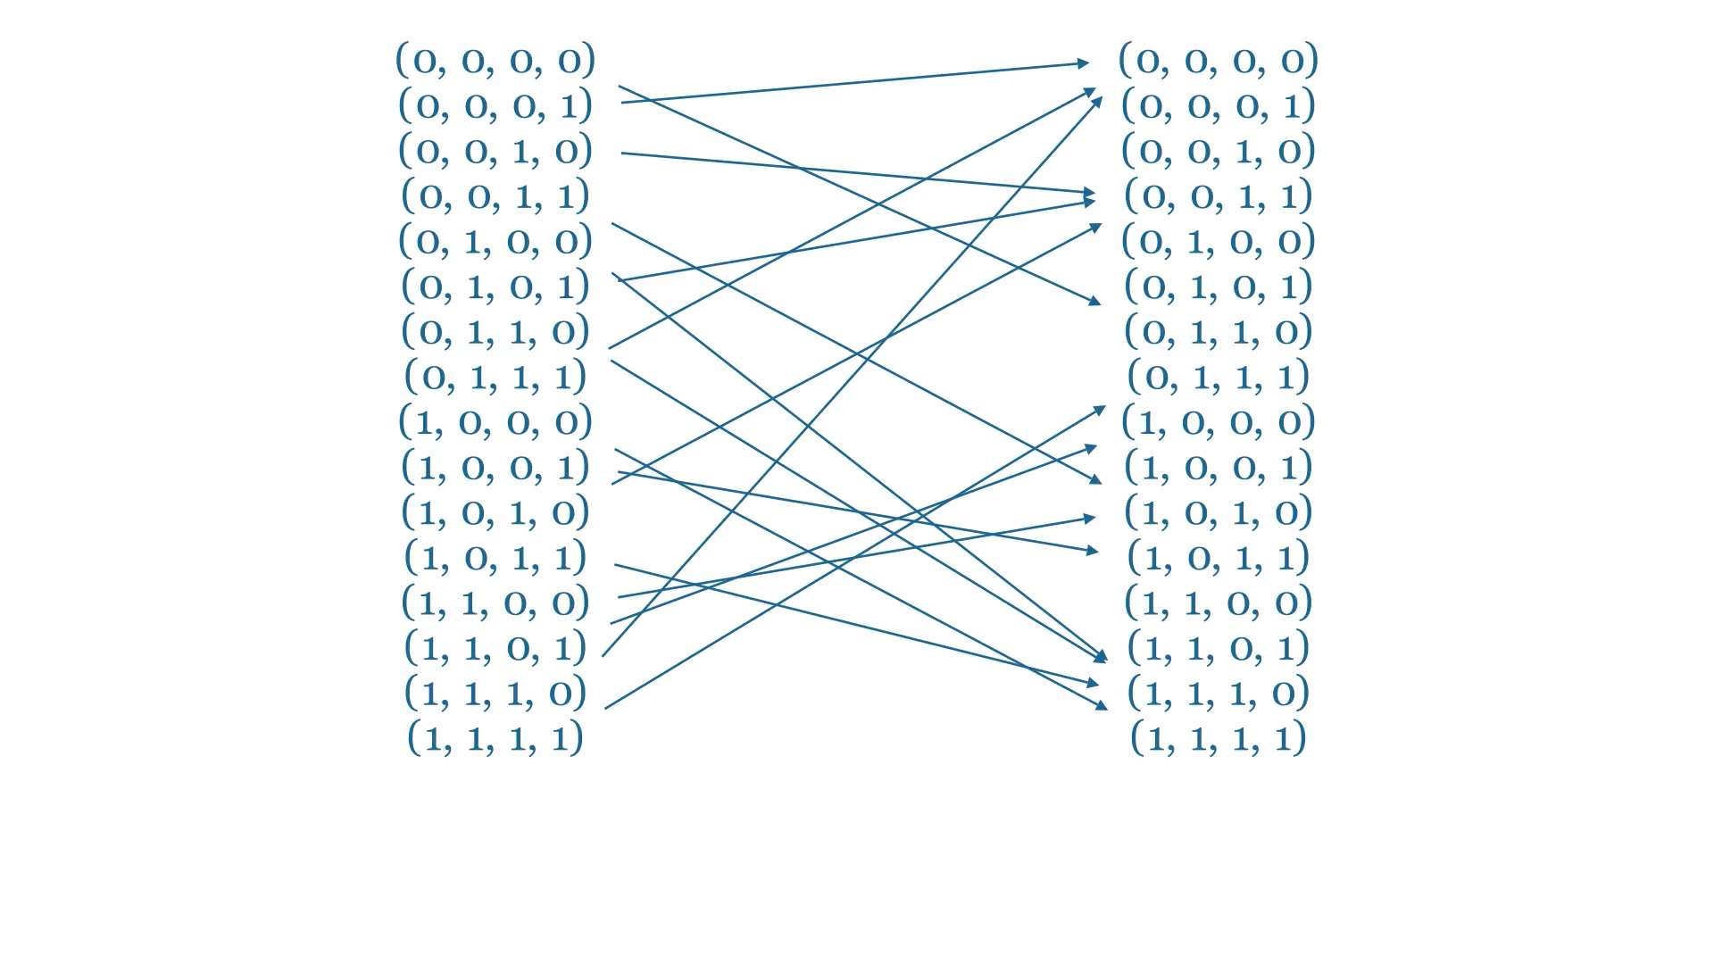
Biological Motivation
Example: Gene regulatory networks
2
Nathan Kershaw - Categorical Discrete Dynamical Systems - University of Western Ontario

Slide 6
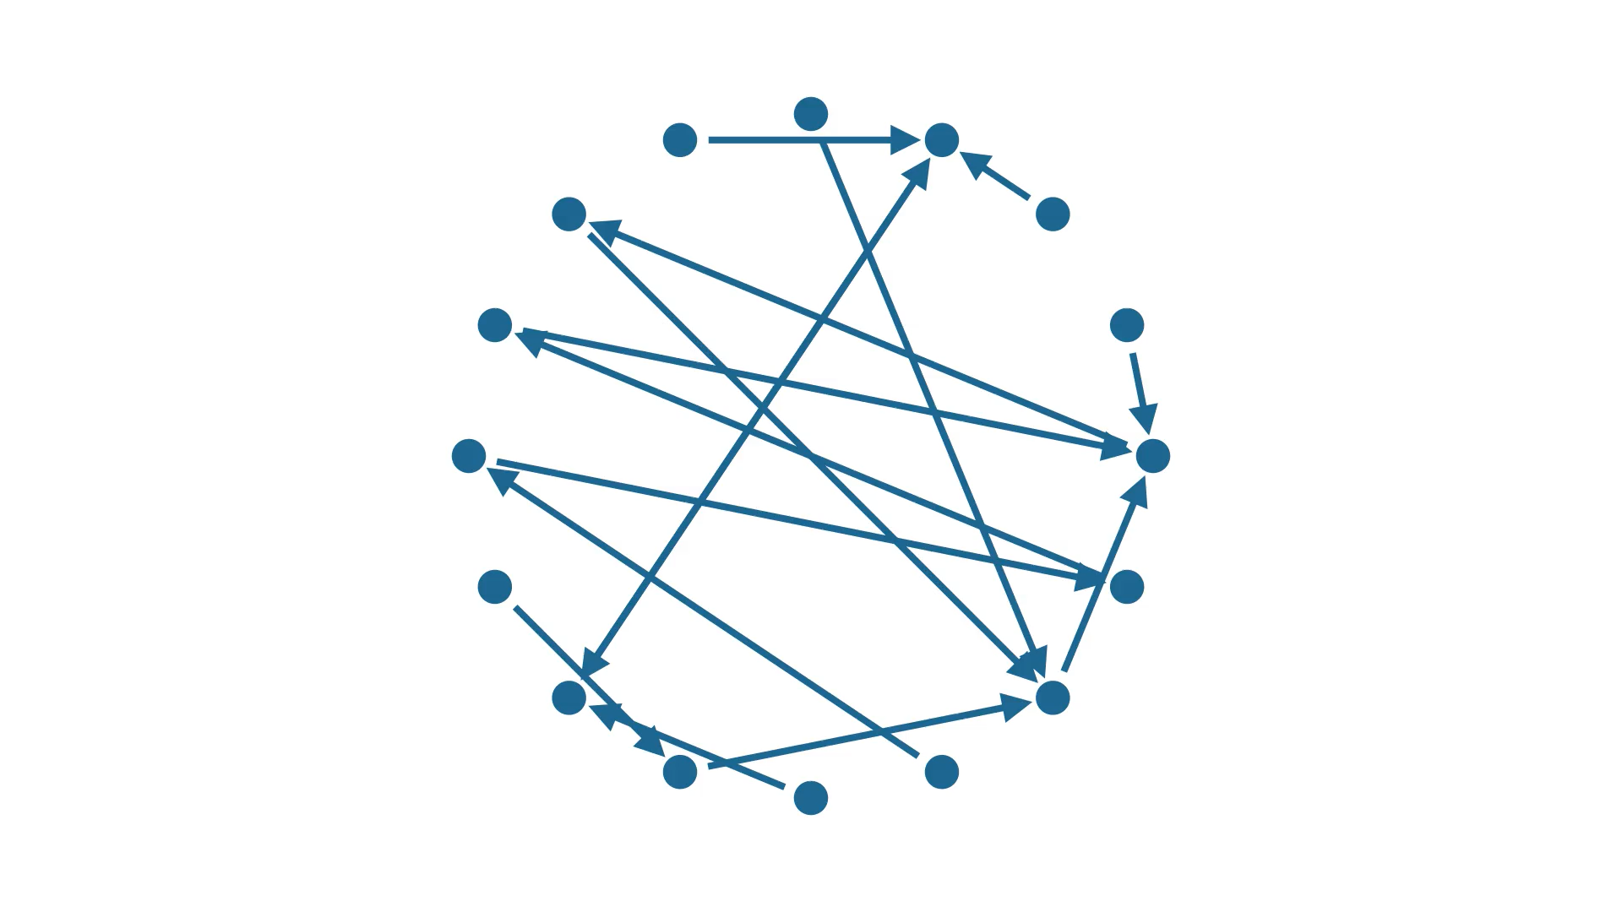
Biological Motivation
Example: Gene regulatory networks
2
Nathan Kershaw - Categorical Discrete Dynamical Systems - University of Western Ontario

Slide 7
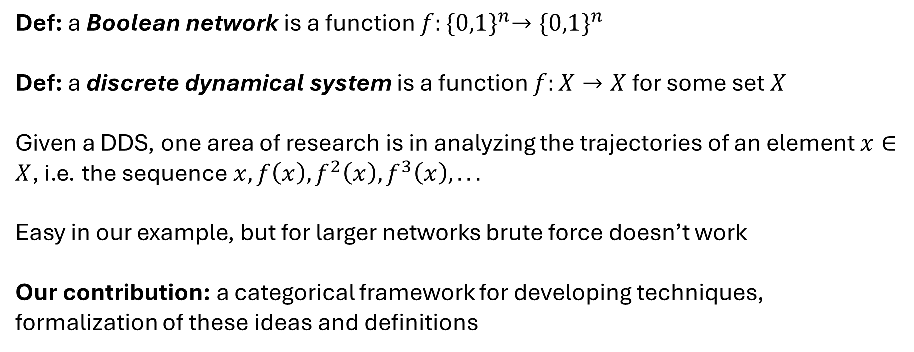
Biological Motivation
Def: a Boolean network is a function $f:{\{0,1\}}^{n}→{\{0,1\}}^{n}$
Def: a discrete dynamical system is a function $f:X→X$ for some set $X$
Given a DDS, one area of research is in analyzing the trajectories of an element $x∈X$, i.e. the sequence $x, f\left(x\right), f^{2}\left(x\right), f^{3}\left(x\right), . . .$
Easy in our example, but for larger networks brute force doesn’t work
Our contribution: a categorical framework for developing techniques, formalization of these ideas and definitions
3
Nathan Kershaw - Categorical Discrete Dynamical Systems - University of Western Ontario

Slide 8

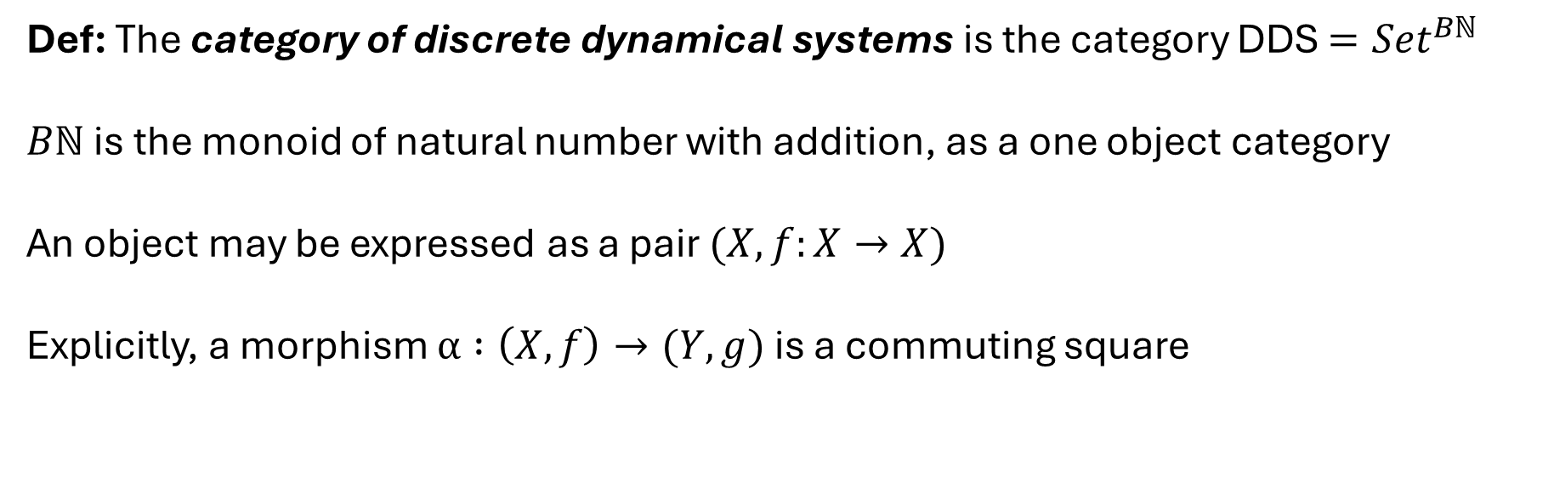







The Category of DDS
Def: The category of discrete dynamical systems is the category DDS $={Set}^{Bℕ}$
$Bℕ$ is the monoid of natural number with addition, as a one object category
An object may be expressed as a pair $(X, f:X→X)$
Explicitly, a morphism $α :\left(X,f\right)→(Y,g)$ is a commuting square
$$X$$
$$α$$
$$Y$$
$$f$$
$$g$$
$$X$$
$$Y$$
$$α$$
4
Nathan Kershaw - Categorical Discrete Dynamical Systems - University of Western Ontario

Slide 9
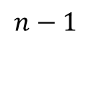
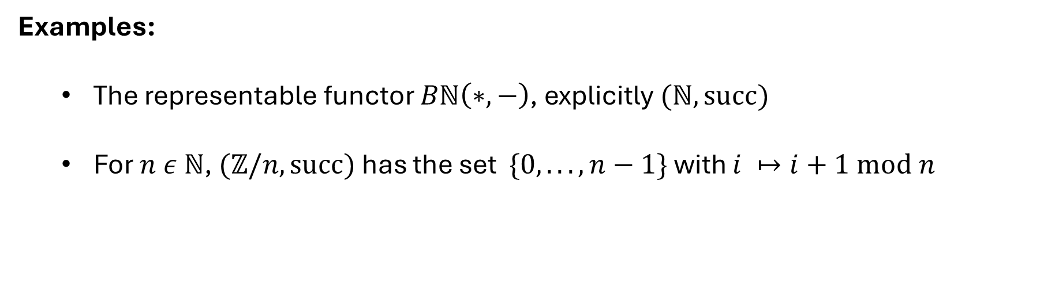








The Category of DDS
Examples:
  The representable functor $Bℕ\left(∗,−\right)$, explicitly $(ℕ,succ)$
  For $n ε ℕ$, $(ℤ/n,succ)$ has the set $\{0, . . ., n−1\}$ with $i ↦i+1 mod n$
$$0$$
$$n−1$$
$$1$$
$$0$$
$$2$$
$$3$$
$$4$$
. . .
. . .
$$3$$
$$2$$
5
Nathan Kershaw - Categorical Discrete Dynamical Systems - University of Western Ontario

Slide 10
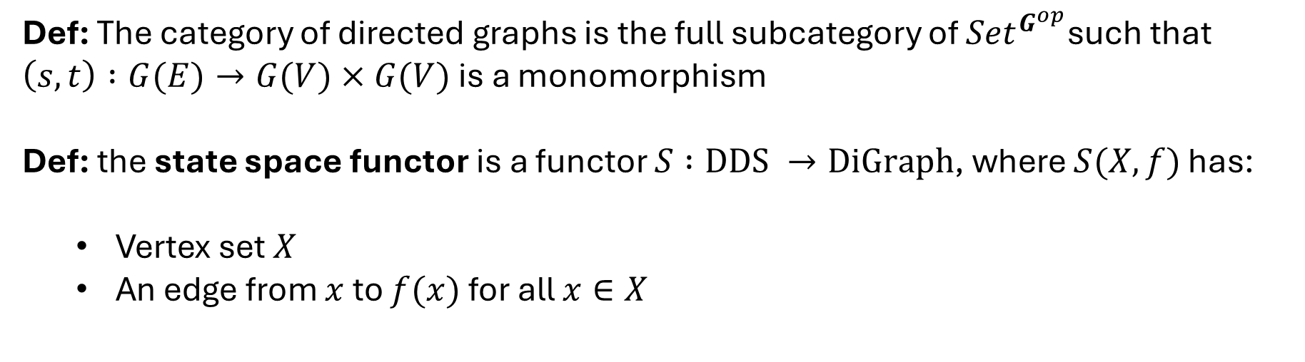


Digraphs and State Spaces
Let $G$ be the category given by:
$$s$$
$$G ≔V E$$
$$t$$
Def: The category of directed graphs is the full subcategory of ${Set}^{G^{op}}$such that $\left(s,t\right) :G(E)→G(V)×G(V)$ is a monomorphism
Def: the state space functor is a functor $S :DDS →DiGraph$, where $S(X,f)$ has:
  Vertex set $X$
  An edge from $x$ to $f(x)$ for all $x∈X$
6
Nathan Kershaw - Categorical Discrete Dynamical Systems - University of Western Ontario

Slide 11
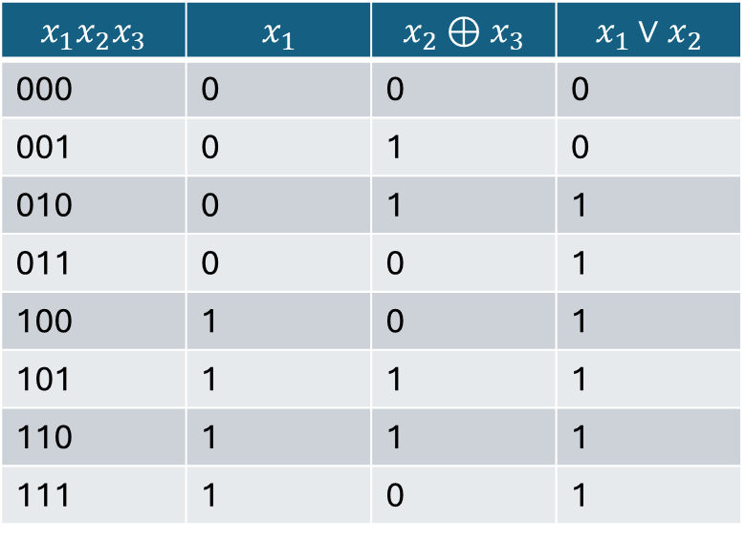
Digraphs and State Spaces
Example: $f:\{0,1\}^{3}→\{0,1\}^{3}$ given by
$f\left(x_{1},x_{2},x_{3}\right)=(x_{1}, {x_{2}⊕x}_{3},x_{1}∨x_{2}$)
$$x_{1}x_{2}x_{3}$$ | $$x_{1}$$ | $${x_{2}⊕x}_{3}$$ | $$x_{1}∨x_{2}$$
000 | 0 | 0 | 0
001 | 0 | 1 | 0
010 | 0 | 1 | 1
011 | 0 | 0 | 1
100 | 1 | 0 | 1
101 | 1 | 1 | 1
110 | 1 | 1 | 1
111 | 1 | 0 | 1
000
001
010
011
100
101
111
110
7
Nathan Kershaw - Categorical Discrete Dynamical Systems - University of Western Ontario

Slide 12
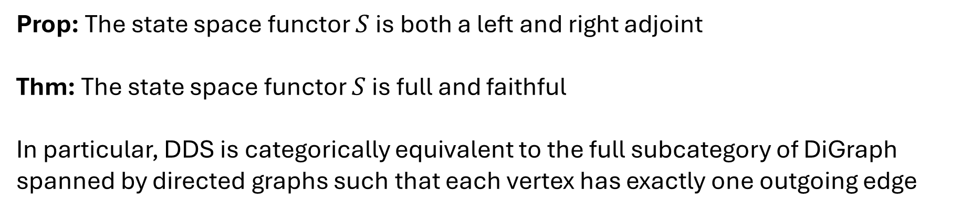
Digraphs and State Spaces
Prop: The state space functor $S$ is both a left and right adjoint
Thm: The state space functor $S$ is full and faithful
In particular, DDS is categorically equivalent to the full subcategory of DiGraph spanned by directed graphs such that each vertex has exactly one outgoing edge
8
Nathan Kershaw - Categorical Discrete Dynamical Systems - University of Western Ontario

Slide 13

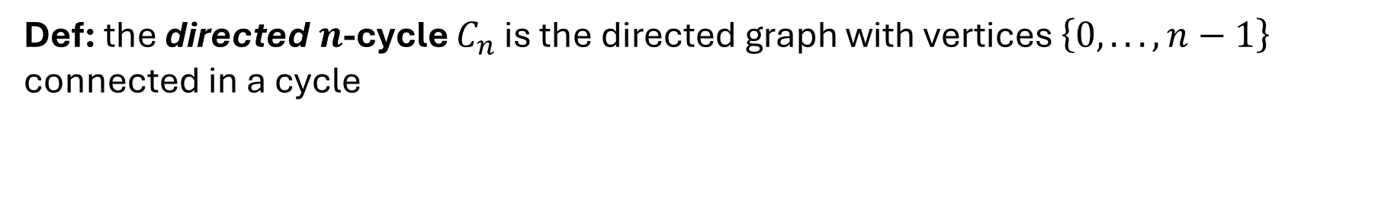



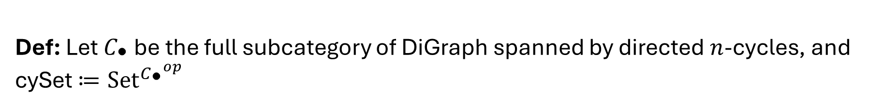
Cycle Sets and Attractors
Def: the directed $n$-cycle $C_{n}$ is the directed graph with vertices $\left\{0, . . .,n−1\right\}$ connected in a cycle
$$C_{1}$$
$$C_{2}$$
$$C_{3}$$
$$C_{4}$$
Def: Let $C_{\text{•}}$ be the full subcategory of DiGraph spanned by directed $n$-cycles, and cySet $≔{Set}^{{C_{\text{•}}}^{op}}$
9
Nathan Kershaw - Categorical Discrete Dynamical Systems - University of Western Ontario

Slide 14
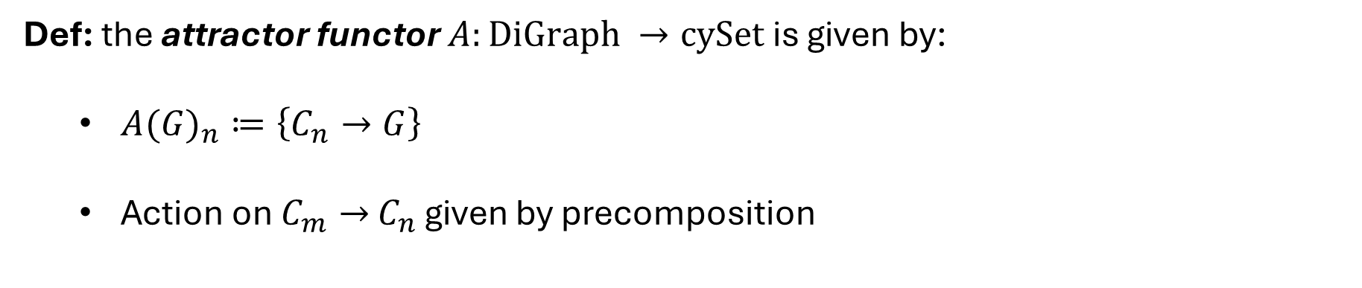


Cycle Sets and Attractors
Def: the attractor functor $A:DiGraph →cySet$ is given by:
  ${A(G)}_{n}≔\left\{C_{n}→G\right\}$
  Action on $C_{m}→$ $C_{n}$ given by precomposition
Prop: $A$ is right adjoint to the functor given by the left Kan extension:
$$C_{\text{•}}$$
DiGraph
$$|−|$$
cySet
10
Nathan Kershaw - Categorical Discrete Dynamical Systems - University of Western Ontario

Slide 15

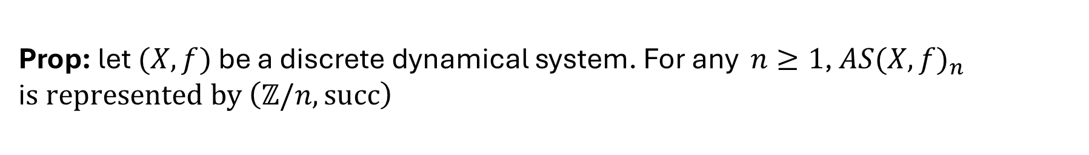

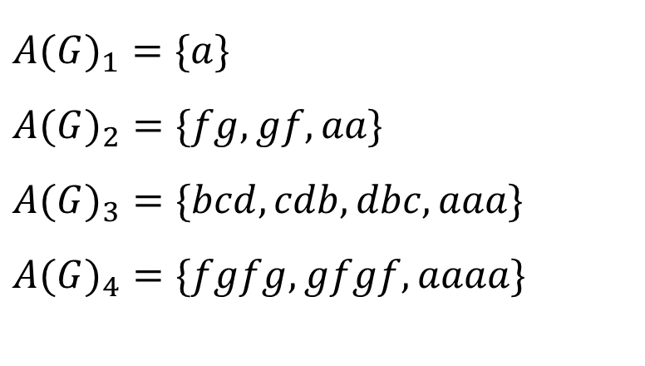






Cycle Sets and Attractors
Example:
$$a$$
$$b$$
$$c$$
$$A(G)_{1}=\{a\}$$
$$A(G)_{2}=\{fg,gf,aa\}$$
$$A(G)_{3}=\{bcd,cdb,dbc,aaa\}$$
$$A(G)_{4}=\{fgfg,gfgf,aaaa\}$$
$$d$$
$$e$$
$$f$$
$$g$$
$$h$$
Prop: let $(X,f)$ be a discrete dynamical system. For any $n≥1$, $AS(X,f)_{n}$ i$s represented by \left(ℤ/n, succ\right)$
11
Nathan Kershaw - Categorical Discrete Dynamical Systems - University of Western Ontario

Slide 16

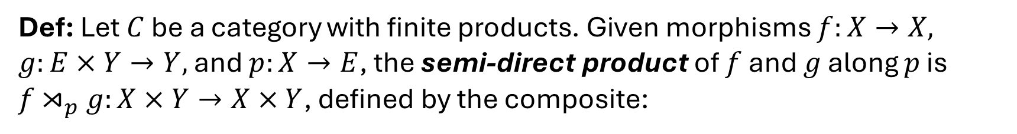





Concrete Application
Def: Let $C$ be a category with finite products. Given morphisms $f:X→X, g:E×Y→Y,$ and $p:X→E$, the semi-direct product of $f$ and $g$ along $p$ is $f{\text{⋊}}_{p}g:X×Y→X×Y$, defined by the composite:
$$f{\text{⋊}}_{p}g$$
$$X×Y$$
$$X×Y$$
$(proj_{X}, p∘proj_{X}$, $proj_{Y})$
$$(f∘proj_{X}, g∘proj_{E×Y})$$
$$X×E×Y$$
12
Nathan Kershaw - Categorical Discrete Dynamical Systems - University of Western Ontario

Slide 17





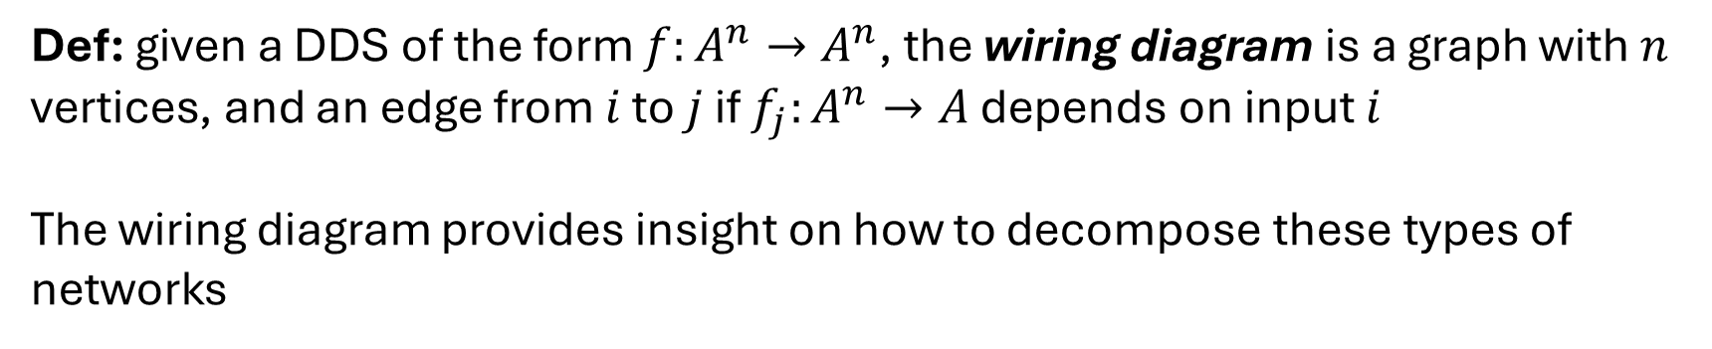

Concrete Application
Def: a function $f:A^{n}→B$ is independent of input $i$ if there is a unique lift
$$f$$
$$A^{n}$$
$$B$$
$${proj}_{≠i}$$
$$\overline{f}$$
$$A^{n−1}$$
Def: given a DDS of the form $f:A^{n}→A^{n}$, the wiring diagram is a graph with $n$ vertices, and an edge from $i$ to $j$ if $f_{j}:A^{n}→A$ depends on input $i$
The wiring diagram provides insight on how to decompose these types of networks
13
Nathan Kershaw - Categorical Discrete Dynamical Systems - University of Western Ontario

Slide 18
Concrete Application
Example: gene regulatory networks (again)
Independent of downstream genes
  Decompose into semi-direct product using strongly connected components
  Look at attractors separately
14
Nathan Kershaw - Categorical Discrete Dynamical Systems - University of Western Ontario

Slide 19
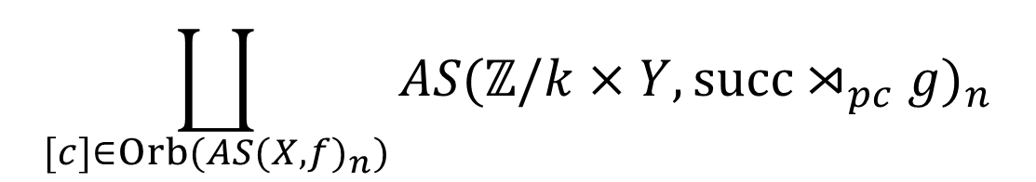

Concrete Application
Thm: Let $(X×Y,f{\text{⋊}}_{p}g)$ be a semi-direct product. Then for each $n≥1$, we have an isomorphism of $(ℤ/n)$-sets:
$$\coprod_{[c]∈Orb(AS(X,f)_{n})}{AS\text{(}ℤ/k×Y, succ{\text{⋊}}_{pc}g)_{n}}$$
$$AS\left(X×Y, f{\text{⋊}}_{p}g\right)≅$$
Very large, hard to deal with
Smaller and easier to handle
15
Nathan Kershaw - Categorical Discrete Dynamical Systems - University of Western Ontario

Slide 20
Concrete Application
Boolean network
State space
Wiring diagram
Object of interest
Too large to directly analyze
Small
Manageable
Tells us how to decompose state space
16
Nathan Kershaw - Categorical Discrete Dynamical Systems - University of Western Ontario

Slide 21
Conclusion
Using elementary category theory, we:
Formalize many ideas and definitions
Provide a framework and tools for analyzing DDS
Provide a pipeline to analyze attractors:
  Take functor to wiring diagram
  Decompose as a semi-direct product
  Break down attractors into disjoint unions of more manageable sets
  More powerful and general theorem than previously known (Kadelka et al, 2023)
17
Nathan Kershaw - Categorical Discrete Dynamical Systems - University of Western Ontario

